Slide 1

Training For Regular Taxing Authorities
Presented by:
The TRIM Team
Truth In Millage
Property Tax Oversight

Slide 2

Overview
Introduction
TRIM Timetable
TRIM Certification Forms
Maximum Millage
TRIM Advertising Requirements
TRIM Hearing Requirements
Resolutions/Ordinances
Certifying Compliance to the Department
2023 Top Infractions and Violations
TRIM Compliance Contacts

Slide 3
Introduction
TRIM process and the public
Chapter 200, Florida Statutes

Slide 4
TRIM Timetable

Slide 5

TRIM Timetable
The property appraiser (PA) provides total assessed value of nonexempt property to taxing authorities by June 1 for budget planning purposes.
By July 1, the property appraiser certifies the taxable value to each taxing authority (TA) on Certification of Taxable Value (Form DR-420).
1
Jan
Feb
Mar
Apr
May
Jun
Jul
Aug
Sep
Oct
Nov
Dec

Slide 6
TRIM Timetable
Day 1 = July 1
The first day of the TRIM process is July 1 or the date of certification of taxable value, whichever is later.
1
Jan
Feb
Mar
Apr
May
Jun
Jul
Aug
Sep
Oct
Nov
Dec
Day 1

Slide 7
TRIM Timetable
Day 35 = August 4
Within 35 days of certification of value, each TA must inform the property appraiser of:
Prior year millage rate
Current year proposed millage rate
Current year rolled-back rate
The date, time, and meeting place of the tentative budget hearing
4
Jan
Feb
Mar
Apr
May
Jun
Jul
Aug
Sep
Oct
Nov
Dec
Day 35

Slide 8

TRIM Timetable
If a taxing authority fails to provide the information to the property appraiser within 35 days:
The TA will be prohibited from levying a millage rate greater than the rolled-back rate
The PA will compute the rolled-back rate and use it to prepare the Notice of Proposed Property Taxes

Slide 9
TRIM Timetable
Day 55 = August 24
The PA should mail the Notice of Proposed Property Taxes (TRIM notice) no later than 55 days after certification of value.
If the Department issues a review notice, the PA cannot send the TRIM notice until the Department of Revenue (Department) has approved the assessment roll.
24
Jan
Feb
Mar
Apr
May
Jun
Jul
Aug
Sep
Oct
Nov
Dec
Day 55

Slide 10
TRIM Timetable
Days 65-80 = Sept. 3-18
The TA should hold a public hearing on the tentative budget and proposed millage rate. This tentative hearing is published on the TRIM notice the property appraiser mails.
3
18
Jan
Feb
Mar
Apr
May
Jun
Jul
Sep
Oct
Nov
Dec
Aug
Days 65-80

Slide 11
TRIM Timetable
Days 81-95 = Sept. 4-Oct. 3
Within 15 days after the tentative hearing, the TA must advertise its intent to adopt a final millage and budget. The notification may be:
A Notice of Proposed Tax Increase, or
A Notice of Budget Hearing and
A Budget Summary ad
4
3
Jan
Feb
Mar
Apr
May
Jun
Jul
Sep
Oct
Nov
Dec
Aug
Days 81-95

Slide 12
TRIM Timetable
Days 97-100 = Final Hearing
The TA should hold a public hearing on the final millage rates and budget 97-100 days after certification of value.
This final hearing should be held two to five days after the hearing is advertised.
public hearing
AD PUBLISHED
DAY 1
DAY 2
DAY 3
DAY 4
DAY 5

Slide 13
TRIM Timetable
Within Three Days of Final Hearing
The TA forwards the resolution or ordinance adopting the final millage rate to the property appraiser, tax collector, and to the Department.
When the PA receives the resolution or ordinance, notification of the final millage rate is considered official.

Slide 14
TRIM Timetable
Within 30 Days of Final Hearing
Each TA must certify compliance to the Department.
Do not wait to certify compliance if the Certification of Final Taxable Value (Form DR-422) has not been received from the PA.
As soon as Form DR-422 has been received, complete it and forward to the PA. A copy should also be sent to the Department’s Property Tax Oversight TRIM section.

Slide 15
TRIM Certification Forms

Slide 16
TRIM Certification Forms
Certification of Taxable Value (Form DR-420)
Certification of Voted Debt Millage (Form DR-420DEBT)
Tax Increment Adjustment Worksheet (Form DR-420TIF)
Maximum Millage Levy Calculation Preliminary Disclosure (Form DR-420MM-P)

Slide 17
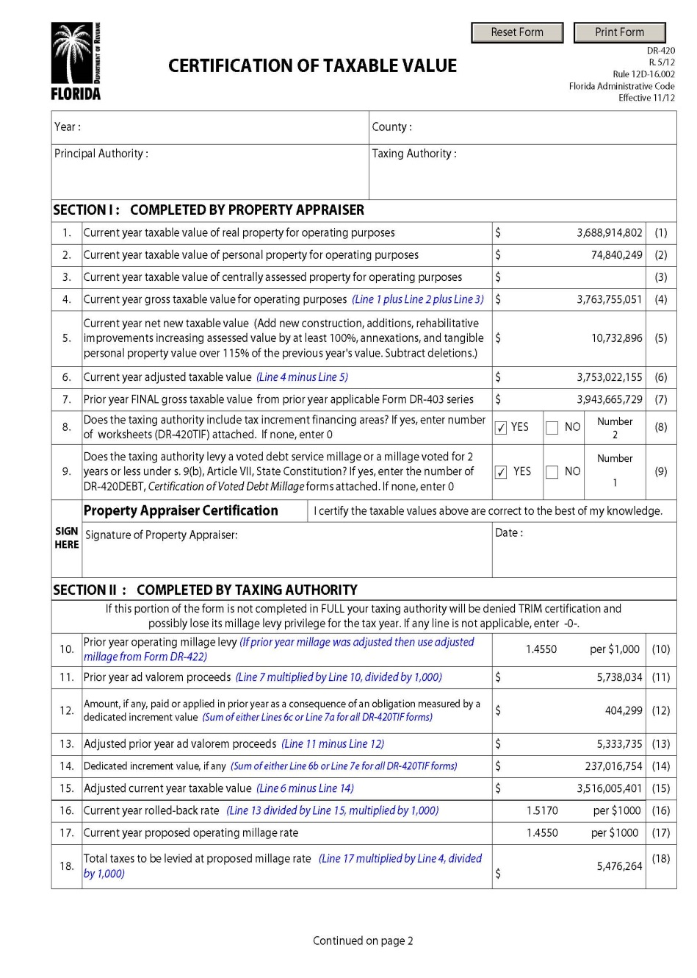
Certification of Taxable Value
(Form DR-420)
July 1
The property appraiser certifies initial values
The taxing authority:
  Enters prior year millage rate
  Calculates rolled-back rate
  Enters proposed millage rate

Slide 18
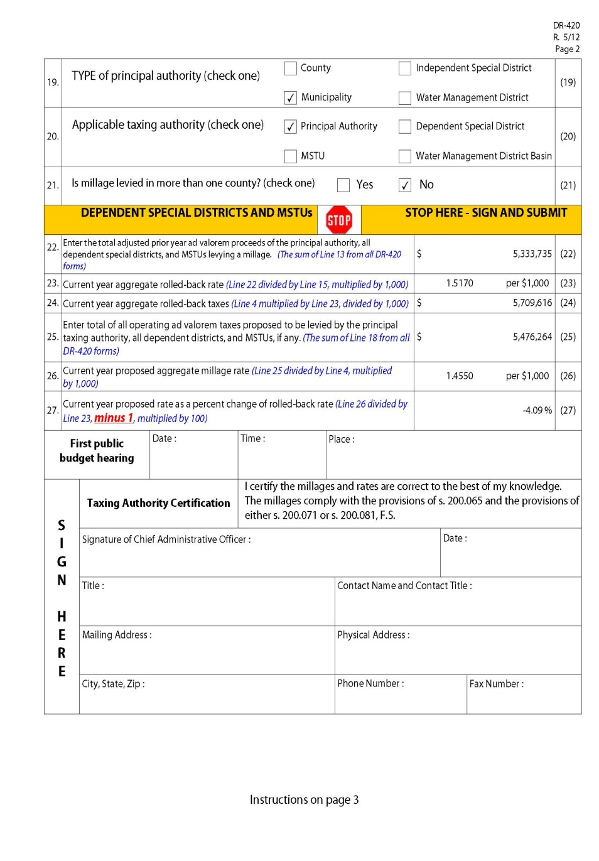
Certification of Taxable Value
(Form DR-420)
The taxing authority (continued):
  Calculates percentage change of rolled-back rate
  Enters tentative budget hearing
  Returns completed form within 35 days
  of certification

Slide 19
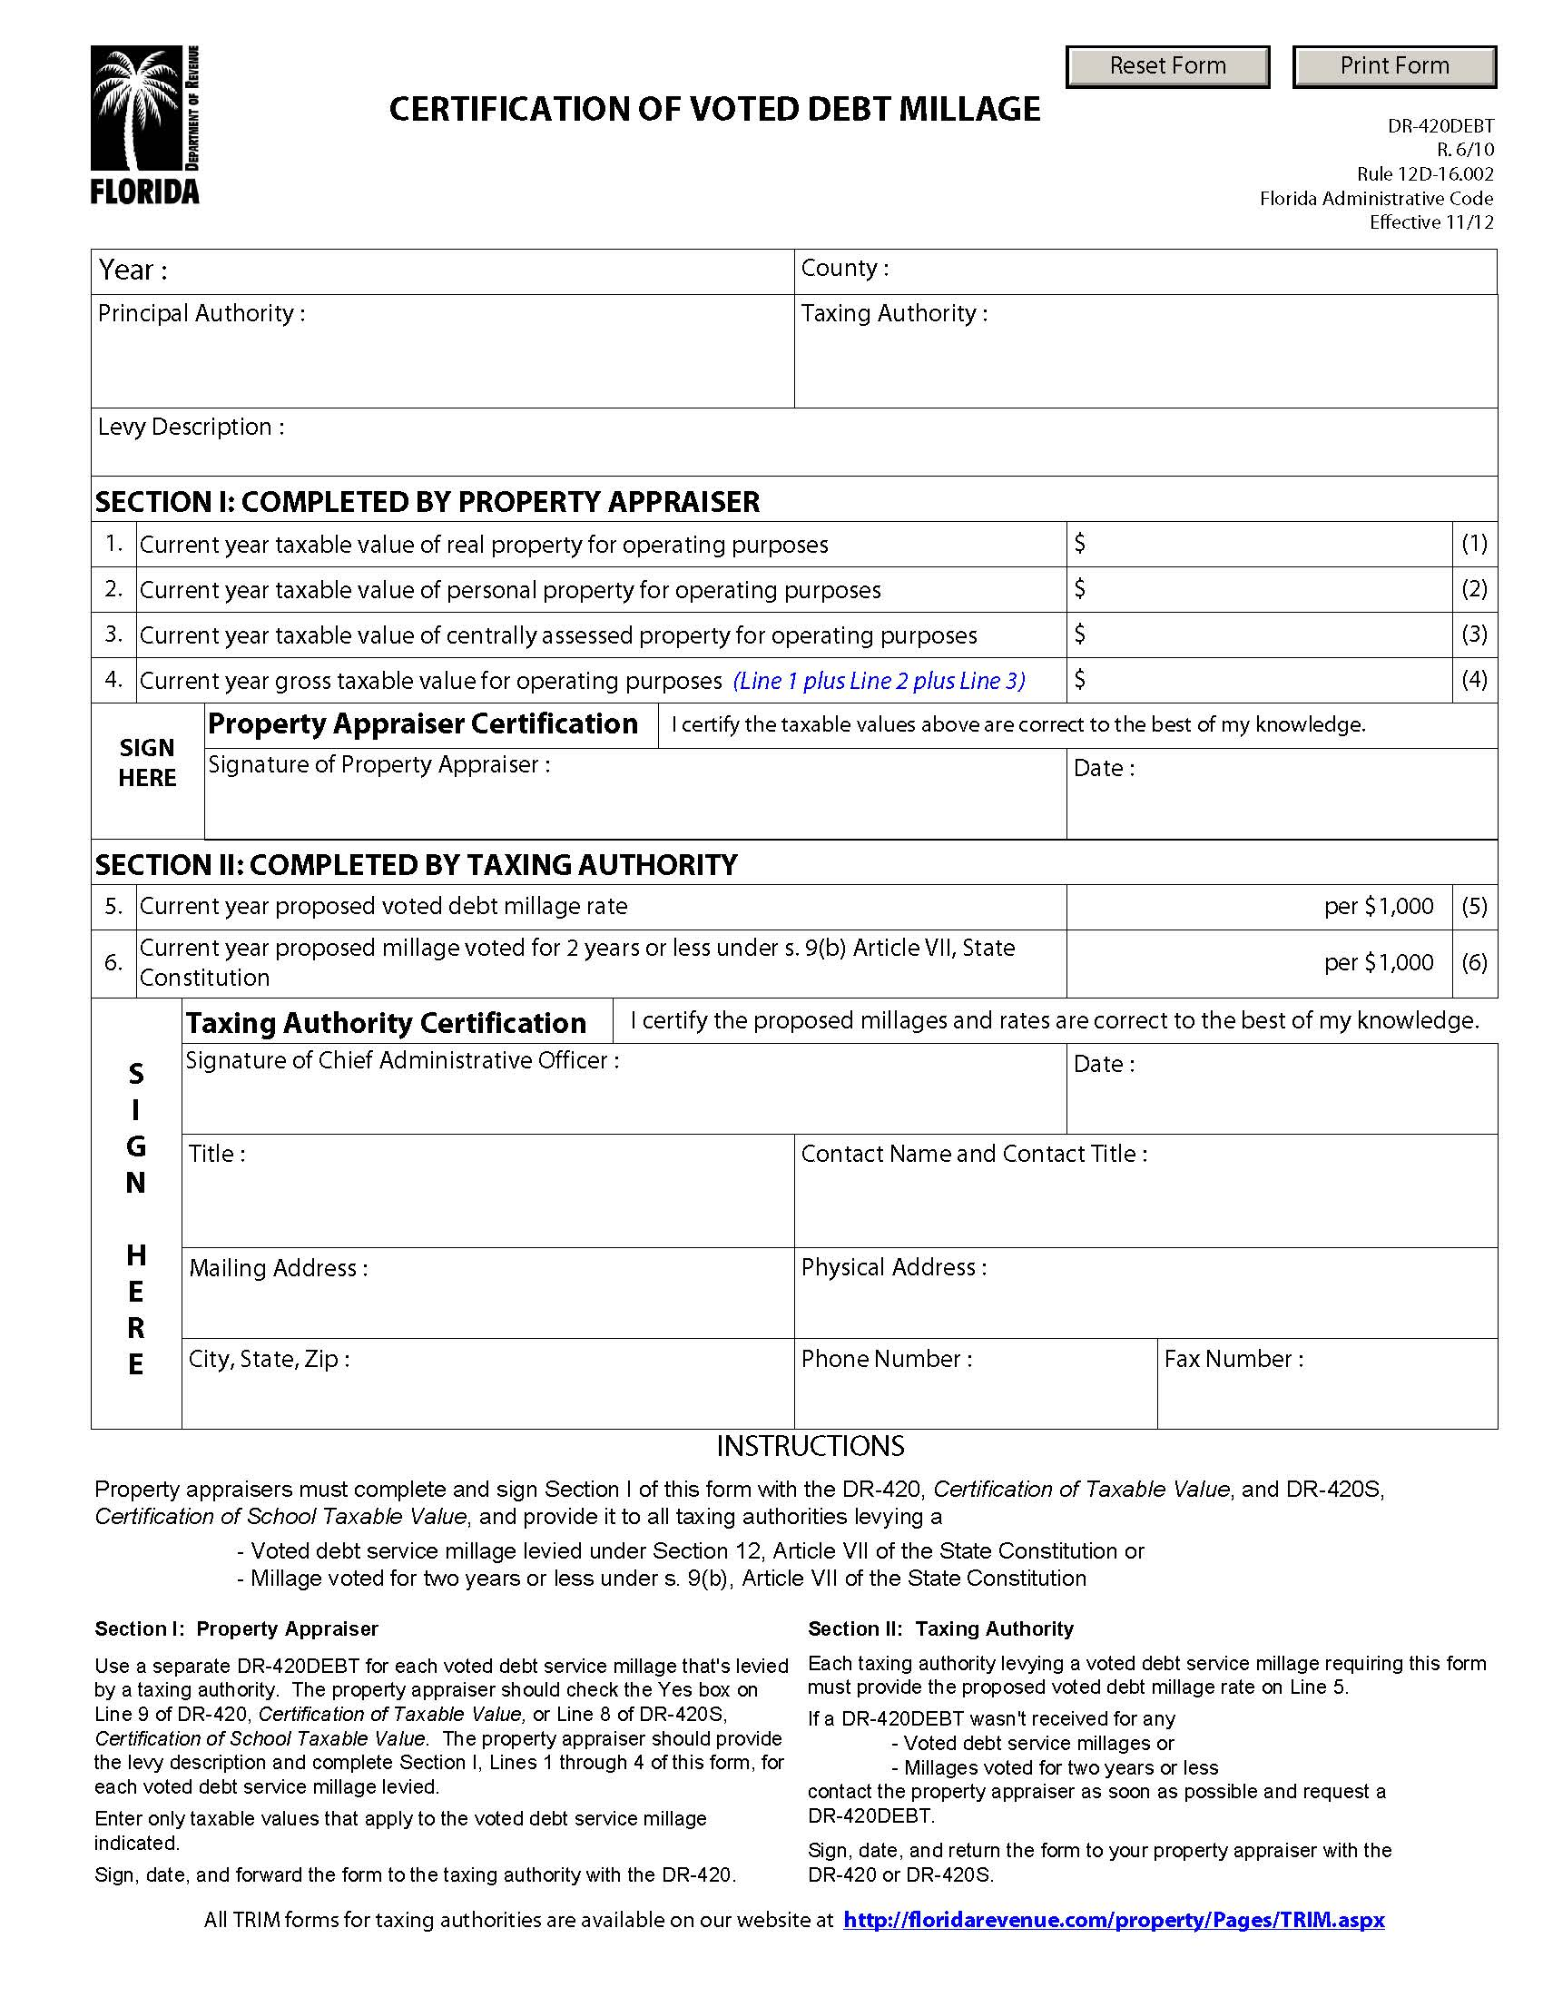
Certification of Voted
Debt Millage
(Form DR-420DEBT)
July 1
The property appraiser certifies initial values
The taxing authority:
  Completes either line 5 or line 6
  Returns completed form within 35 days of certification

Slide 20
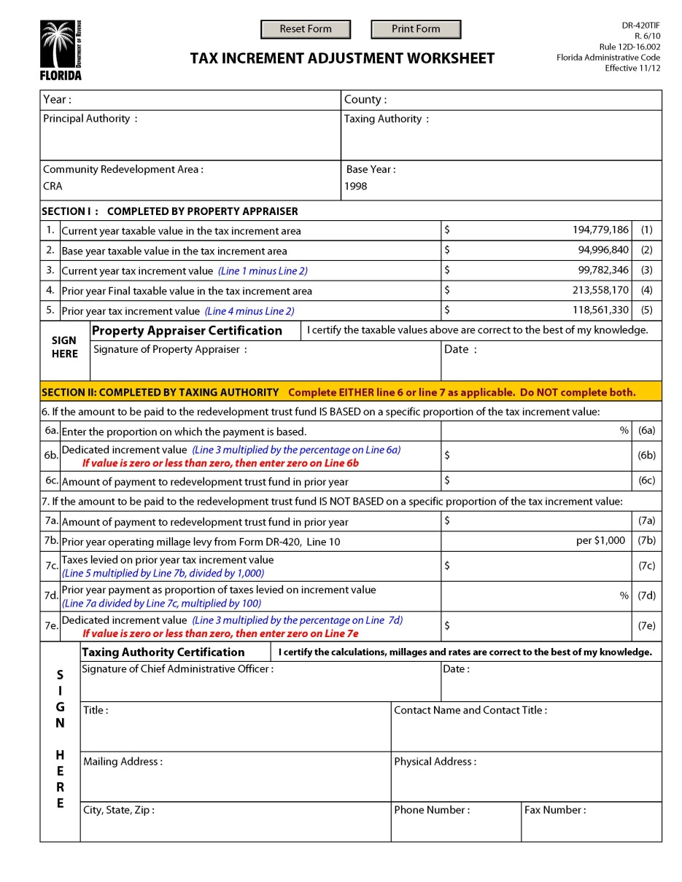
Tax Increment
Adjustment Worksheet
(Form DR-420TIF)
July 1
The property appraiser certifies initial values
The taxing authority:
  Completes either line 6 or line 7
  Returns completed form within 35 days of certification

Slide 21
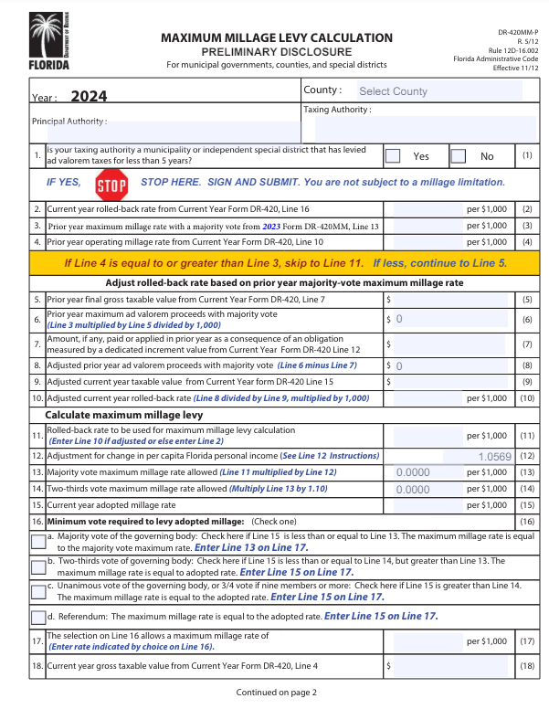
Maximum Millage Preliminary Disclosure
(Form DR-420MM-P)
Enter current year proposed millage
The millage rate determines the type of vote needed to adopt millage.

Slide 22
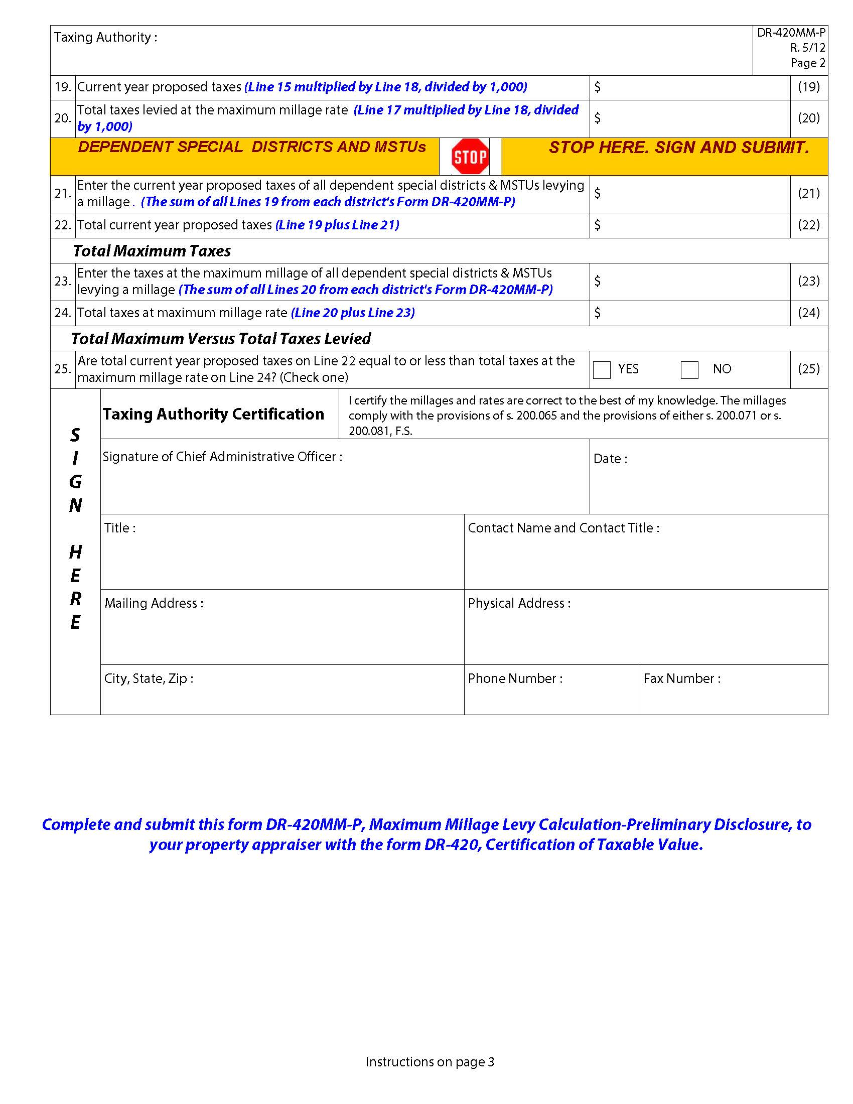
Maximum Millage Preliminary Disclosure (Form DR-420MM-P)
Line 25 determines compliance with maximum millage laws.

Slide 23
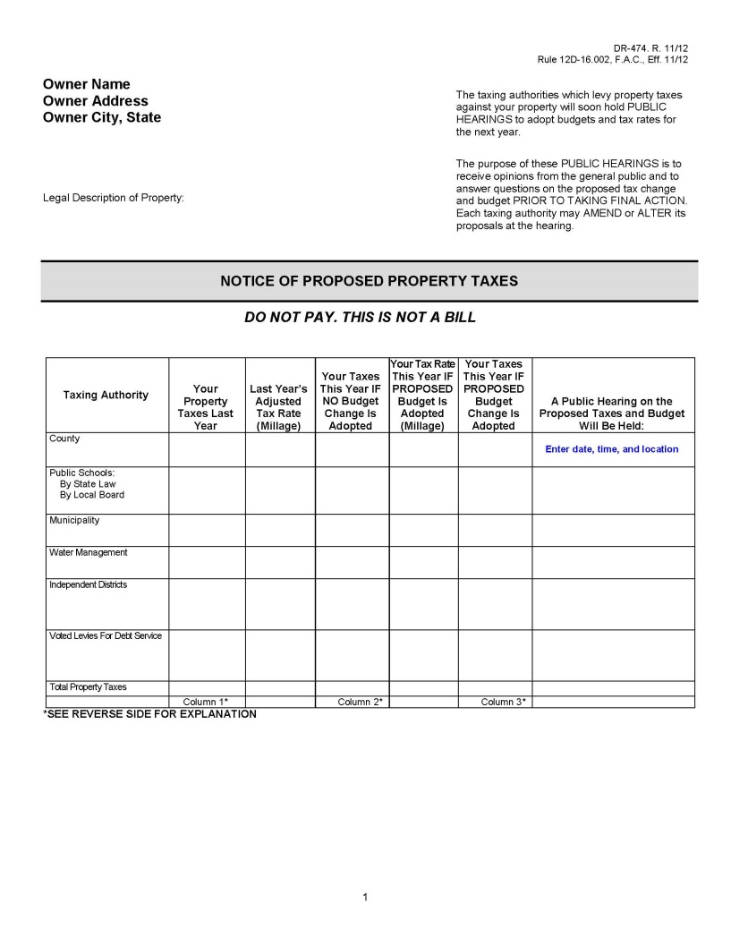
Notice of Proposed Property Taxes
(Form DR-474)

Slide 24
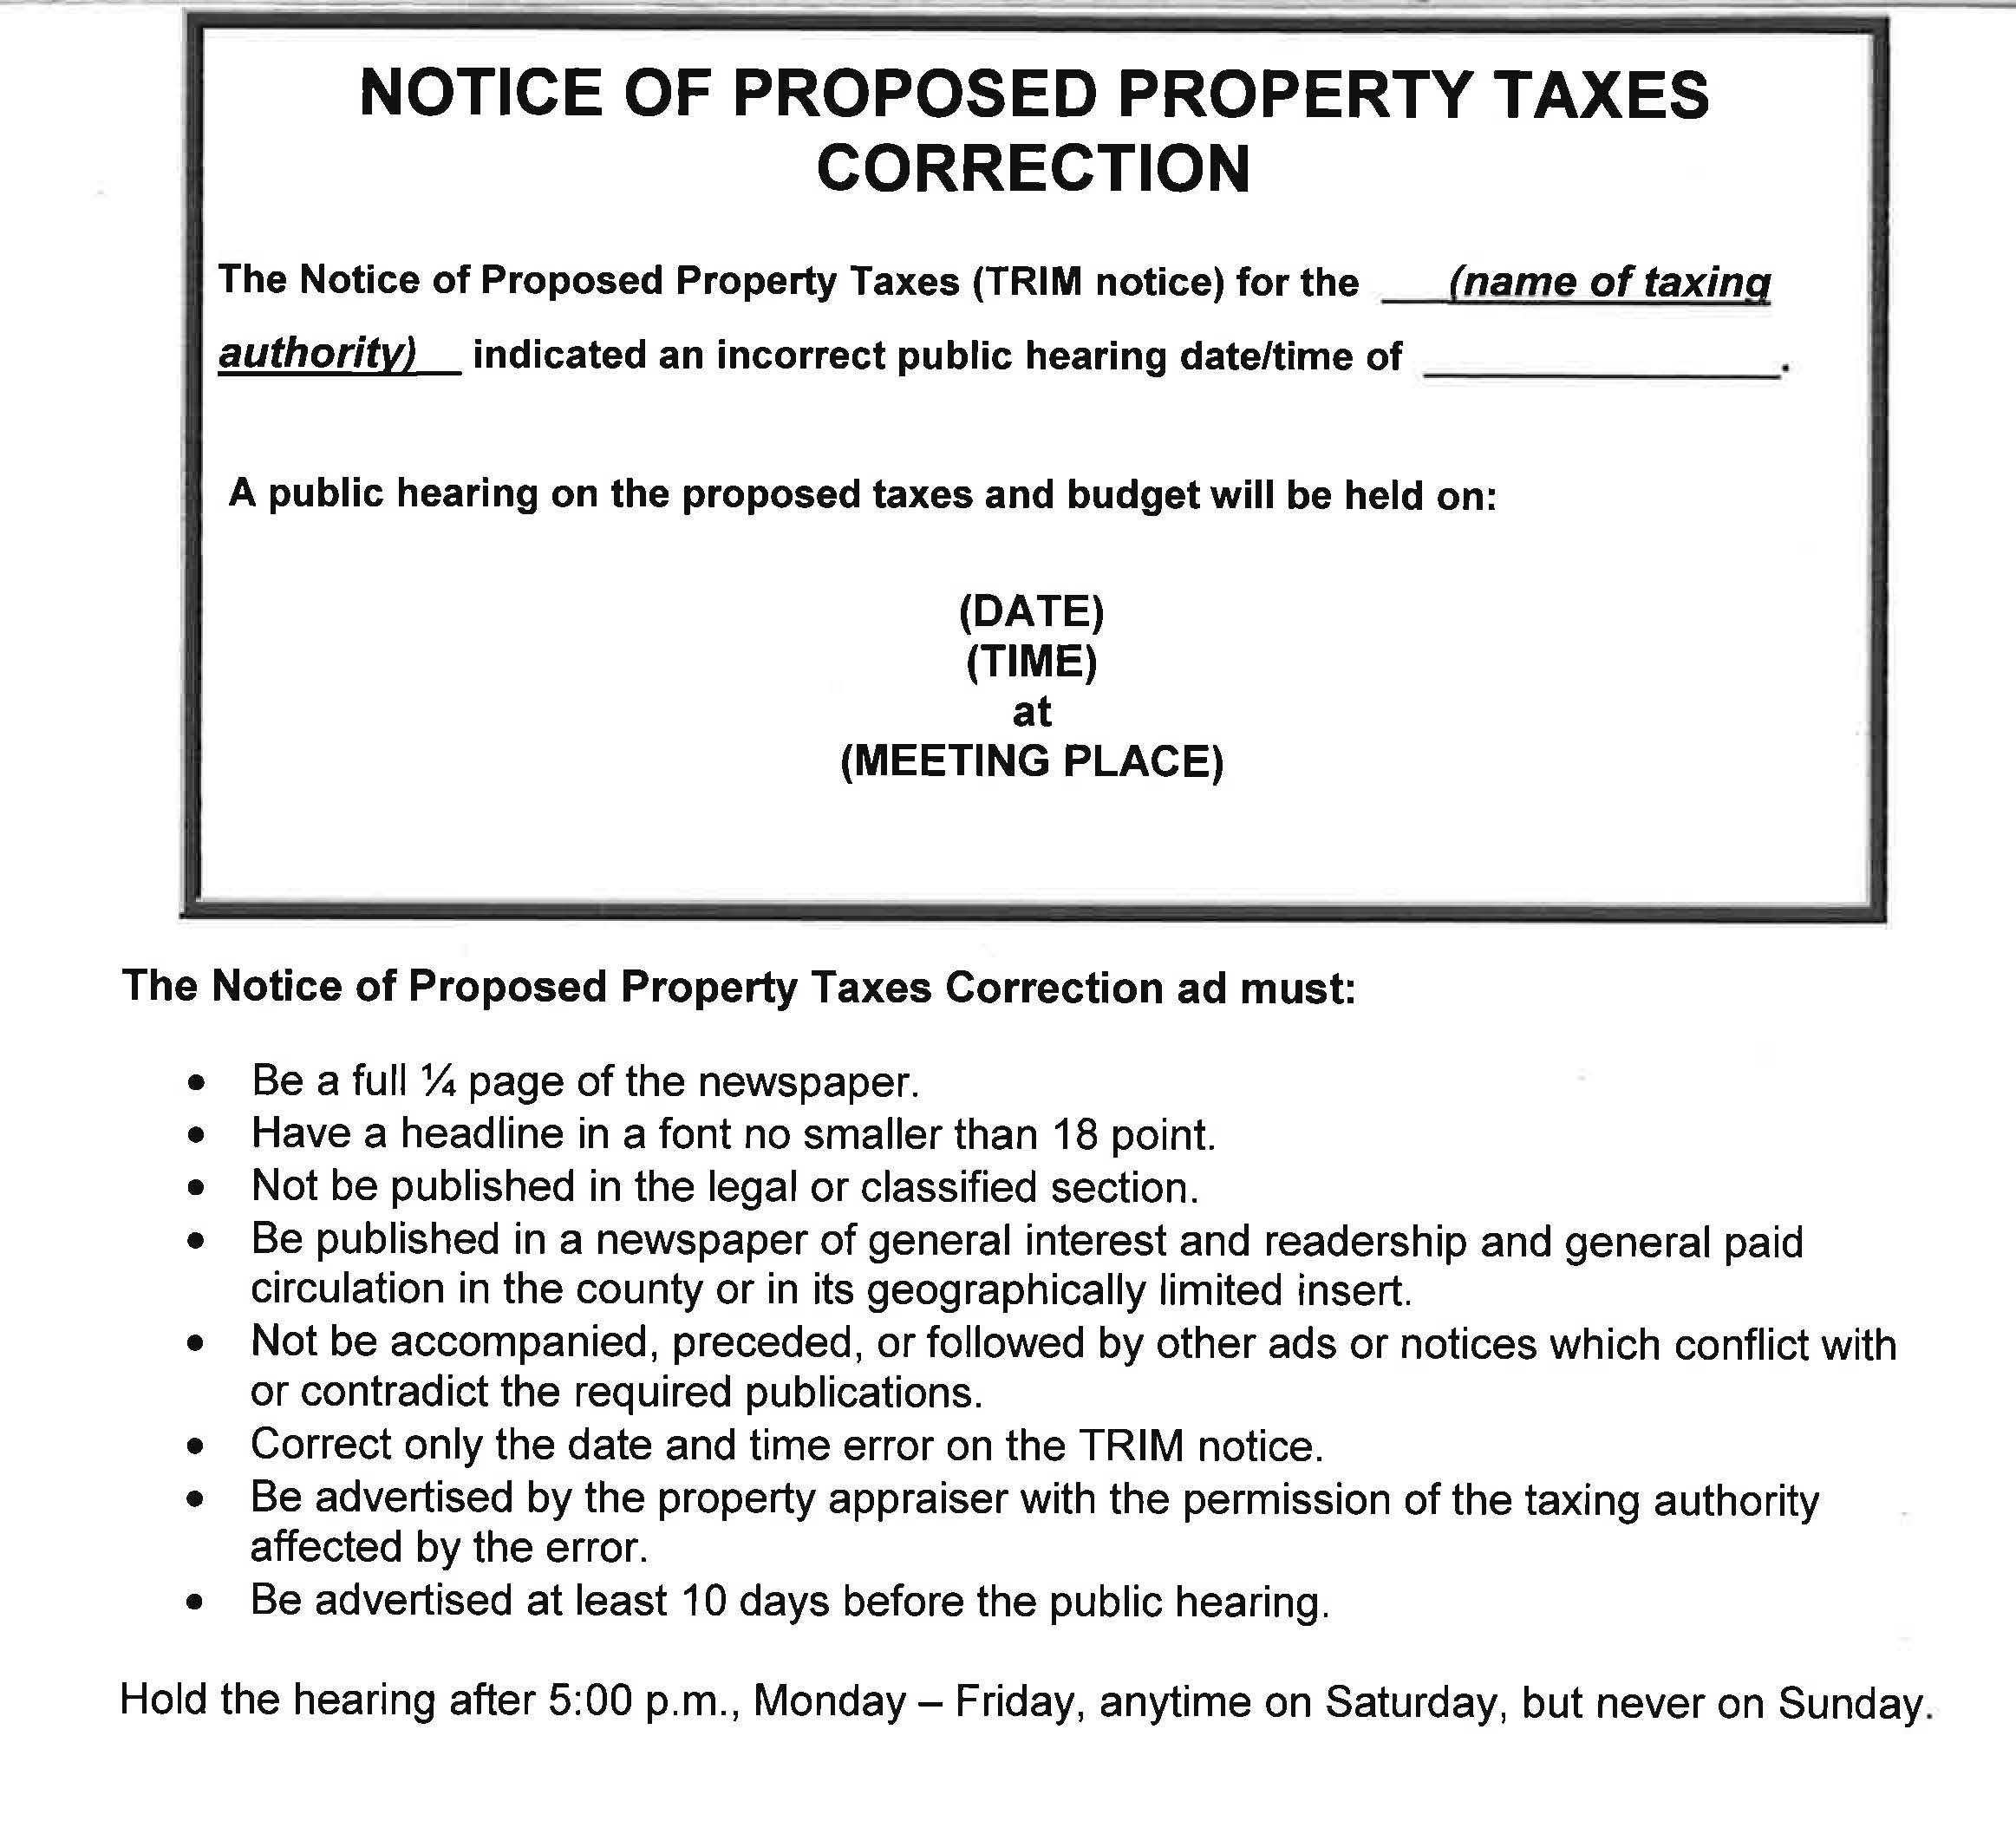
Notice of Proposed Property Taxes Correction

Slide 25
Maximum Millage

Slide 26
Maximum Millage
Local governments must conform to the maximum millage limitation statutory requirements by adopting a millage rate through a vote that is one of the following:
Majority vote
Two-thirds vote
Unanimous vote

Slide 27
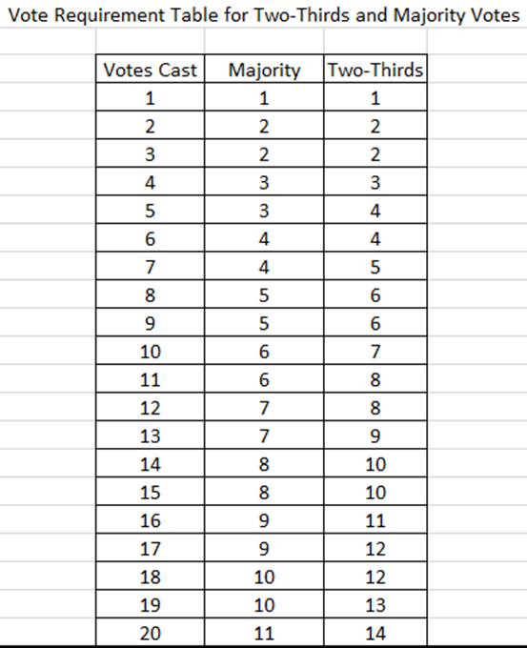
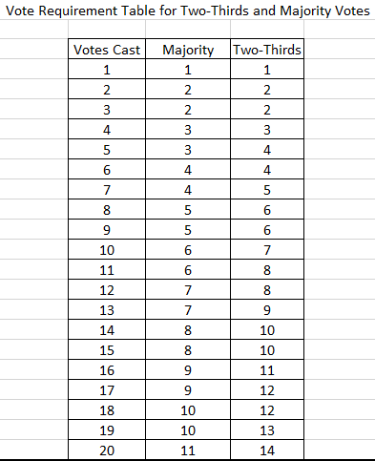
Voting Table
Form DR-420MM
Majority vote – Check here if Line 15 is less than or equal to Line 13. The maximum millage rate is equal to the majority vote maximum rate.
Two-thirds vote – Check here if Line 15 is less than or equal to Line 14 but greater than Line 13. The maximum millage rate is equal the proposed rate. Enter Line 15 on Line 17.
Unanimous vote – This is a unanimous vote of the governing body, or 3/4 vote if there are nine members or more. Check here if Line 15 is greater than Line 14. The maximum millage rate is equal to the proposed rate. Enter Line 15 on Line 17.

Slide 28
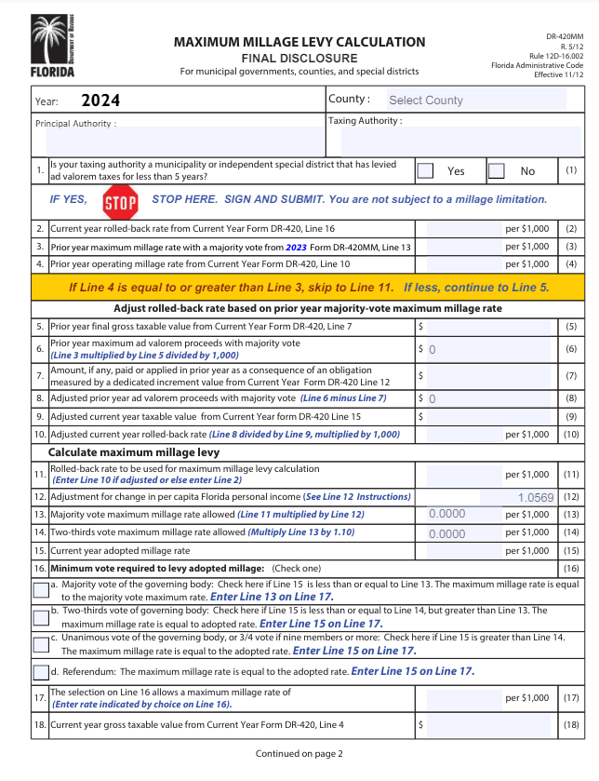
Maximum Millage
Final Disclosure
(Form DR-420MM)
Enter current year adopted millage
The millage rate determines the type of vote needed to adopt millage.

Slide 29
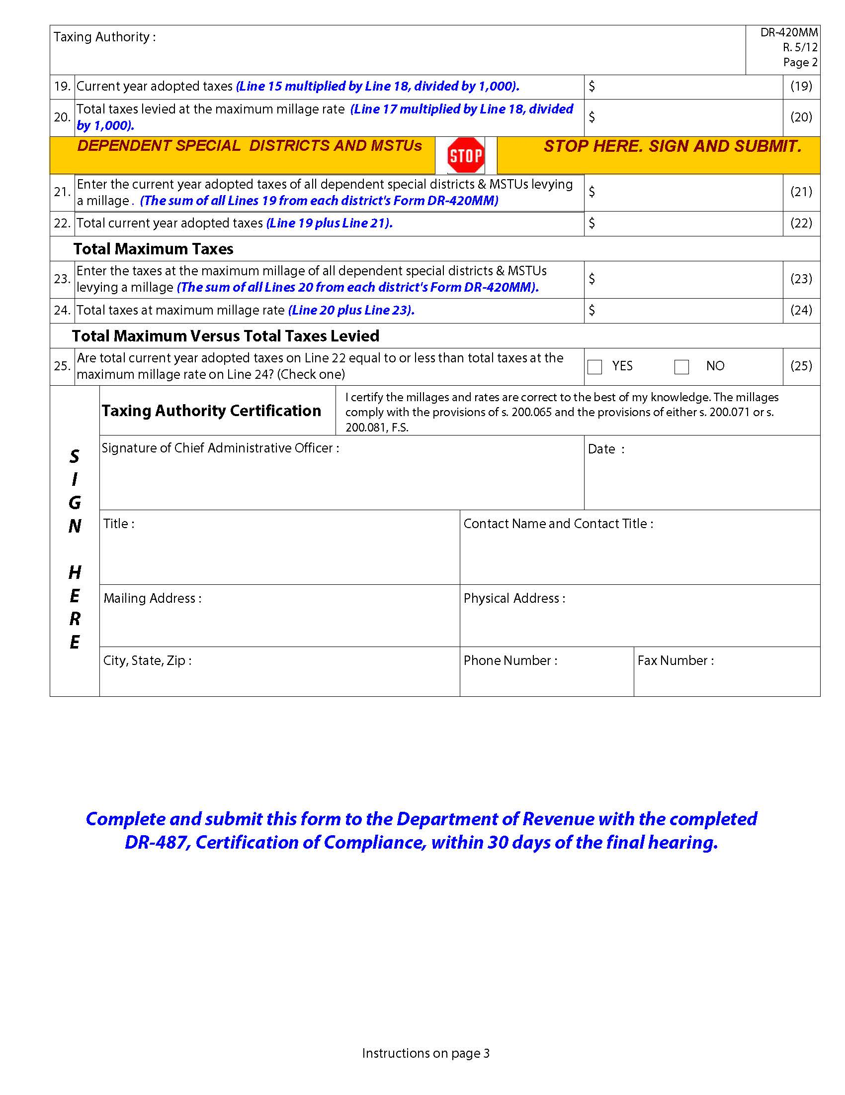
Maximum Millage
Final Disclosure
(Form DR-420MM)
Line 25 determines compliance with maximum millage laws.

Slide 30
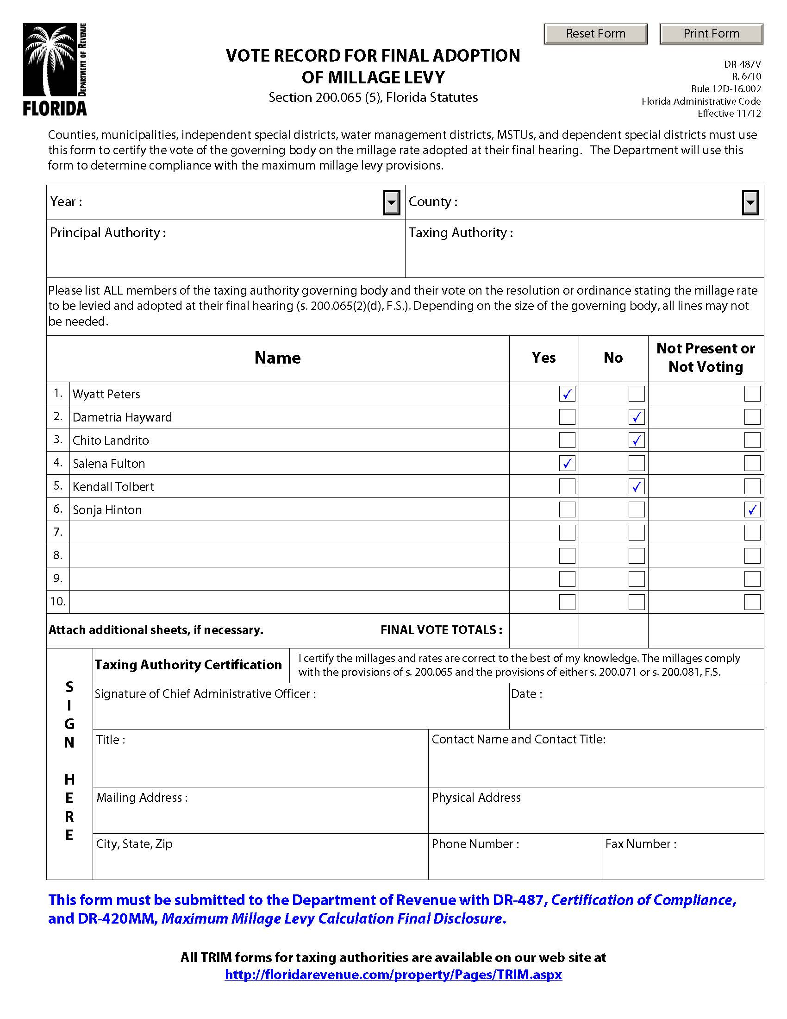
Vote Record
(Form DR-487V)
Must be completed with Form DR-420MM
List all board members and how they voted

Slide 31
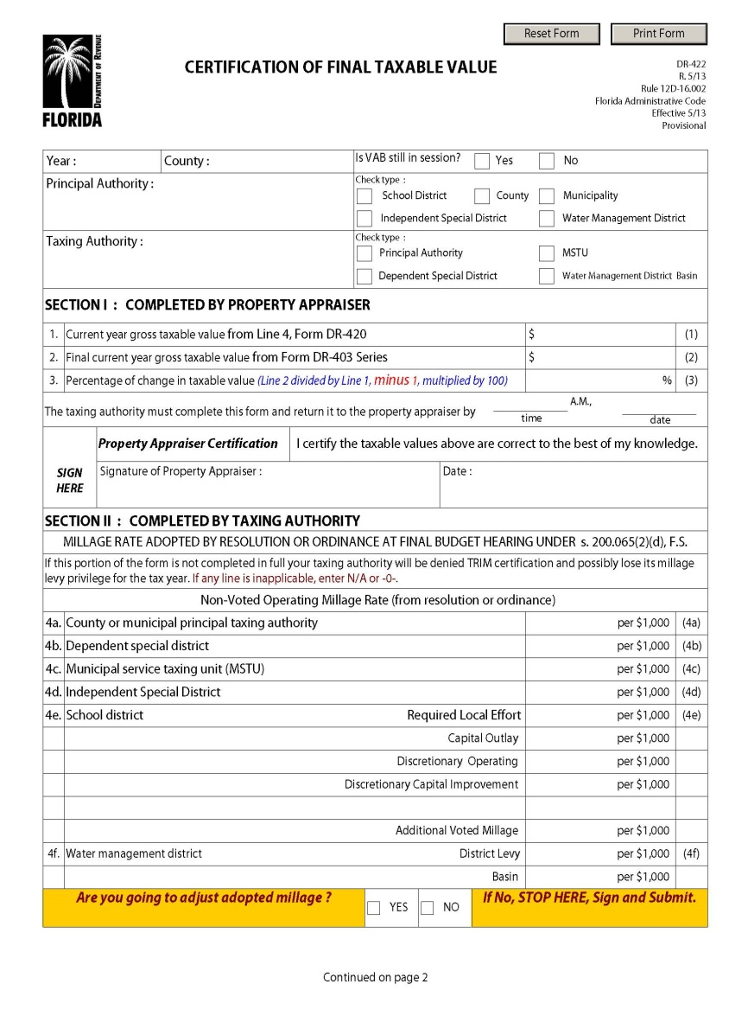
Certification of Final
Taxable Value
(Form DR-422)
The property appraiser certifies final taxable value
The taxing authority enters final millage rate

Slide 32
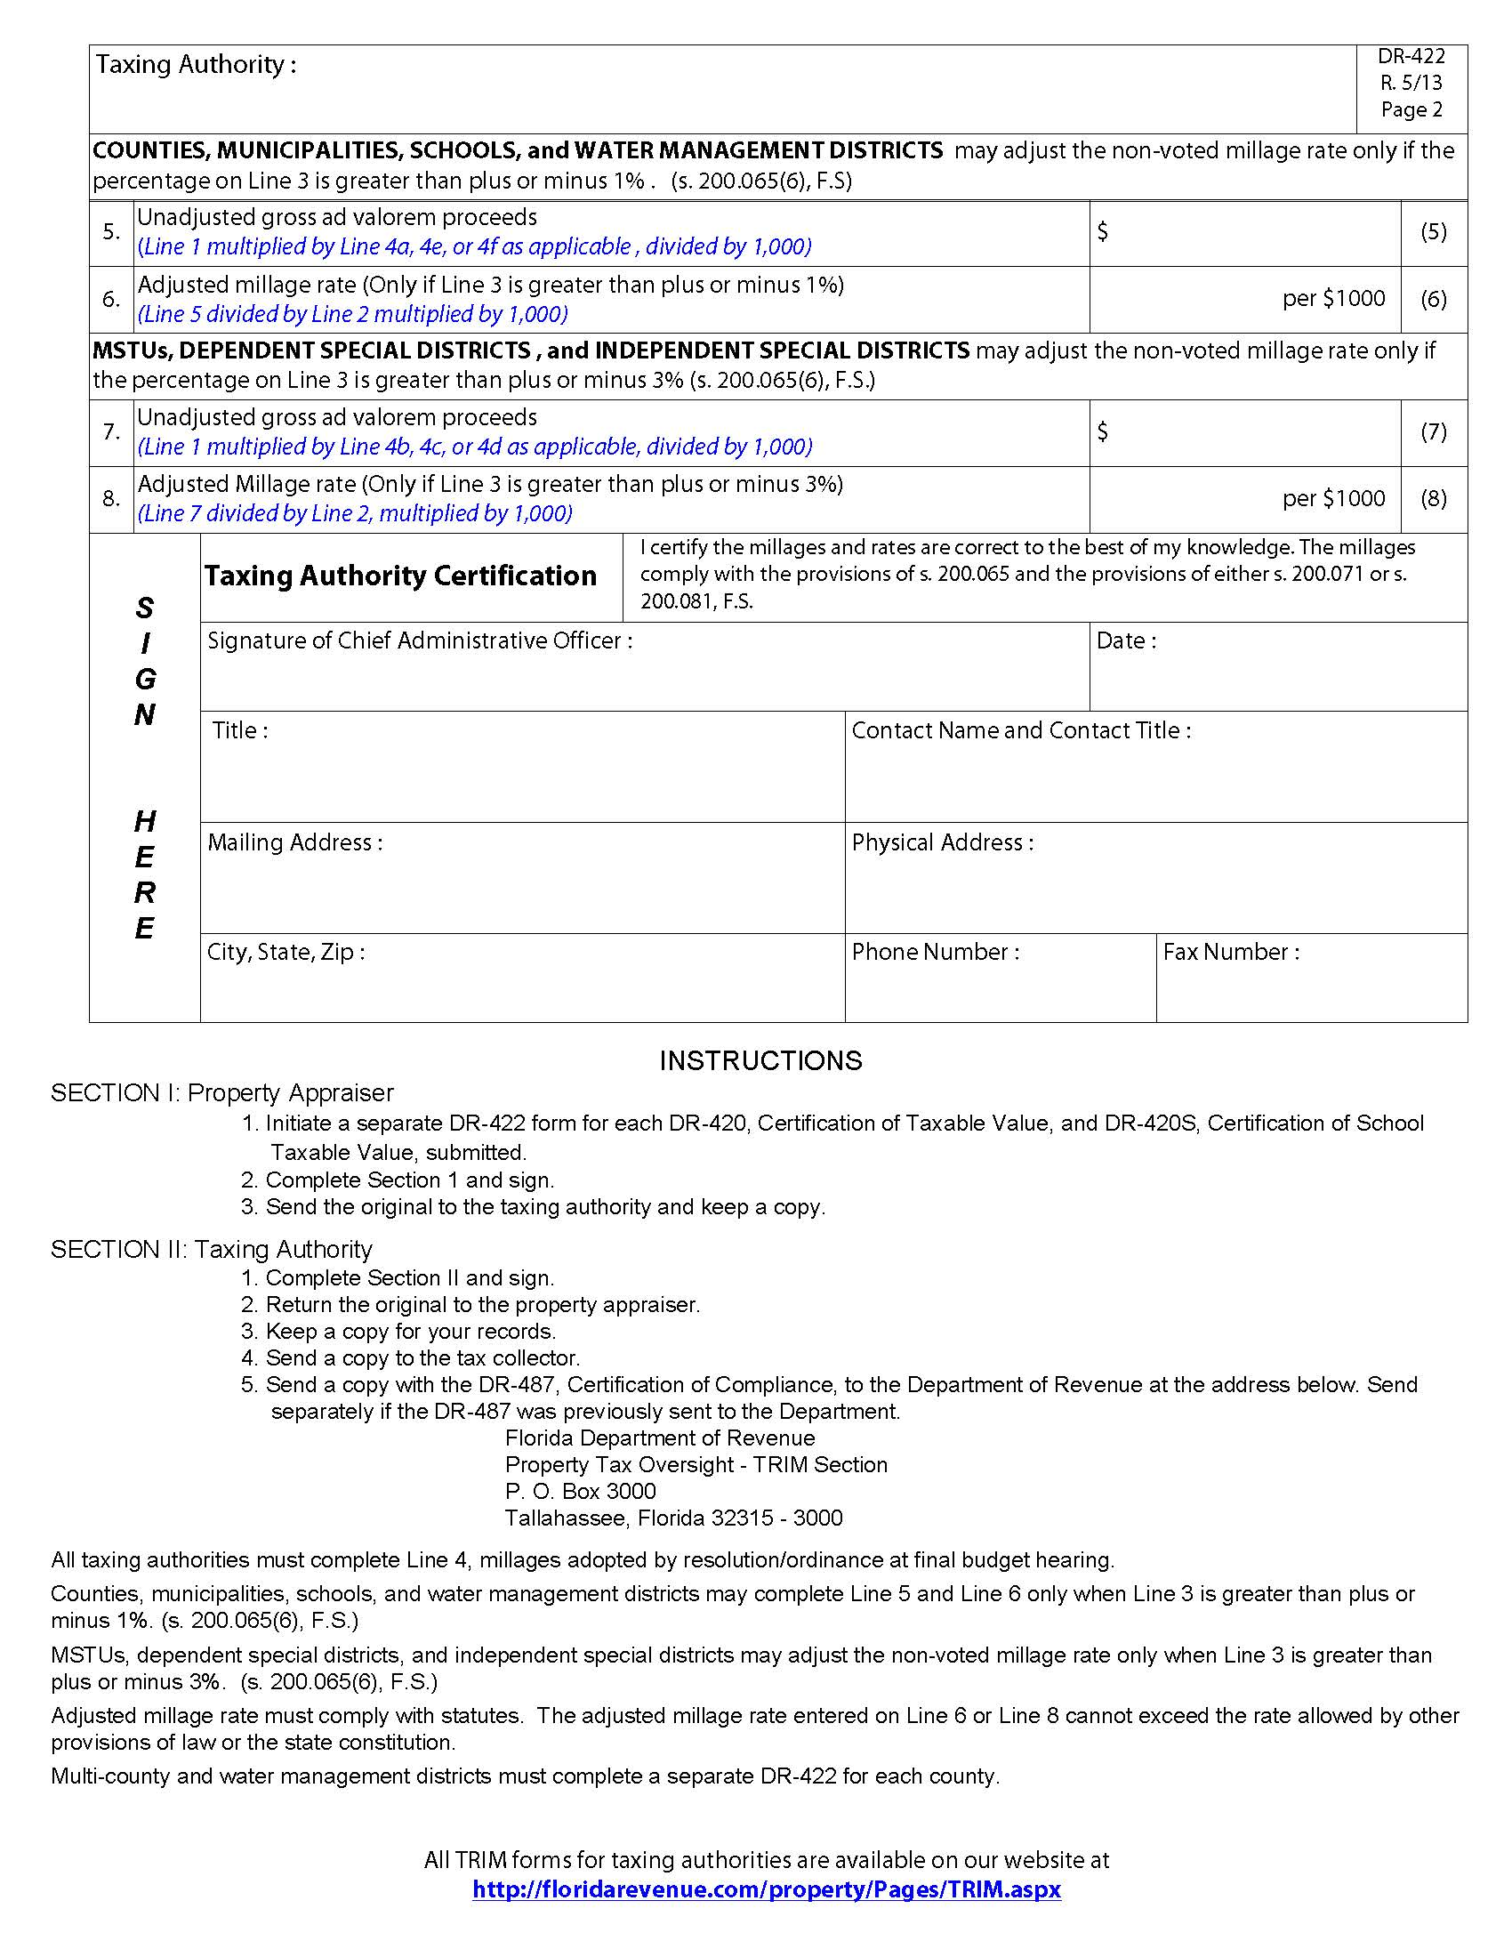
Certification of Final
Taxable Value
(Form DR-422)
The taxing authority may adjust the millage rate.

Slide 33
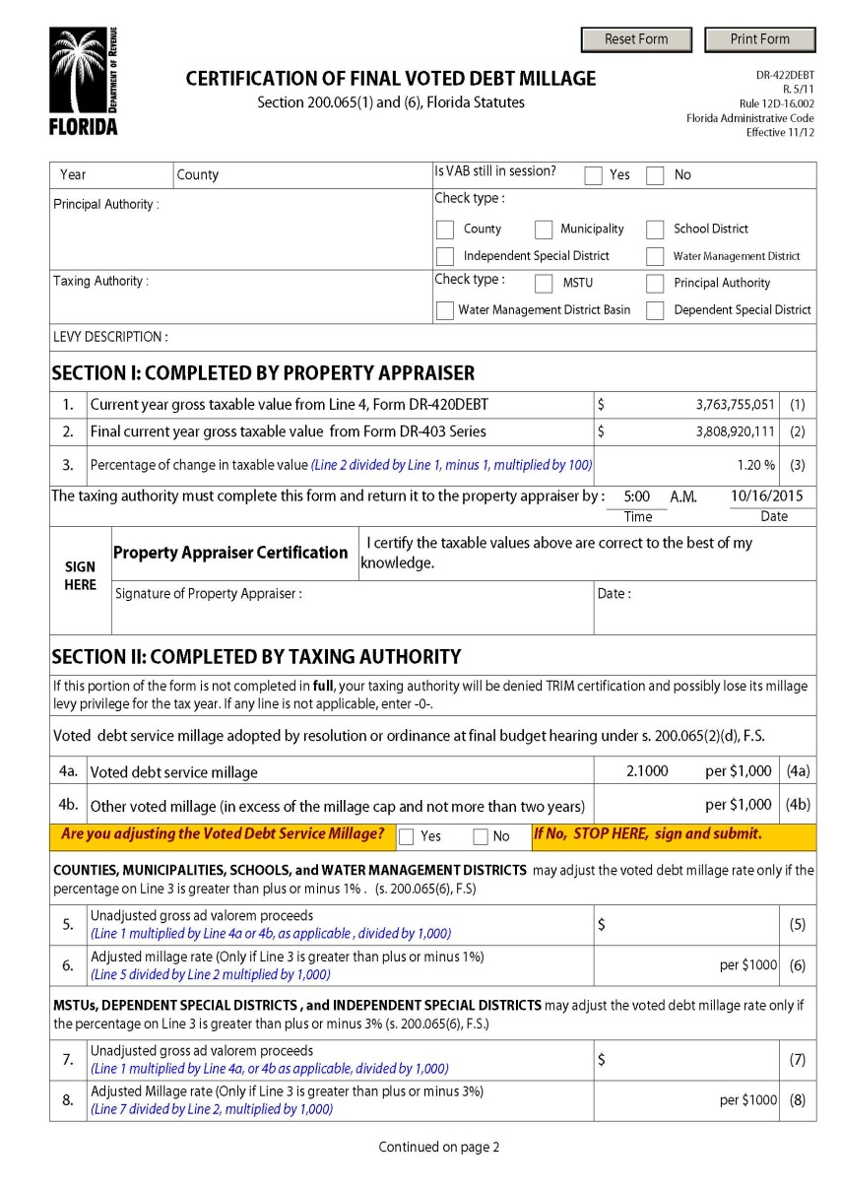
Certification of Final
Voted Debt Millage
(Form DR-422DEBT)
The property appraiser certifies final taxable value
The taxing authority enters:
  Final millage rate
  Adjusted millage rate

Slide 34
TRIM Hearing Requirements

Slide 35
TRIM Hearing Information
2
Taxing authorities must hold two public hearings to adopt a millage rate and budget.

Slide 36
TRIM Hearing Information
Scheduling and Advertising Hearing
TRIM hearings should be held:
Monday – Friday
after 5:00 p.m.
Any time on
Saturday
Never on
Sunday

Slide 37
TRIM Hearing Information
Scheduling and Advertising Hearing
The school board has priority for a hearing date.
The board of County Commissioners (BOCC) has second choice.
No other taxing authority in the county can hold a hearing on the same date as the school board or BOCC.

Slide 38
TRIM Hearing Information
Scheduling and Advertising Hearing
The tentative TRIM hearing is advertised on the TRIM notice.
The final hearing must be advertised within 15 days of adopting the tentative millage and budget.
final hearing advertisement
TENTATIVE MILLAGE & BUDGET ADOPTED
1
2
3
4
5
6
7
8
9
10
11
12
13
14
15
DAYS

Slide 39
TRIM Hearing Information
At the Hearing
The first issues discussed will be:
Percentage increase in millage over the rolled-back rate necessary to fund the budget, if any
Specific reasons why ad valorem tax revenues are increasing

Slide 40

TRIM Hearing Information
At the Hearing
The general public may speak and ask questions before the governing body adopts any measures.
The governing body must adopt its tentative or final millage rate before adopting its tentative or final budget.
Adopt millage first; adopt budget second.

Slide 41
TRIM Hearing Information
At the Hearing
Each taxing authority levying a millage rate must publicly announce, before adopting the millage resolution:
The taxing authority’s name
The rolled-back rate
The percentage increase over the rolled-back rate
The millage rate to be levied

Slide 42
TRIM Hearing Information
At the Hearing
The tentative millage rate cannot exceed the proposed millage rate unless the PA mails each taxpayer a revised TRIM notice at the TA’s expense.
The final millage rate cannot exceed the tentatively adopted millage rate.
The TRIM process must be completed within 101 days.

Slide 43
TRIM Hearing Information
At the Hearing
The TA cannot levy any millage until its governing board has approved a resolution or ordinance.

Slide 44
Executive Order for State of Emergency
Executive Order
In the event of a state of emergency declared because of an imminent tropical storm, hurricane, or other calamity, the governor of the State of Florida will issue an executive order. The executive order will provide pertinent information and guidance such as:
A list of the counties or areas impacted by the emergency event
Suspension of the effect of any statute, rule, or order that would prevent, hinder, or delay any action necessary to cope with the emergency

Slide 45
Executive Order for State of Emergency
Department Emergency Order
The executive director of the Department will in turn issue an emergency order to implement the provisions of the governor’s order. The emergency order will provide specific guidance for the TRIM process, such as:
A list of the counties impacted
Extension of TRIM timelines
Temporarily waived TRIM compliance requirements
Specific guidance related to TRIM hearing and advertising requirements

Slide 46
TRIM Advertising Requirements

Slide 47
TRIM Advertising Requirements
Taxing authorities must select the appropriate advertisement to announce the final TRIM hearing.
Advertisements shall be published as provided in chapter 50, Florida Statutes. The TRIM ads may be placed in a newspaper of general circulation in the county or in its geographically limited insert. The insert must circulate in the geographic boundaries that include the taxing authority’s geographic boundaries
(s. 200.065(3)(h), F.S.).

Slide 48

TRIM Advertising Requirements
Newspaper advertisements cannot:
Be placed in the legal or classified section (s. 200.065(3), F.S.)
Deviate from the language specified in s. 200.065, F.S.
Be accompanied, preceded, or followed by other advertising or
notices that conflict with or contradict the required publications
(s. 200.065(3)(h), F.S.)
Be combined. The advertisements must be separate and adjacent
(s. 200.065(3)(I), F.S.).

Slide 49
TRIM Advertising Requirements
“Adjacent to,” when used in reference to newspaper advertisements, means next to, touching, or contiguous, either at the sides or at the corners. This term includes advertisements placed adjacent to one another, either on the same page or on adjoining pages with a crease separating them, so that a reader may view the advertisements simultaneously when the newspaper pages are open on a flat surface.

Slide 50
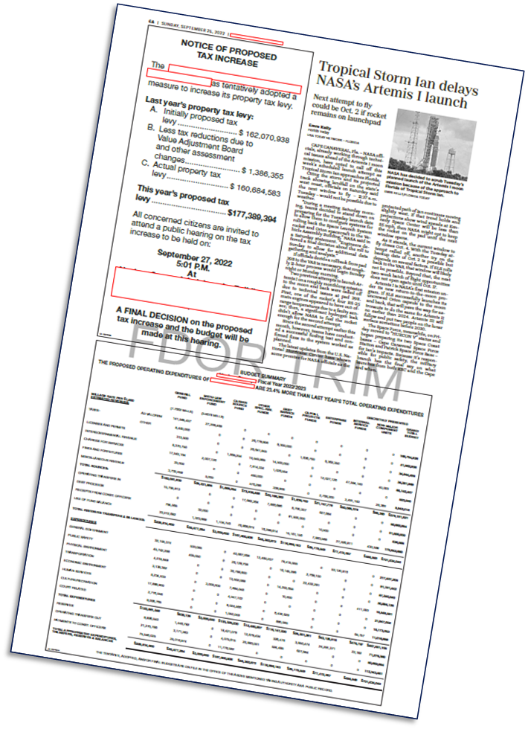
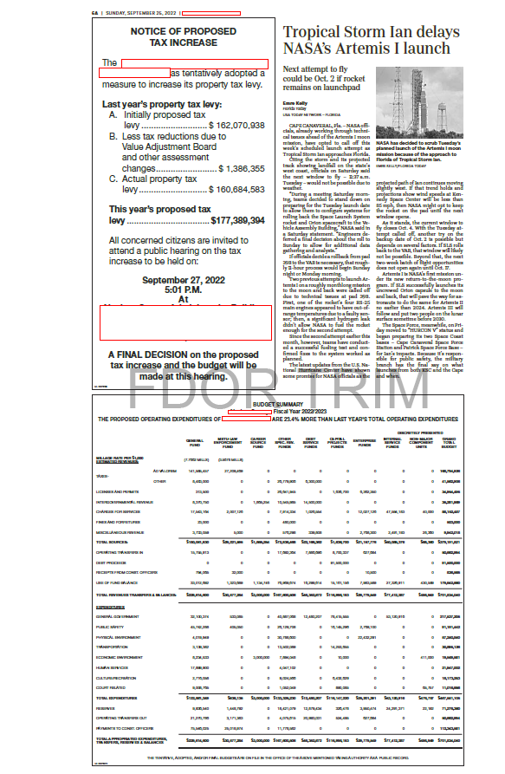
Adjacent Newspaper Example

Slide 51
TRIM Advertising Requirements
Publication on a Publicly Accessible Website
TAs may also publish TRIM advertisements on the publicly accessible website of the county in which it lies if the cost to publish the advertisement is less than the cost of advertising in a newspaper.
A TA in a county with fewer than 160,000 residents must hold a public hearing (noticed in the newspaper) to make a determination that the residents have sufficient access to broadband internet service.
A multi-county taxing authority that chooses this option must publish the ads on the website of each county that it spans.
Continued

Slide 52
TRIM Advertising Requirements
Publication on a Publicly Accessible Website
TAs who use this option shall provide notice once per year in a newspaper of general circulation or other publication that is mailed or delivered to all residents and property owners throughout the TA’s jurisdiction.
The notice must indicate that the owners and residents may receive legal ads and notices from the TA by first-class mail or email after making a request and registering their names and addresses or email addresses with the TA.
A link to the advertisements shall be prominently placed on or accessible through a direct link from the website homepage of the county and the website homepage of the TA (see s. 50.0311, F.S., for additional requirements.)

Slide 53
TRIM Advertising Requirements
Advertisement Selection
After calculating the percentage change of rolled-back rate, choose the proper notice:
Publish a Notice of Proposed Tax Increase when percent change is greater than 0%.
Publish a Notice of Budget Hearing when the percent change is equal to or less than 0%.

Slide 54
TRIM Advertising Requirements
Notice of Proposed Tax Increase Ad
Must be no smaller than a quarter-page advertisement
Must have a headline in at least 18-point type
Must have an adjacent Budget Summary ad
Must advertise the final hearing within 15 days of tentative (first) hearing
The final hearing must be held two to five days after advertising.

Slide 55
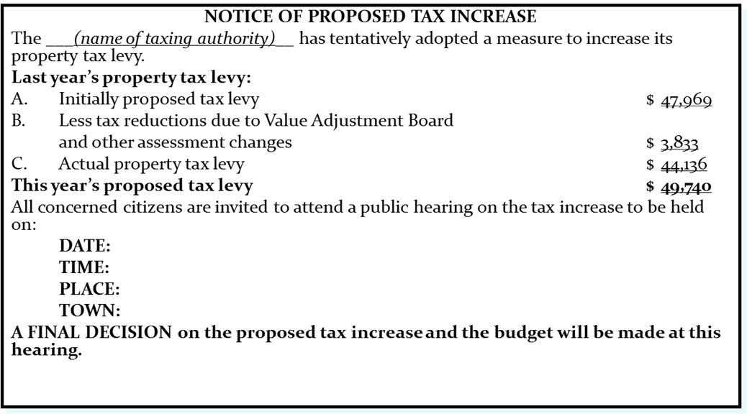
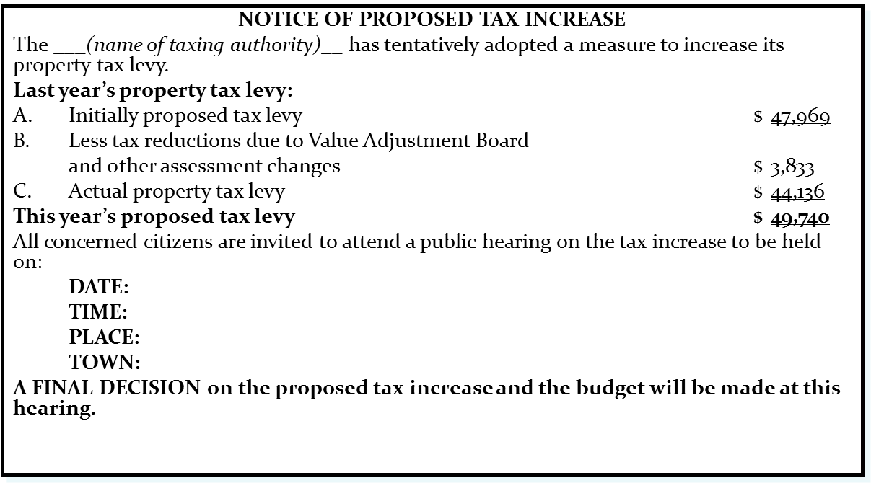
TRIM Advertising Requirements
Notice of Proposed Tax Increase Ad
EXAMPLE
Use 100% of tax levies in advertisement.

Slide 56
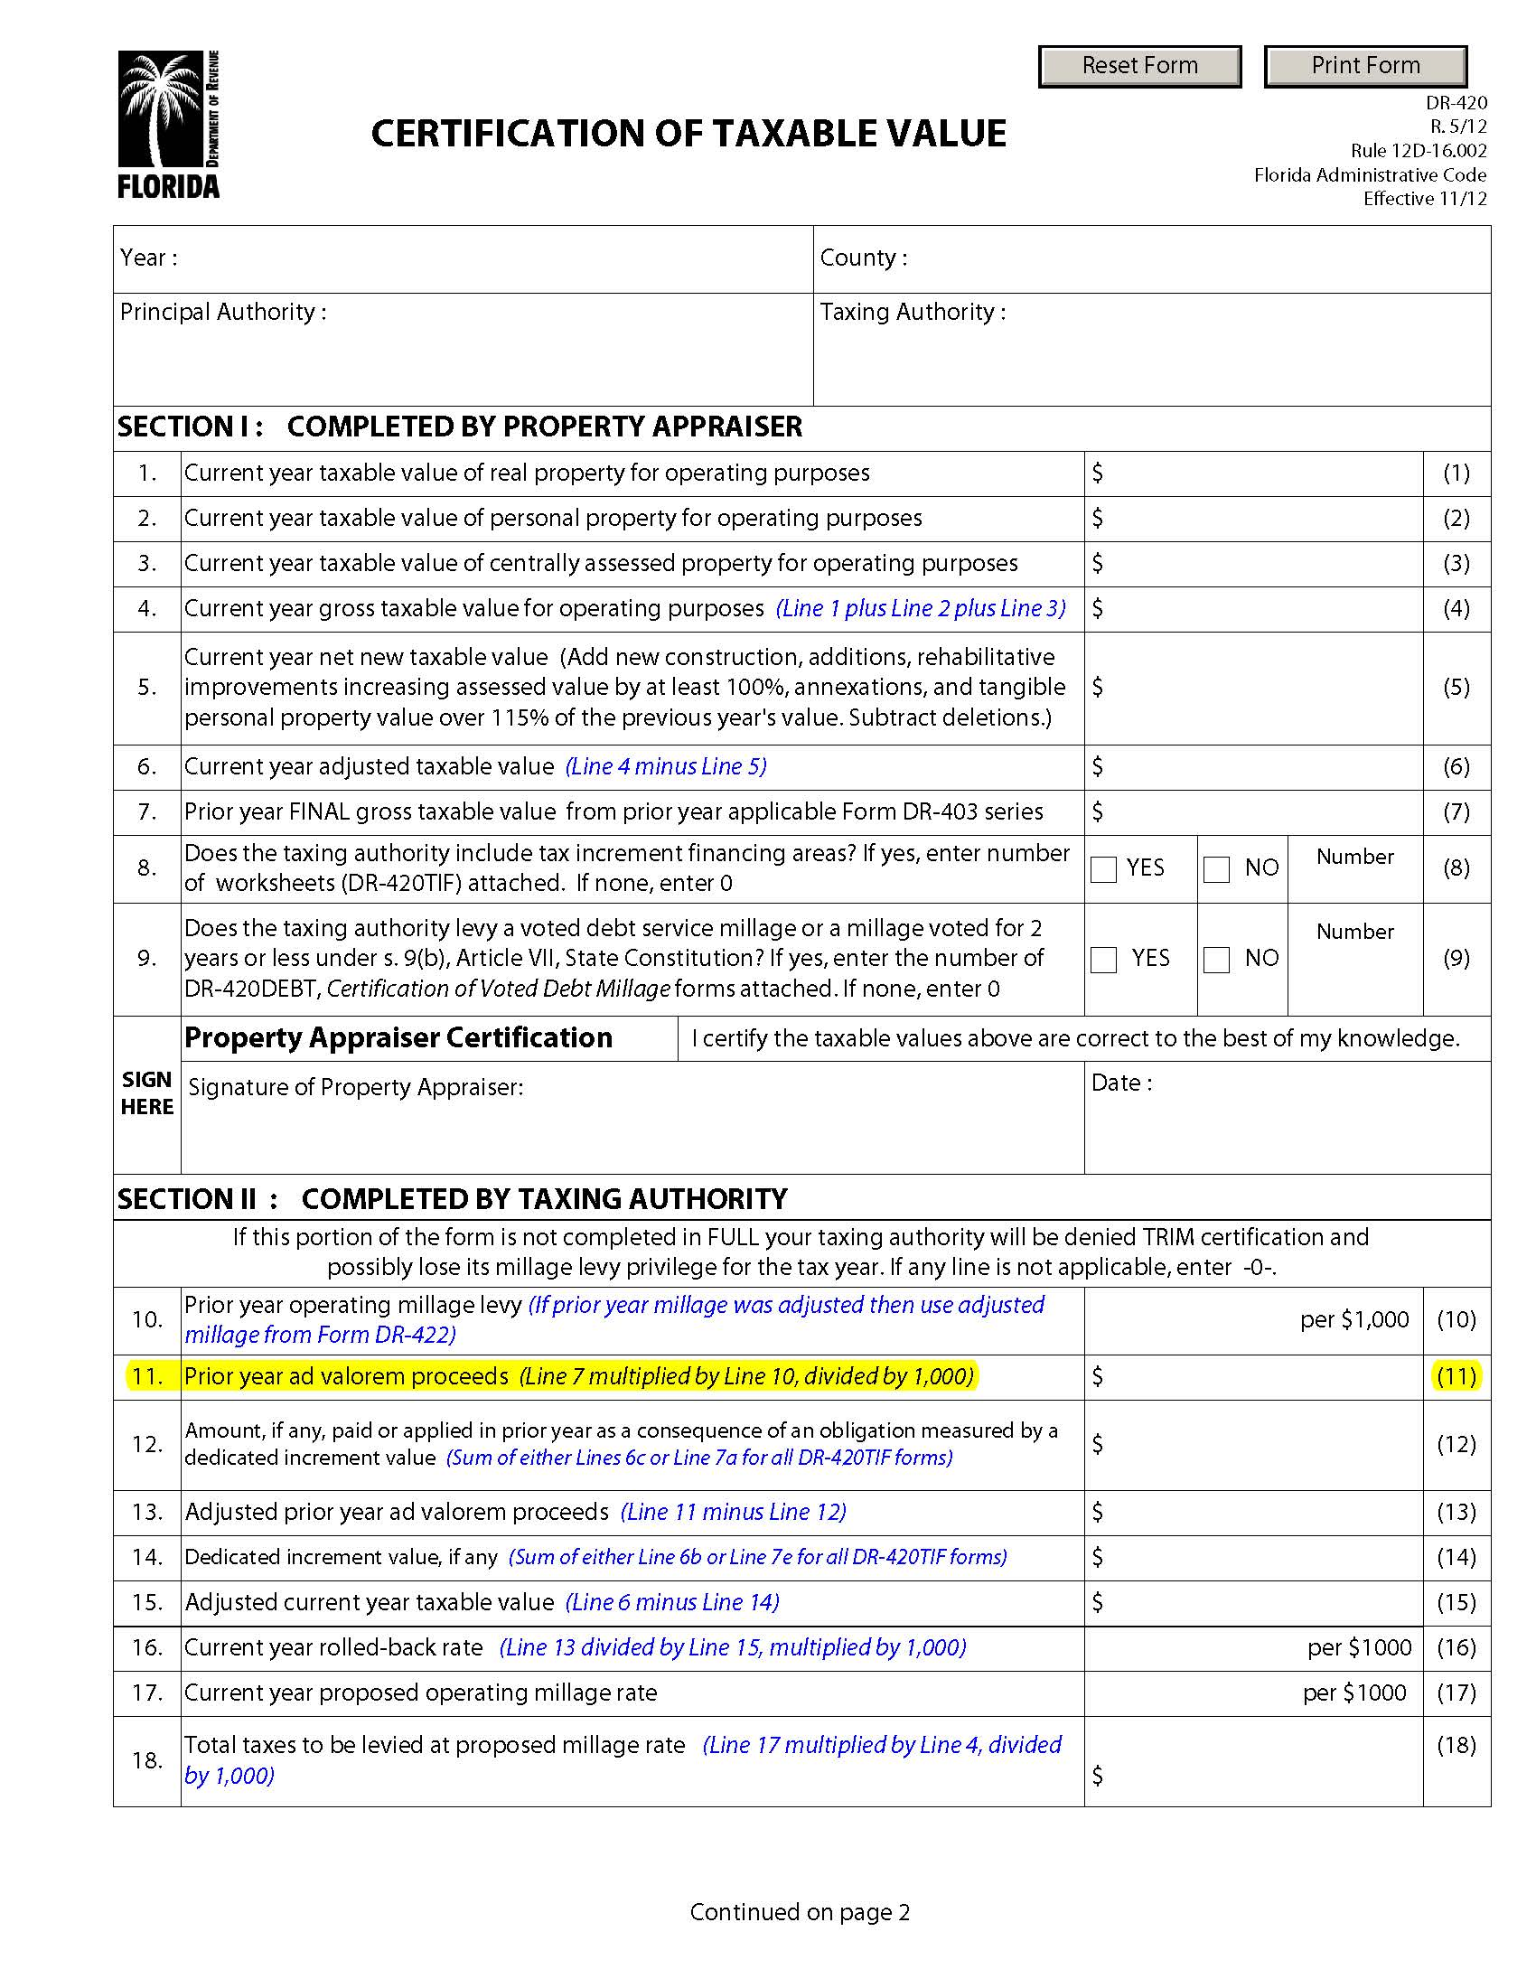
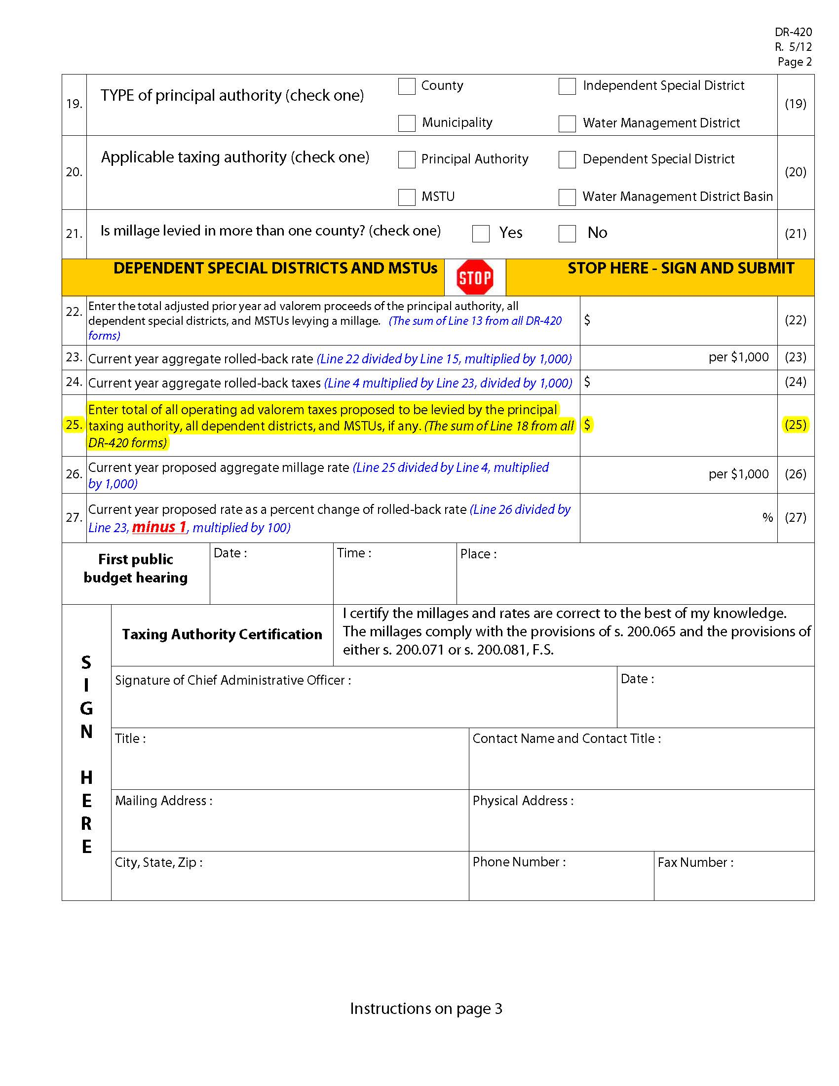
TRIM Advertising Requirements
Notice of Proposed Tax Increase Ad
Line A = Prior year DR-420, line 25
Line B = Subtract line C from line A
Line C = Current year DR-420, line 11
This year’s proposed tax levy = current year’s tentatively adopted millage rate x current year gross taxable value ÷ 1,000 (line 4, current year DR-420).
*If the tentatively adopted millage
rate is the same as the proposed
millage rate, use current year Form
DR-420, line 25.

Slide 57
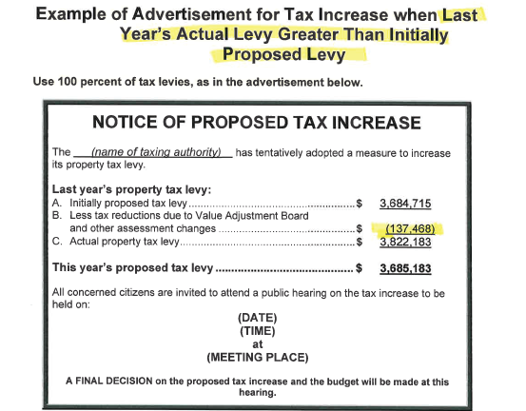
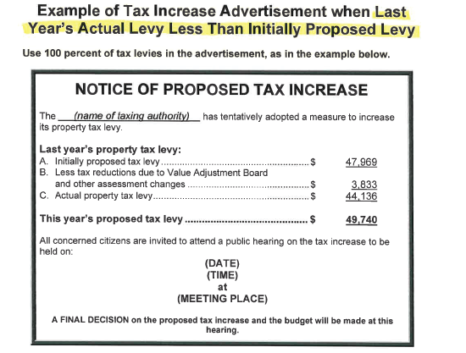
Notice of Proposed Tax Increase Ad
Important to Remember
If Line A Is Less
than Line C
If Line A is Greater
than Line C

Slide 58

Newspaper Example
Notice of Proposed Tax Increase

Slide 59
TRIM Advertising Requirements
Notice of Budget Hearing
Budget hearing advertisement:
Does not have a size requirement
Must have an adjacent Budget Summary ad
Must advertise the final hearing within 15 days of tentative (first) hearing
The final hearing must be held two to five days after advertising.

Slide 60
TRIM Advertising Requirements
Notice of Budget Hearing
EXAMPLE
NOTICE OF BUDGET HEARING
The ____________ has tentatively adopted
a budget for (fiscal year).
A public hearing to make a FINAL DECISION on the budget AND TAXES will be held on:
(Date)
(Time)
at
(Meeting Place)

Slide 61
Newspaper Example
Notice of Budget Hearing

Slide 62
TRIM Advertising Requirements
Budget Summary Ad
The advertisement must show all tentatively adopted millage rates:
General fund
Dependent district
Municipal Service
Taxing Unit (MSTU)
Voted debt service

Slide 63
TRIM Advertising Requirements
Budget Summary Ad
For this advertisement:
Each millage rate must include at least 95% of ad valorem taxes in the budget.
All funds must be shown.
The ad must show a balanced budget.
  All funds should balance.
  The total of all funds should balance.
A line item for reserves must be shown.

Slide 64
TRIM Advertising Requirements
Budget Summary Ad
Other requirements:
The ad must have an adjacent Notice of Proposed Tax Increase ad or Notice of Budget Hearing ad (not both).
This ad has no size requirements.
The ad must comply with all statutory budget requirements.

Slide 65
TRIM Advertising Requirements
Budget Summary Ad
If the proposed operating budget expenditures are more than last year's total operating expenditures, include this statement in bold.
THE PROPOSED OPERATING BUDGET EXPENDITURES OF (name of taxing authority) ARE (percent, rounded to one decimal place) MORE THAN LAST YEAR'S TOTAL OPERATING EXPENDITURES. (s. 200.065(3)(l), F.S.)

Slide 66
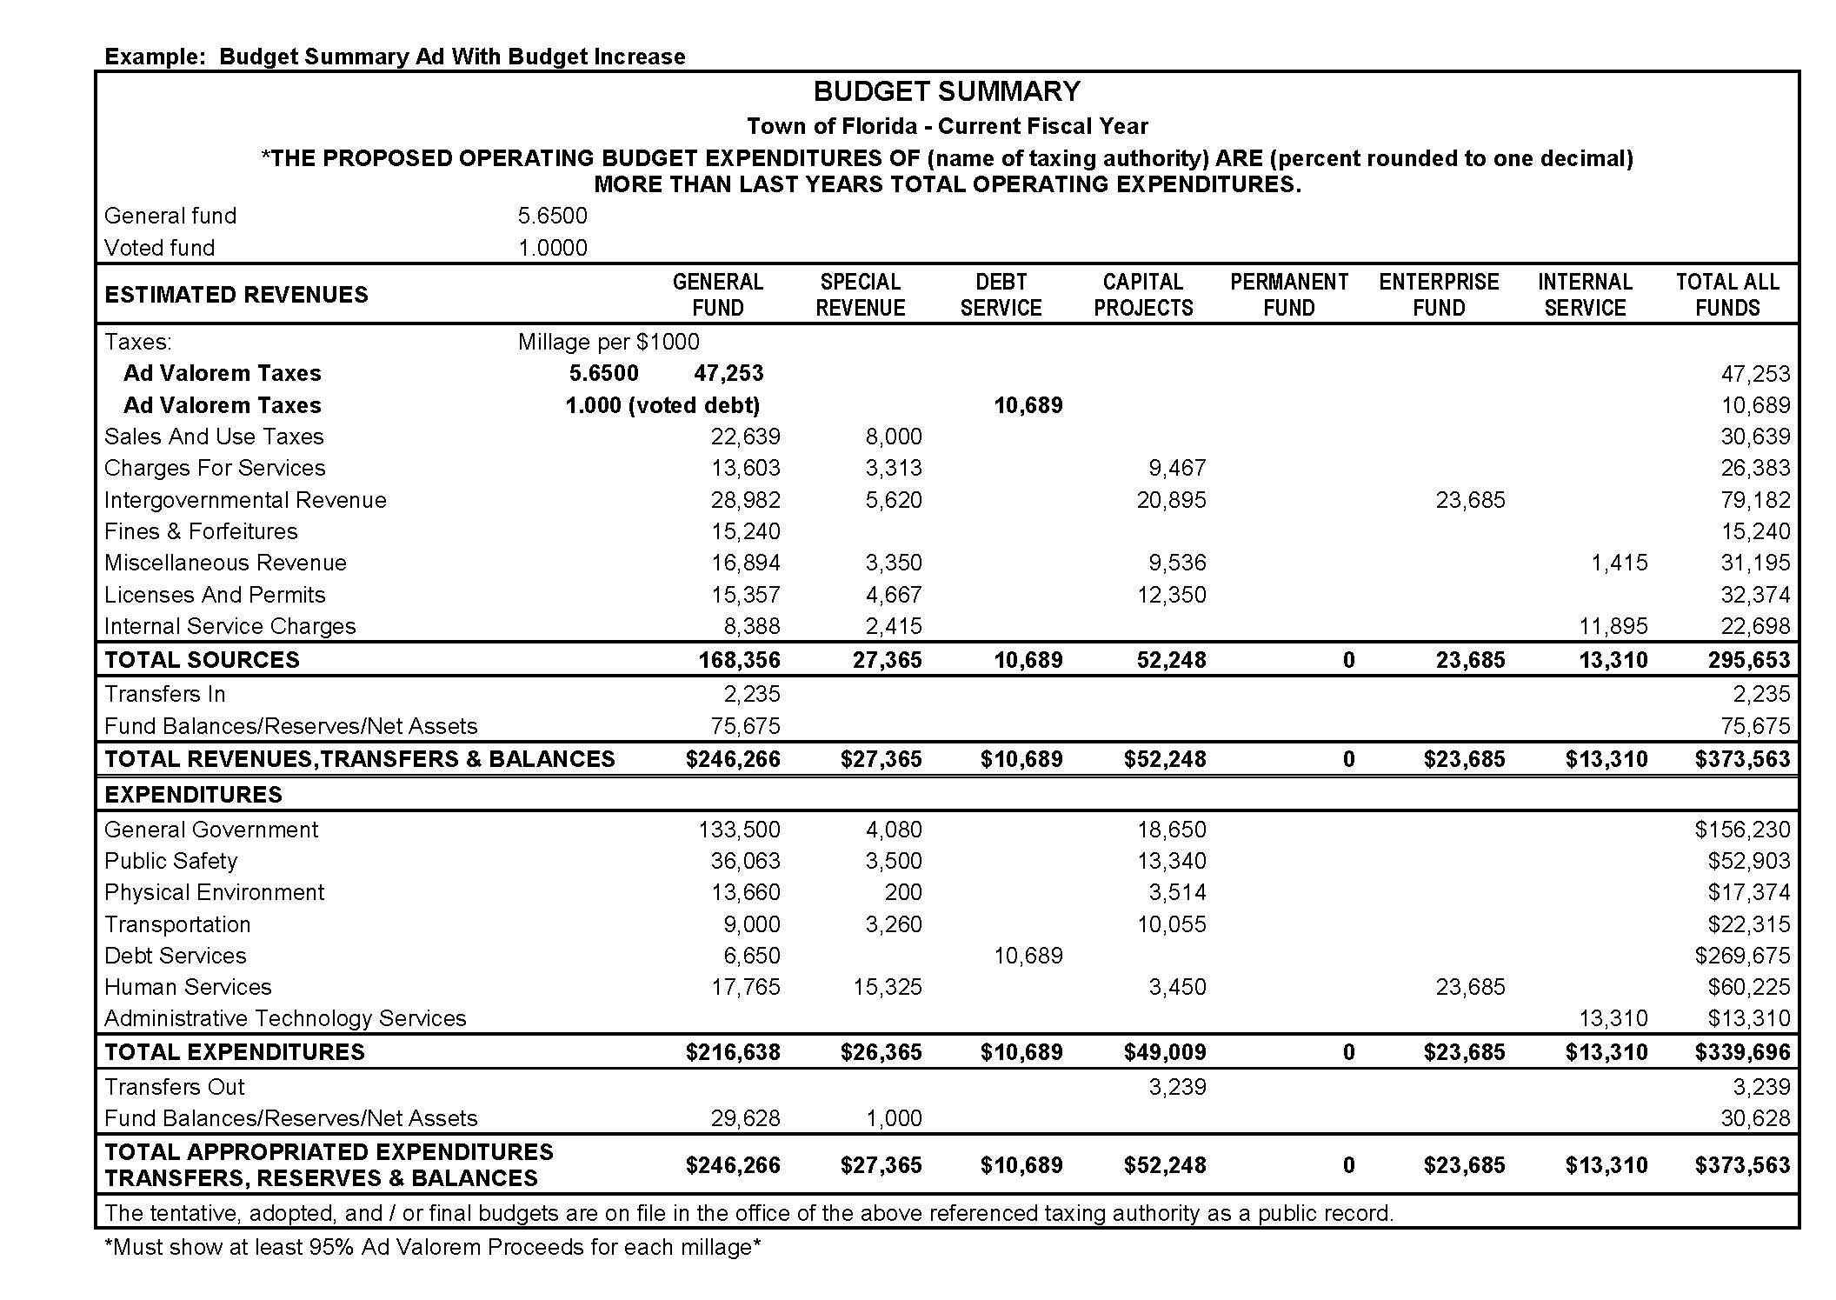
TRIM Advertising Requirements
Budget Summary Ad
Percentage example:
If calculations equal 8.45%,
input 8.5%.
Verify the budget is balanced.

Slide 67
TRIM Advertising Requirements
Recessed Hearing Information
If the hearing is recessed, the taxing authority must publish a Notice of Continuation in a newspaper of general circulation in the county.
The notice will state the time, date, and location of the hearing.
Do not adjourn the hearing. The hearing is to be recessed.

Slide 68
TRIM Advertising Requirements
Recessed Hearing Information
EXAMPLE
NOTICE OF CONTINUATION
The tentative/final budget hearing held on (date of hearing)
for the (name of taxing authority) was recessed and will be continued on
(date, time, and location of new hearing).
(Include name of town)

Slide 69
Newspaper Example
Notice of Continuation

Slide 70
TRIM Advertising Requirements
Rescheduled Hearing Information Ad
If a hearing is postponed or rescheduled due to circumstances beyond its control, the taxing authority should publish a Notice of Rescheduled Hearing in a newspaper of general circulation in the county.
The notice must state the time, date, and location of the rescheduled hearing.

Slide 71
TRIM Advertising Requirements
Rescheduled Hearing Information Ad
EXAMPLE
NOTICE OF RESCHEDULED HEARING
The tentative/final hearing adopting a millage and budget on (hearing date)
for the (name of taxing authority) is being rescheduled due to (named storm).
A rescheduled (tentative/final) budget hearing will be held on:
(date, time, and meeting place).

Slide 72
Newspaper Example
Notice of Rescheduled Hearing

Slide 73
TRIM Advertising
Requirements
Proof of Publications
Submit one for each published advertisement.
If there is only one proof of publication, each published ad should be included in the same document
Submit with Certification of Compliance (Form DR-487).

Slide 74
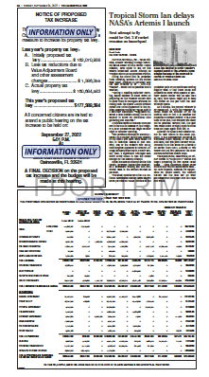
Tear Sheets
A tear sheet is an actual copy of the published newspaper ad.
Tear sheets are used as an alternative to submitting a newspaper.
They can be emailed with the package or individually.

Slide 75
Resolutions/Ordinances

Slide 76
TRIM
Resolution/Ordinance
The taxing authority cannot levy any millage until its governing board has approved a resolution or ordinance.

Slide 77
TRIM
Millage Resolution/Ordinance
The tentative and final resolution/ordinance adopting millage rates must include:
The TA’s name
The percentage increase over the rolled-back rate
Each adopted millage rate
The rolled-back rate

Slide 78
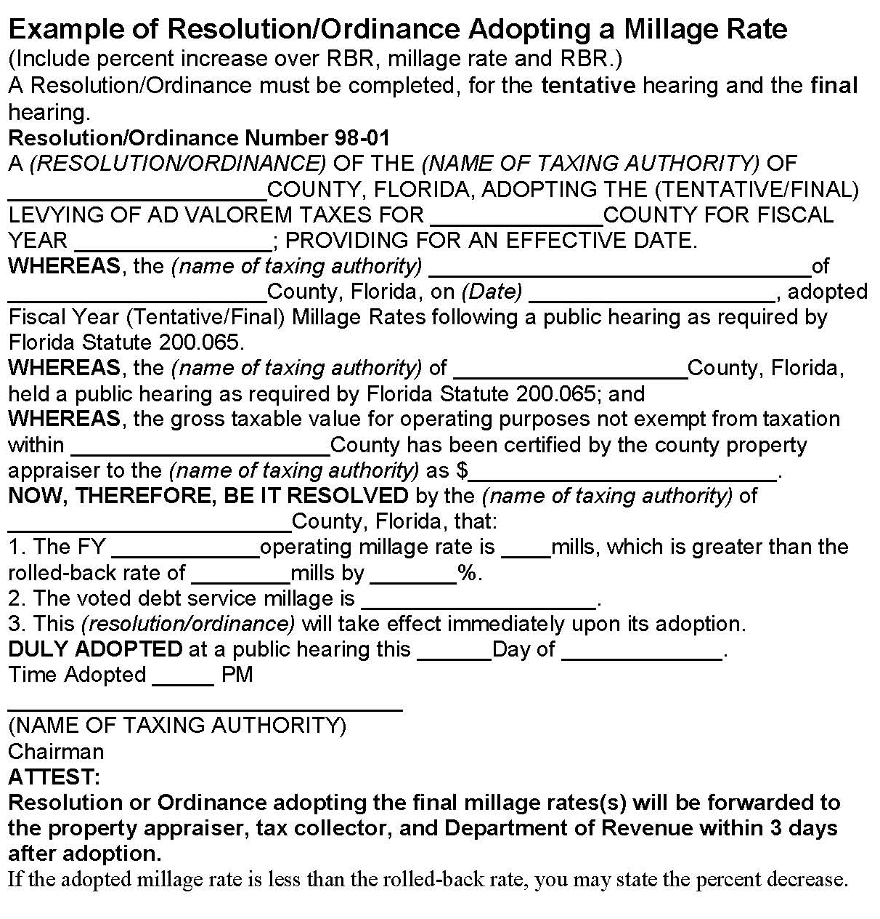
Millage Resolution/
Ordinance Ad
Roll-back rate reflected from
Form DR-420, Line 16
Millage rate reflected from Form DR-420MM, Line 15
Percentage increase reflected from Form DR-420, Line 27

Slide 79
TRIM
Budget Resolution/Ordinance
Must be adopted by separate vote after the millage adoption
If order of millage and budget adoption cannot be determined, send minutes of meeting
When the PA receives the resolution or ordinance, it is considered official notice of the millage rate the taxing authority approved.

Slide 80
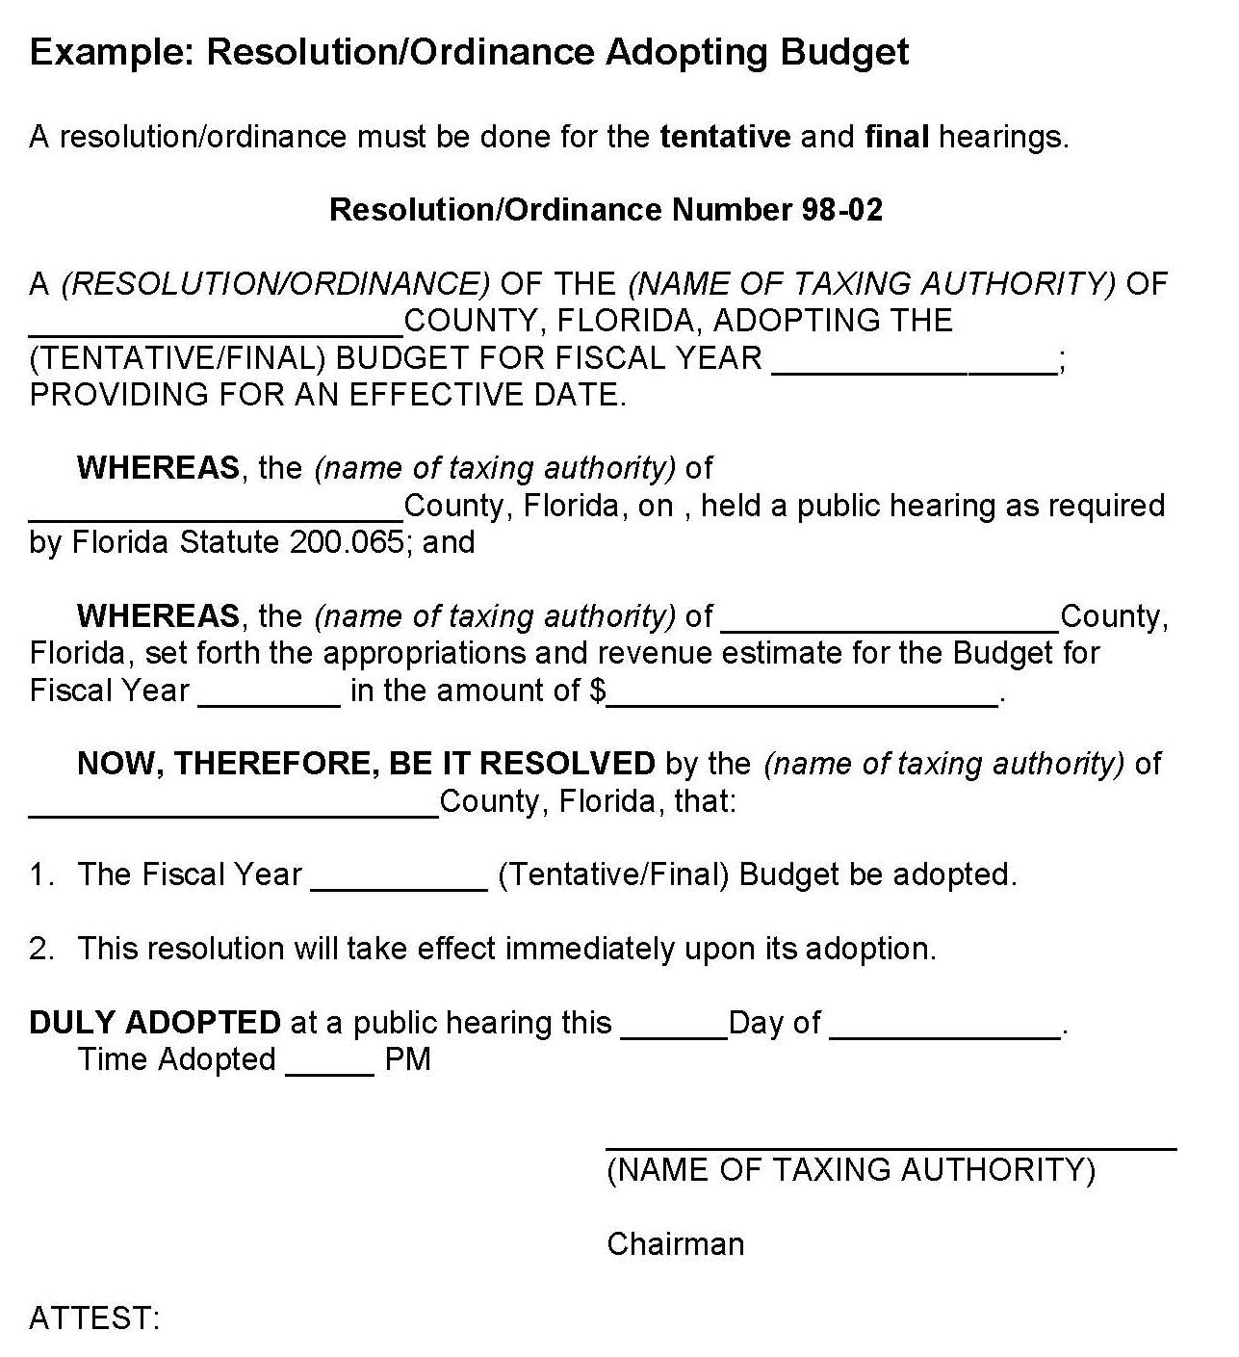
Budget Resolution

Slide 81
TRIM
Resolution/Ordinance
Within three days following the final hearing, forward the resolution/ordinance adopting final millage to the:
Property appraiser
Tax collector
The Department of Revenue

Slide 82
Certifying Compliance
to the Department

Slide 83
Certification of TRIM Compliance
Certification of Compliance (Form DR-487)
Maximum Millage Levy Calculation – Final Disclosure (Form DR-420MM)
Vote Record for Final Adoption of Millage Levy (Form DR-487V)
Certification of Voted Debt Millage (Form DR-420DEBT)
Certification of Final Taxable Value (Form DR-422)

Slide 84
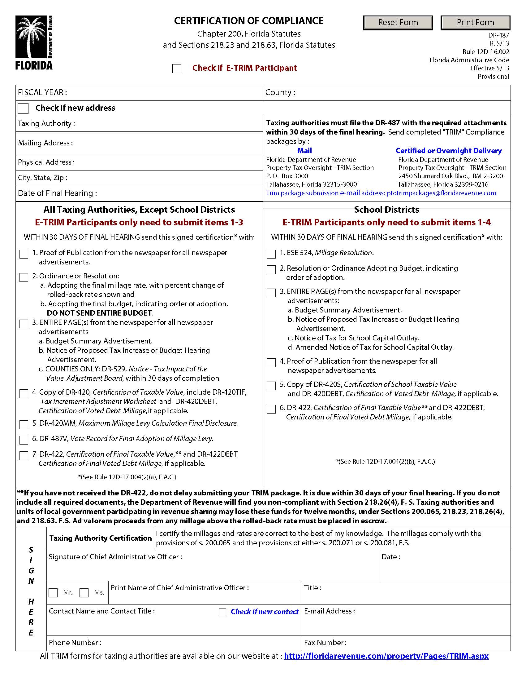
Certification of Compliance
(Form DR-487)

Slide 85
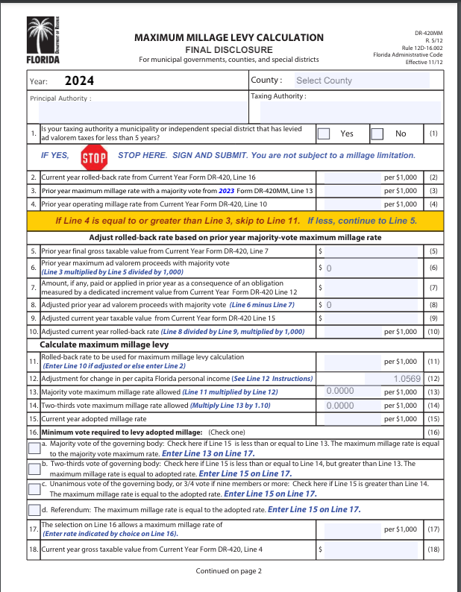
Maximum Millage
Levy Calculation
Final Disclosure
(Form DR-420MM)

Slide 86
Vote Record for
Final Adoption of
Millage Levy
(Form DR-487V)

Slide 87
Electronic Submission
When submitting the TRIM compliance package to the Department’s TRIM section electronically, the package must include:
  Form DR-487
  Resolution/ordinance adopting the final millage rate
  Resolution/ordinance adopting the final budget
  Entire page of the newspaper or screenshots for the publicly accessible website for TRIM advertisements
  Proof of publications for all TRIM advertisements
  All TRIM forms

Slide 88
TRIM
Value Adjustment Board Information
The VAB has five members:
Two from the county’s board of county commissioners
One from the county’s school board
Two citizens
The purpose of the VAB is to hear appeals regarding:
Property value assessments
Denied exemptions or classifications
Ad valorem tax deferrals, portability decisions,
and change of ownership or control

Slide 89
TRIM
Value Adjustment Board Information
The VAB meets 30 – 60 days after mailing of the TRIM notice.
The VAB remains in session from day to day until the board has heard all petitions, complaints, appeals, and disputes.

Slide 90
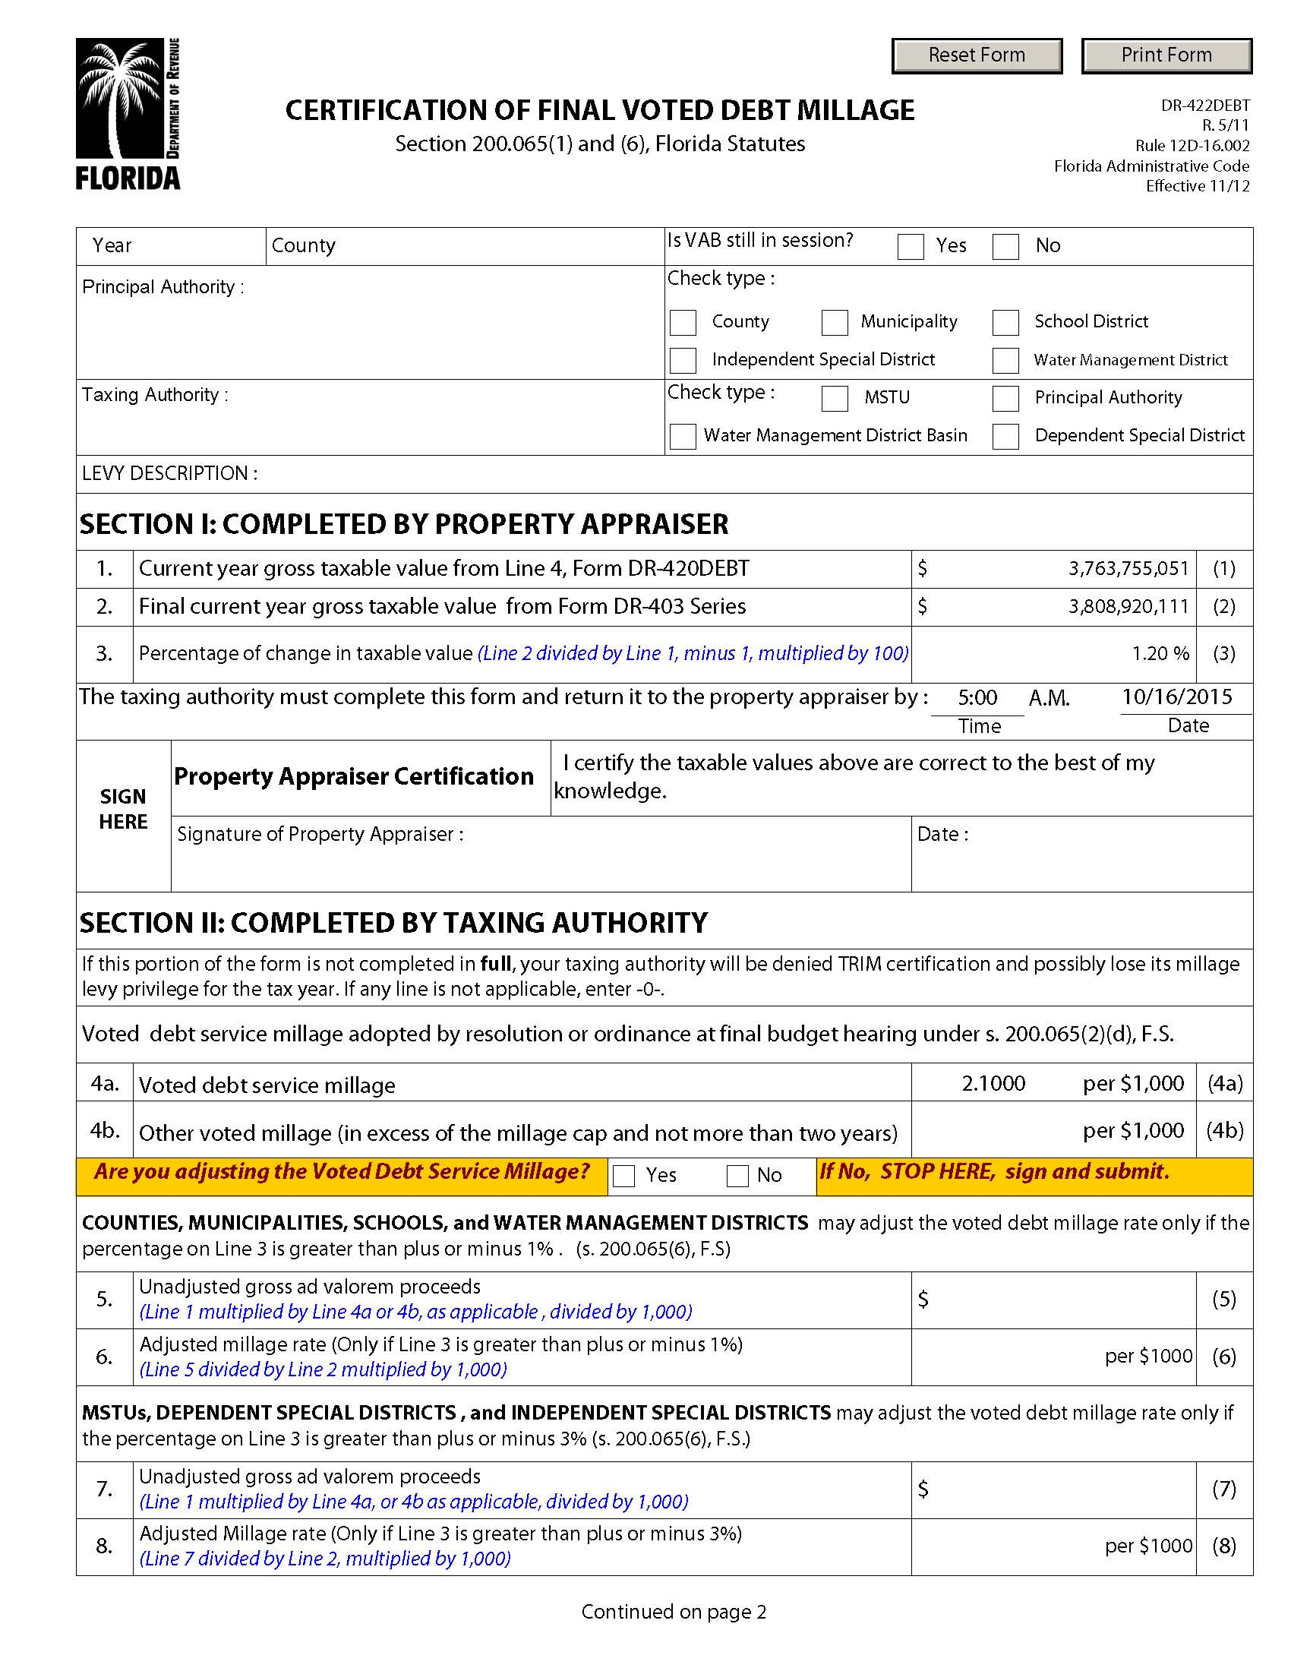
Final Taxable Value
Forms
Certification of Final Taxable Value
(Form DR-422)
Certification of Final Voted Debt Millage (Form DR-422DEBT)

Slide 91
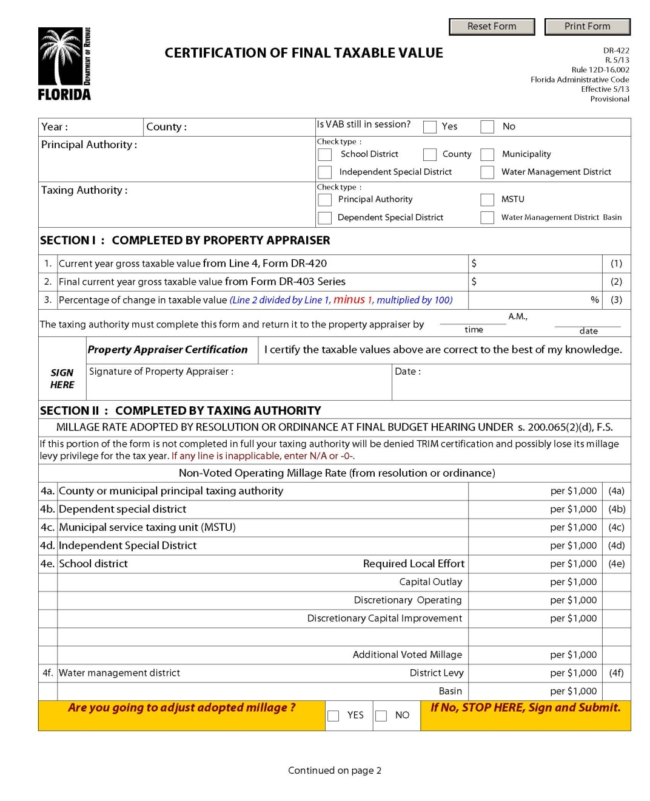
Certification of
Final Taxable Value
(Form DR-422)

Slide 92
Certification of
Final Taxable Value
(Form DR-422)
The TA may adjust millage rate.

Slide 93
Certification of Final
Voted Debt Millage
(Form DR-422DEBT)

Slide 94
2023 Top Infractions and Violations
1. Tax levy incorrect/percent increase incorrect
2. Percent Increase over the Roll-Back-Rate is not shown or is incorrect (ordinance/resolution)
3. Late package
4. Incorrect verbiage in advertisement
5. Budget not balanced

Slide 95
Notice of Proposed Tax Increase Ad
If Line A Is Less
than Line C
If Line A is Greater
than Line C

Slide 96
Percent Increase Over RBR Not Shown or Incorrect
The resolution or ordinance must include the:
Name of the taxing authority
Rolled-back rate
Percentage increase over the rolled-back rate
Final adopted millage rate

Slide 97
Late Package Example
Continued

Slide 98
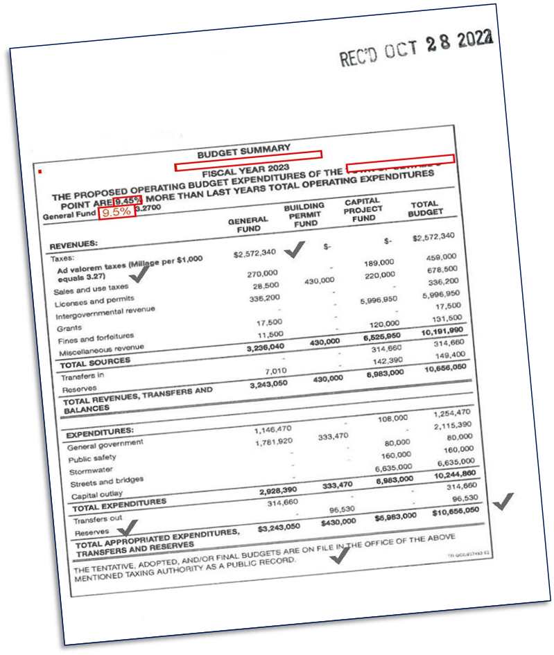
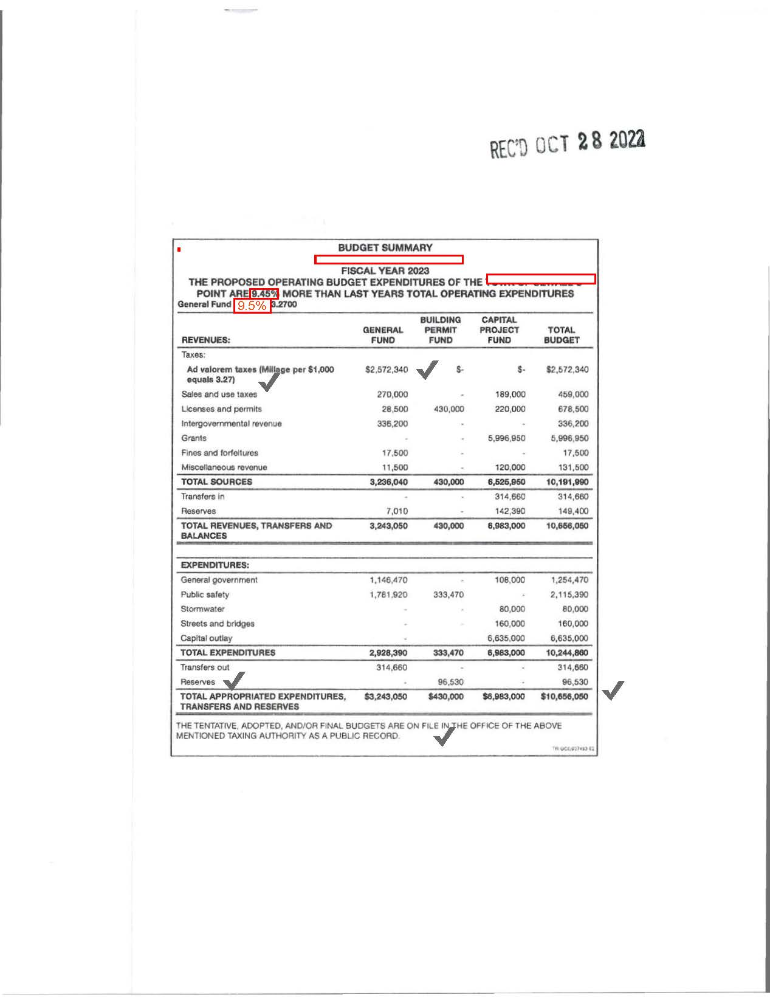
Incorrect Verbiage

Slide 99
Budget is Not Balanced

Slide 100
To Help Prevent Infractions
To help prevent infractions, submit a copy of your ads, resolutions, and calculations to the TRIM team at TRIM@floridarevenue.com BEFORE publishing to ensure compliance.

Slide 101
TRIM Compliance Contacts
TRIM STAFF | PHONE NUMBER
Wyatt Peters | (850) 617-8921
Kendall Tolbert | (850) 617-8861
Breauna Hines | (850) 617-8923
Roberta Epp | (850) 617-8890
Dianne Porter | (850) 617-8920
Fax Number | (850) 617-6115
TRIM Email Address eTRIM Email Address | TRIM@floridarevenue.com eTRIM@floridarevenue.com

Slide 102
Thank you for your participation today!

