Slide 1
Training For School Districts 2024
Presented by
Wyatt Peters and Roberta Epp, Truth In Millage Process
Property Tax Oversight

Slide 2
Overview
Introduction
TRIM Timetable
TRIM Certification Forms
TRIM Advertising Requirements
TRIM Hearing Requirements
Resolutions/Ordinances
Certifying Compliance to the Department
2023 Top Infractions and Violations
TRIM Compliance Contacts

Slide 3
Introduction
TRIM process and the public
Chapter 200, Florida Statutes

Slide 4
TRIM Timetable

Slide 5
TRIM Timetable
The property appraiser (PA) provides total assessed value of nonexempt property to taxing authorities by June 1 for budget planning purposes.
1
Jan
Feb
Mar
Apr
May
Jun
Jul
Aug
Sep
Oct
Nov
Dec
The PA certifies the school district’s taxable value on Certification of School Taxable Value (Form DR-420S).

Slide 6
TRIM Timetable Day 1 = July 1
The first day of the TRIM process is July 1 or the date of certification of taxable value, whichever is later.
1
Jan
Feb
Mar
Apr
May
Jun
Jul
Aug
Sep
Oct
Nov
Dec
Day 1

Slide 7
TRIM Timetable Day 24 = July 24
Within 24 days of date of certification of taxable value, the superintendent submits the budget to the board for approval.
24
Jan
Feb
Mar
Apr
May
Jun
Jul
Aug
Sep
Oct
Nov
Dec
Day 24

Slide 8
TRIM Timetable Day 29 = July 29
Within 29 days of date of certification of taxable value, the school district shall advertise its intent to adopt a tentative budget and millage rates.
29
Jan
Feb
Mar
Apr
May
Jun
Jul
Aug
Sep
Oct
Nov
Dec
Day 29

Slide 9
TRIM Timetable
Within two to five days of the advertisements publicizing the tentative budget hearing, each school district should hold a public hearing on the tentative budget and millage.
public hearing
ADVERTISEMENT
DAY 1
DAY 2
DAY 3
DAY 4
DAY 5

Slide 10
TRIM Timetable Day 35 = August 4
Within 35 days of certification of value, each school district must inform the PA of:
Prior year millage rate
Current year proposed millage rate
Current year rolled-back rate
The date, time, and meeting place of the final budget hearing for school districts
4
Jan
Feb
Mar
Apr
May
Jun
Jul
Aug
Sep
Oct
Nov
Dec
Day 35

Slide 11
TRIM Timetable
If a school district fails to provide the information required within 35 days, it will be prohibited from levying a millage rate greater than the rolled-back rate for the upcoming year.
The PA will compute the rolled-back rate and use it to prepare the Notice of Proposed Property Taxes.

Slide 12
TRIM Timetable Day 55 = August 24
The PA should mail the Notice of Proposed Property Taxes (TRIM notice) no later than 55 days after certification of value.
If the Department issues a review notice, the PA cannot send the TRIM notice until the Department has approved the assessment roll.
24
Jan
Feb
Mar
Apr
May
Jun
Jul
Aug
Sep
Oct
Nov
Dec
Day 55

Slide 13
TRIM Timetable Days 65-80 = Sept. 3-18
The school district should hold a public hearing on the final budget and final millage rates 65 to 80 days after certification of value.
This hearing is published on the TRIM notice the PA mails.
3
18
Jan
Feb
Mar
Apr
May
Jun
Jul
Aug
Sep
Oct
Nov
Dec
Day 65-80

Slide 14
TRIM Timetable
At the final hearing, the school district will:
Amend the tentatively adopted budget and millage rates
Publicly announce the percentage increase in the re-computed millage over the rolled-back rate
Adopt final millage rates and final budget
If the adopted millage rate exceeds the tentatively adopted rate, each taxpayer in the jurisdiction will be notified of the increase by first class mail at the taxing authority’s expense.

Slide 15
TRIM Timetable
Within three days of the final hearing:
The school district will forward the resolution or ordinance adopting the final millage rate to the PA, tax collector, and Department of Revenue.
When the PA receives the resolution or ordinance, notification of the final millage rate is considered official.

Slide 16
TRIM Timetable
No taxing authority may levy a millage other than one approved by referendum until the taxing authority’s governing board approves the resolution or ordinance to levy and submits it to the PA, tax collector, and Department of Revenue.

Slide 17
TRIM Timetable
Before the extension of the rolls, the PA will notify each taxing authority of the aggregate change in the assessment roll on Form DR-422.

Slide 18
3
TRIM Timetable
Within three days after receiving Form DR-422, the school district will complete and certify the final millage rates to the PA.

Slide 19
TRIM Timetable
Within 30 days of the Final Hearing, the school district must certify compliance to the Department of Revenue.
Do not wait to certify compliance if you have not received Form DR-422 from the PA.
Complete Form DR-422 as soon as you receive it and submit it to the PA and to the Property Tax Oversight TRIM section.
Certify compliance with the Department
FINAL HEARING
1 | 2 | 3 | 4 | 5 | 6 | 7 | 8 | 9 | 10 | 11 | 12 | 13 | 14 | 14 | 15 | 16 | 17 | 18 | 19 | 20 | 21 | 22 | 23 | 24 | 25 | 26 | 27 | 28 | 29 | 30 | 31
Number of days

Slide 20
Important to Remember
If a package is received more than 30 days after the final hearing date, it is considered late, which results in an infraction.
Notes:
New Slide

Slide 21
TRIM Certification Forms

Slide 22
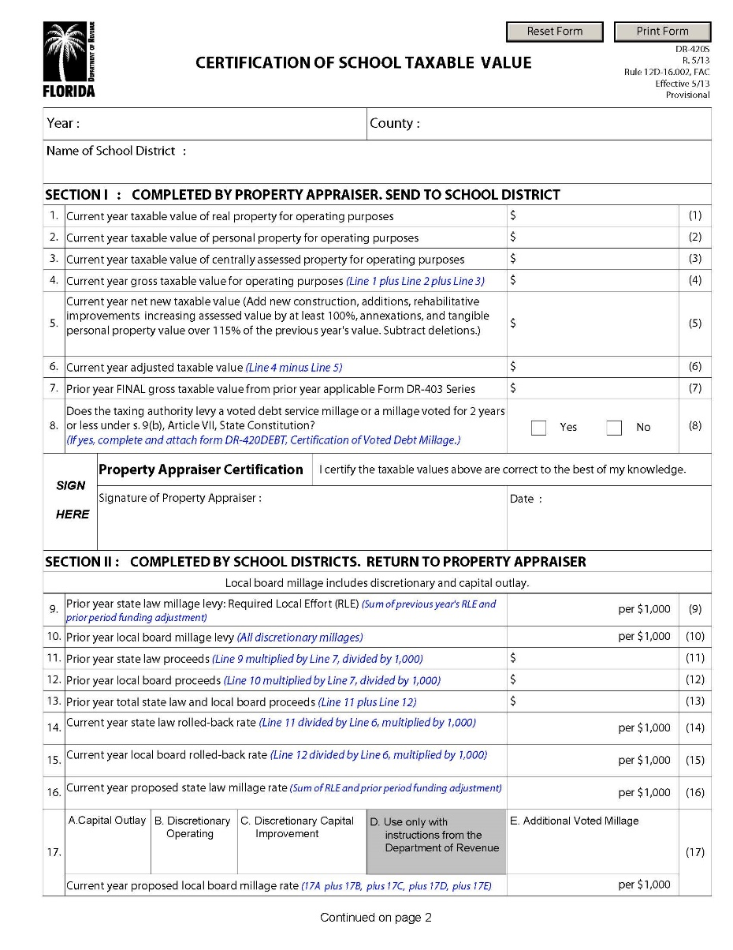
TRIM Certification Forms
Certification of School Taxable Value (Form DR-420S)
Certification of Voted Debt Millage (Form DR-420DEBT)

Slide 23
DR-420S

Slide 24
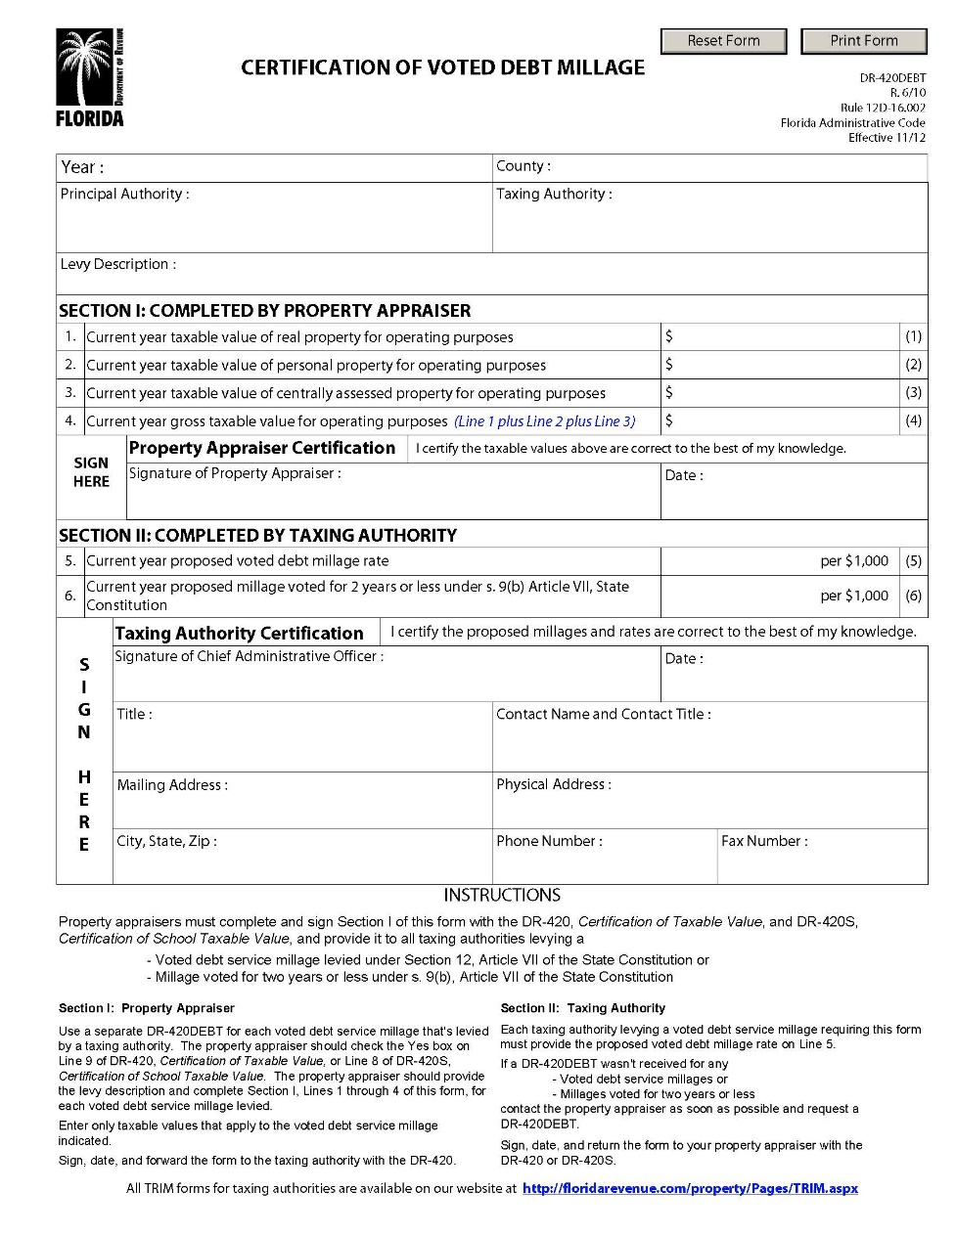
DR-420DEBT

Slide 25
TRIM Advertising Requirements

Slide 26
TRIM Advertising Requirements
Types of TRIM advertisements include:
Notice of Budget Hearing
Notice of Proposed Tax Increase
Notice of Tax for School Capital Outlay
Budget Summary
Amended Notice of Tax for School Capital Outlay
Notice of Continuation
Notice of Rescheduled Hearing

Slide 27
TRIM Advertising Requirements Newspaper Requirements
School districts must select the appropriate newspaper advertisement to announce the tentative TRIM hearing. All TRIM advertisements must:
Be published as provided in chapter 50
Appear in a newspaper of general circulation in the county or in its geographically limited insert
Be adjacent to accompanying TRIM ads
Be submitted with proof of publication and the entire page of the newspaper on which they appear

Slide 28
TRIM Advertising Requirements Newspaper Requirements
TRIM newspaper advertisements cannot:
Appear in the legal or classified section
Deviate from the language specified in s. 200.065, F.S.
Be accompanied, preceded, or followed by other ads or notices which conflict with or contradict the required publications (s. 200.065(3)(h), F.S.)
Be combined. The ads must be separate and adjacent (s. 200.065(3)(l), F.S.)

Slide 29
TRIM Advertising Requirements Newspaper Requirements
“Adjacent to,” when used in reference to newspaper advertisements, means next to, touching, or contiguous, either at the sides or at the corners.
This term includes ads placed adjacent to one another, either on the same page or on adjoining pages with a crease separating them, so that a reader may view the ads simultaneously when the pages are open on a flat surface.

Slide 30
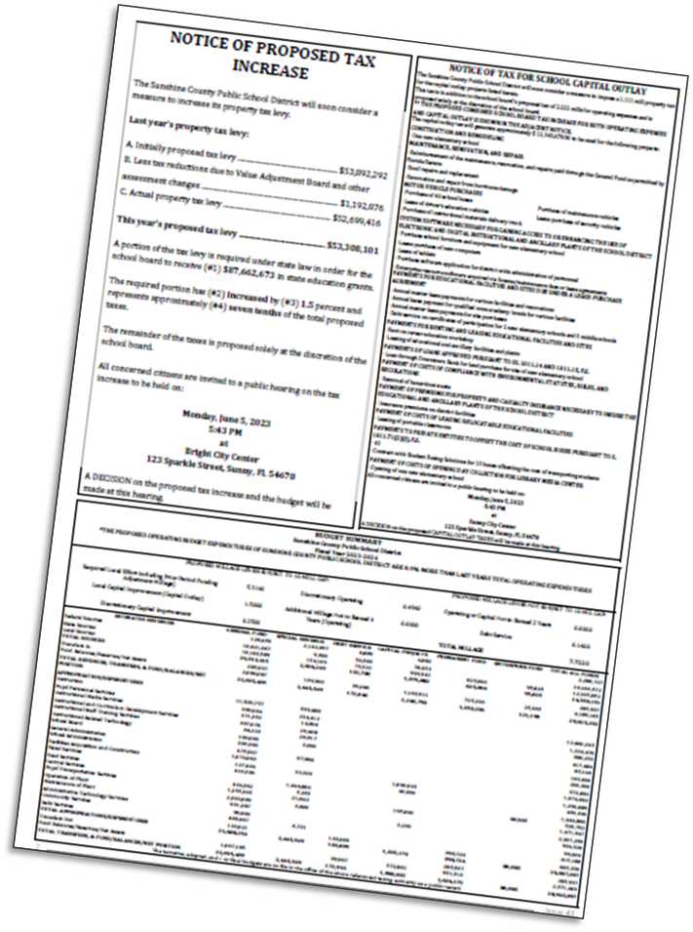
Adjacent Newspaper Example

Slide 31
TRIM Advertising Requirements Publication on a Publicly Accessible Website
School Districts may also publish TRIM advertisements on the publicly accessible website of the school district if the school board’s website satisfies the requirements of s. 50.0311, F.S.
A TA in a county with fewer than 160,000 residents must hold a public hearing noticed in the newspaper to make a determination that the residents have sufficient access to the internet by broadband service.
A multi-county taxing authority that chooses this option must publish the ads on the website of each county it spans.
Notes:
Updated Language with Bullet Points

Slide 32
TRIM Advertising Requirements Publication on a Publicly Accessible Website
TAs that use this option shall provide notice once per year in a newspaper of general circulation or other publication that is mailed or delivered to all residents and property owners throughout the TA’s jurisdiction.
The notice must indicate that the owners and residents may receive legal ads and notices from the TA by first-class mail or email after making a request and registering their names and addresses or email addresses with the TA.
A link to the advertisements shall be prominently placed on or accessible through a direct link from the website homepage of the county and the website homepage of the TA (see s. 50.0311, F.S., for additional requirements).
Notes:
Updated Language with Bullet Points

Slide 33
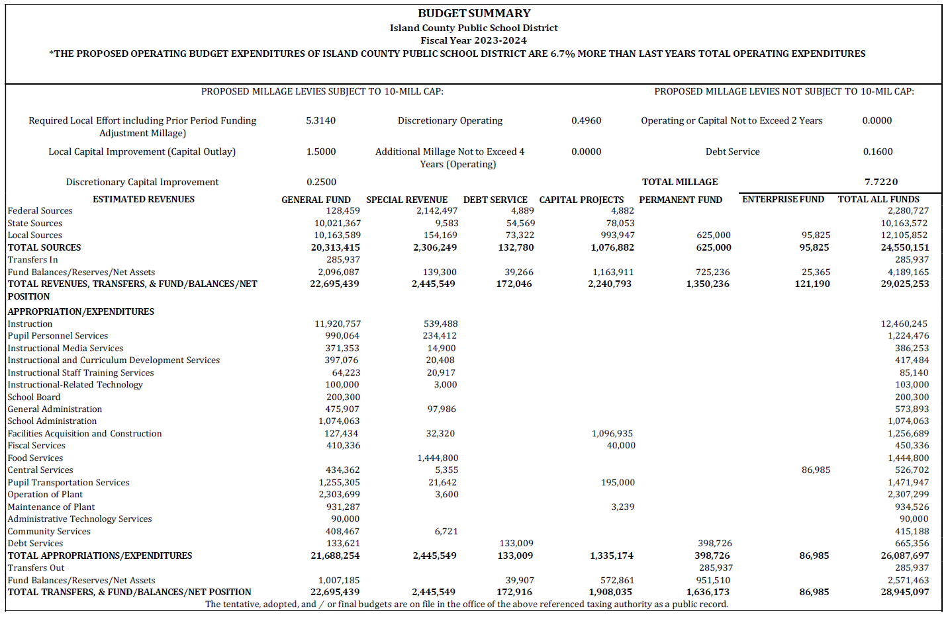
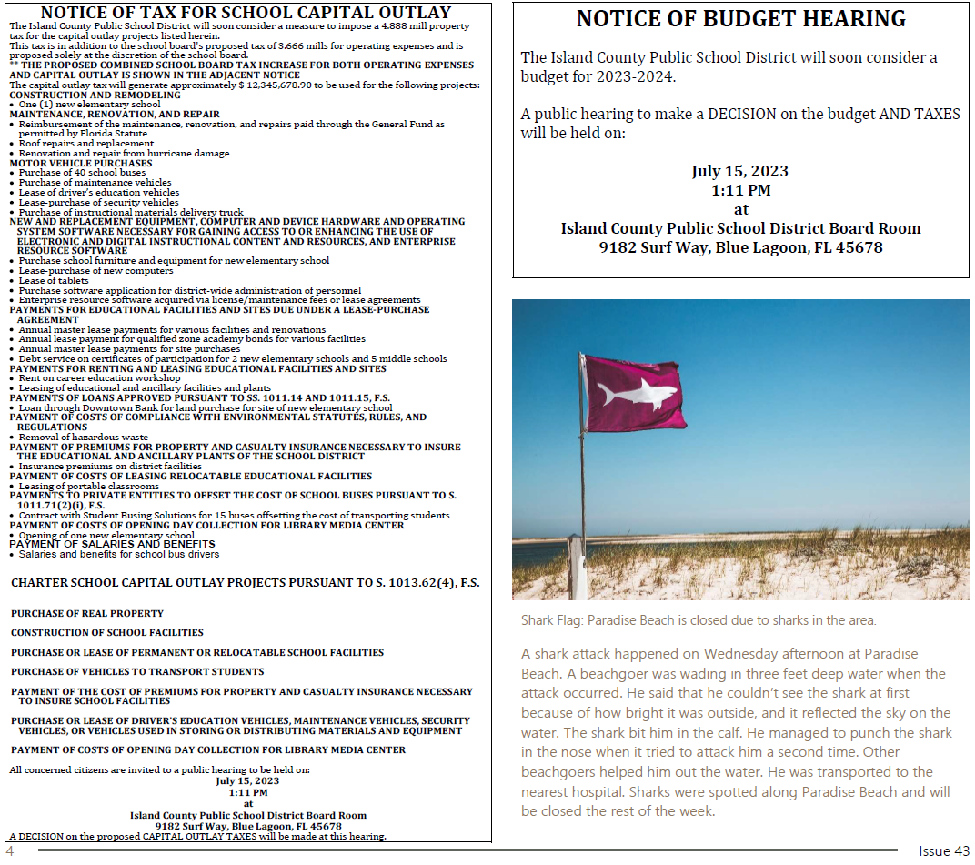
TRIM Advertising Requirements Notice of Budget Hearing Ad
The school district uses the Notice of Budget Hearing ad when the school district proposes a millage rate that is equal to or less than the current year’s rolled back rate.

Slide 34
TRIM Advertising Requirements
The Notice of Budget Hearing does not have a size requirement. The ad must:
Be published within 29 days of certification of taxable value
Not deviate from the specified language
Have an adjacent Budget Summary ad and Notice of Capital Outlay ad, if applicable
The taxing authority must hold the hearing two to five days after ads are published.
public hearing
AD PUBLISHED
DAY 1
DAY 2
DAY 3
DAY 4
DAY 5

Slide 35
TRIM Advertising Requirements Notice of Budget Hearing Ad Example
NOTICE OF BUDGET HEARING
The (name of school district) will soon consider a budget for (fiscal year). A public hearing to make a DECISION on the budget AND TAXES will be held on
(date and time)
at
(meeting place)

Slide 36
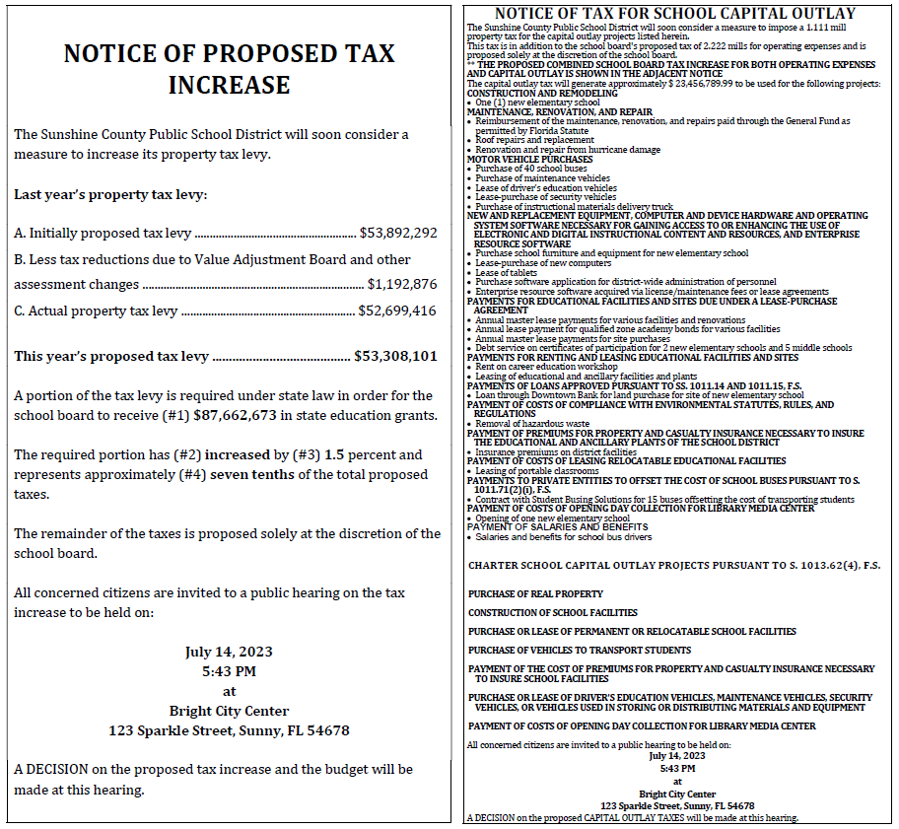
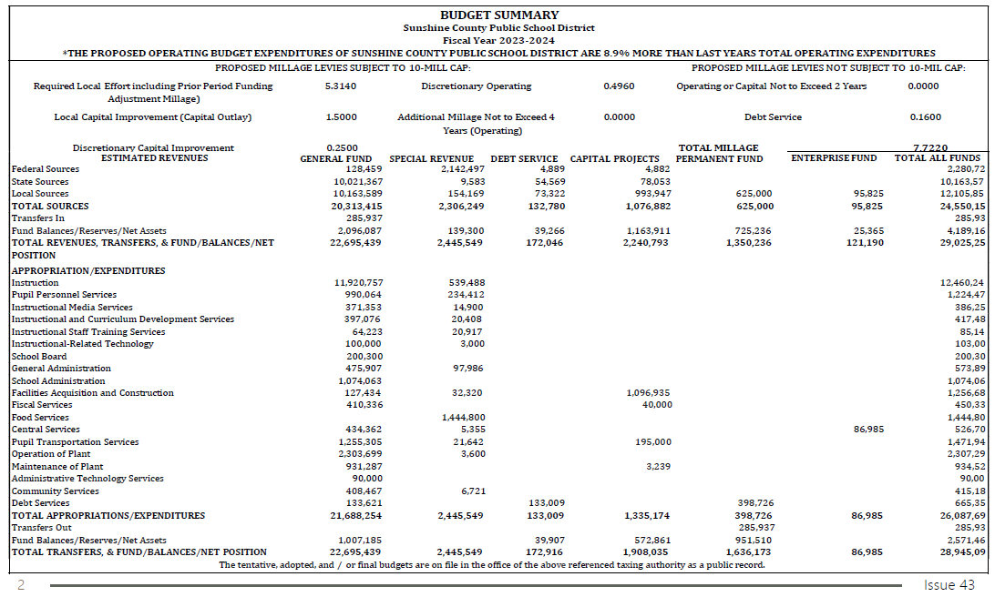
TRIM Advertising Requirements Notice of Proposed Tax Increase Ad
The school district uses the Notice of Proposed Tax Increase ad if the school district proposes a millage rate greater than the current year’s rolled back rate.

Slide 37
TRIM Advertising Requirements
The Notice of Proposed Tax Increase ad must:
Be published within 29 days of certification of taxable value
Use 100% of tax levies
Be a quarter page of the newspaper
Have an adjacent Budget Summary ad and a Notice of Capital Outlay ad (if applicable)
Not deviate from the specified language
The taxing authority must hold the hearing two to five days after the ads are published.
public hearing
AD PUBLISHED
DAY 1
DAY 2
DAY 3
DAY 4
DAY 5

Slide 38
TRIM Advertising Requirements Notice of Proposed Tax Increase Ad Example

Slide 39
TRIM Advertising Requirements Notice of Proposed Tax Increase Ad
Example if Line A is less than Line C

Slide 40
TRIM Advertising Requirements Notice of Tax for School Capital Outlay
If a school district intends to levy capital outlay taxes, then the school district must advertise its intent in an advertisement headed “Notice of Tax for School Capital Outlay.”

Slide 41
TRIM Advertising Requirements
The Notice of Tax for School Capital Outlay must:
Be a quarter page of the newspaper
Be adjacent to the Notice of Proposed Tax Increase or Budget Hearing and Budget Summary
Specify the projects and number of school buses the additional taxes will fund
Not deviate from the specified language

Slide 42
TRIM Advertising Requirements School Capital Outlay Categories
New Construction and Remodeling
Maintenance, Renovation, and Repair
Motor Vehicle Purchases (specify number of buses)
New and Replacement Equipment, Computer and Device Hardware and Operating System Software Necessary for Gaining Access to or Enhancing the Use of Electronic and Digital Instructional Content and Resources, and Enterprise Resource Software
Categories continue on next slide.

Slide 43
TRIM Advertising Requirements School Capital Outlay Categories
Payments for educational facilities and sites due under a lease purchase agreement
Payments for renting and leasing educational facilities and sites
Payments of loans approved pursuant to ss. 1011.14 and 1011.15, F.S.
Payment of costs of compliance with state and federal environmental statutes, rules, and regulations
Categories continue on next slide.

Slide 44
TRIM Advertising Requirements School Capital Outlay Categories
Payment of premiums for property and casualty insurance necessary to insure the educational and ancillary plants of the school district
Payment of costs of leasing relocatable educational facilities
Payments to private entities to offset the cost of school buses pursuant to s. 1011(2)(i), F.S. (specify number of buses)
Payment of cost of opening day collection for library media center
Payment of salaries and benefits
Categories continue on next slide.

Slide 45
TRIM Advertising Requirements Charter School Capital Outlay Projects
Purchase of real property
Construction of school facilities
Purchase or lease of permanent or relocatable school facilities
Purchase of vehicles to transport students
Payment or lease of driver’s education vehicles, maintenance vehicles, security vehicles, or vehicles used in storing or distributing materials and equipment
Categories continue on next slide.

Slide 46
TRIM Advertising Requirements Charter School Capital Outlay Projects
Computer and device hardware and operating system software necessary for gaining access to or enhancing the use of electronic and digital instructional content and resources, and enterprise resources software
Payment of costs of opening day collection for library media center
All concerned citizens are invited to a public hearing to be held on (date and time) at (meeting place). A DECISION on the proposed CAPITAL OUTLAY TAXES will be made at this hearing.

Slide 47
TRIM Advertising Requirements Notice of Tax for School Capital Outlay Example
Ad example continues on next slide.

Slide 48
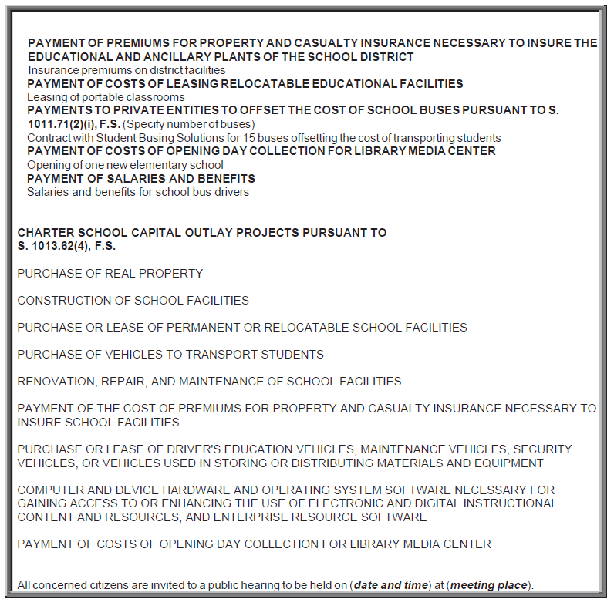
TRIM Advertising Requirements Notice of Tax for School Capital Outlay Example (Continued)

Slide 49
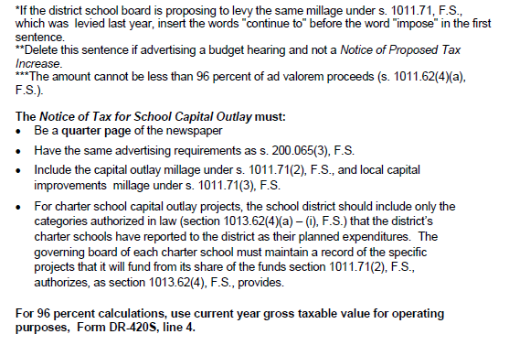
TRIM Advertising Requirements Notice of Tax for School Capital Outlay Example

Slide 50
TRIM Advertising Requirements Budget Summary Advertisement
An adjacent Budget Summary advertisement must accompany all required TRIM advertisements.
This summary must show the proposed tax millages, balances, reserves, and total of each major classification of receipts and expenditures.

Slide 51
TRIM Advertising Requirements Budget Summary Advertisement
The Budget Summary ad must:
Have an adjacent quarter page Notice of Proposed Tax Increase or Notice of Budget Hearing advertisement
Have an adjacent Notice of Tax for School Capital Outlay advertisement if applicable
Show all proposed millage rates applicable to school district
Required Local Effort (RLE) including prior period funding adjustment
Capital Outlay
Discretionary Operating
Discretionary Capital Improvement
Additional Voted Millage
Voted Debt Service
Continued

Slide 52
TRIM Advertising Requirements Budget Summary Advertisement
Show all funds
Have a balanced budget; balance all funds and the total of all funds
Include the statement of increase in operating expenditures in bold type if the proposed operating budget expenditures for the upcoming year are greater than those of the current year

Slide 53
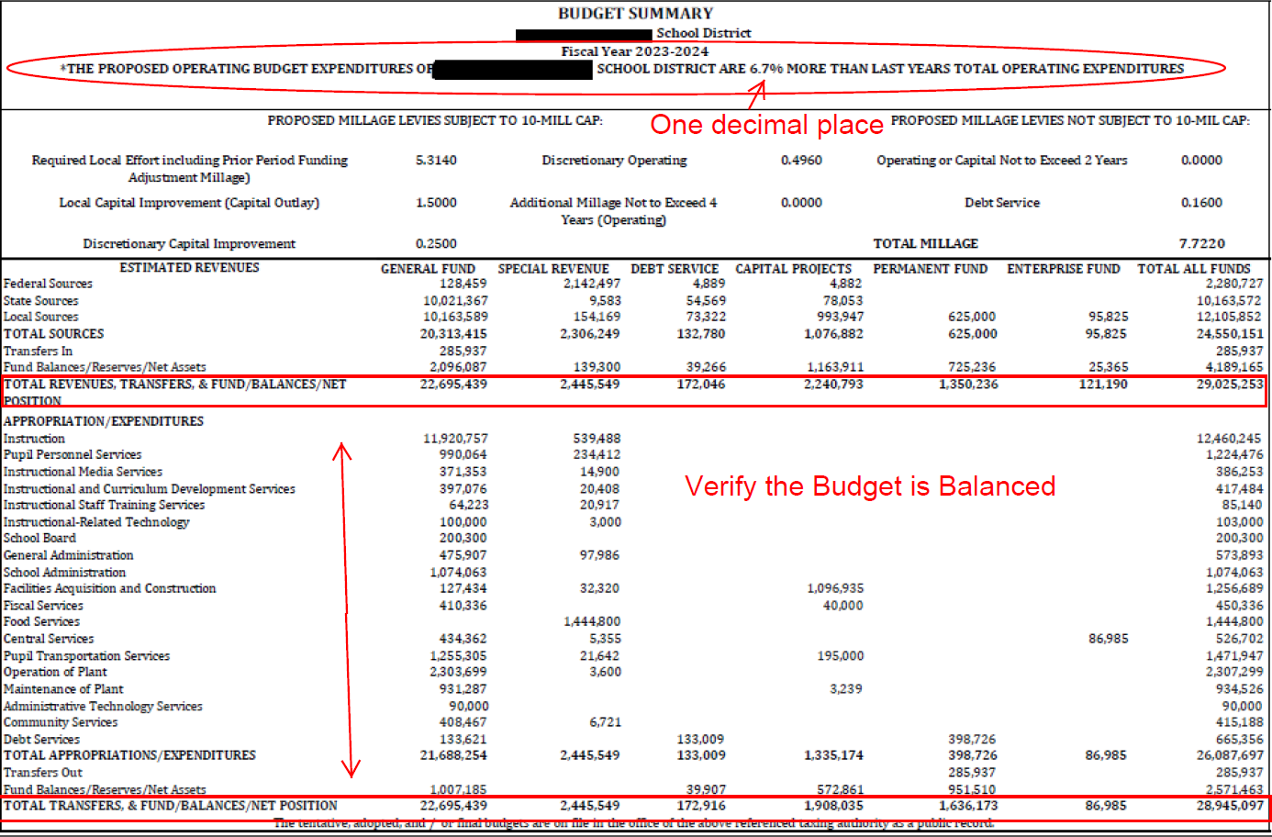
TRIM Advertising Requirements Budget Summary Example

Slide 54
TRIM Advertising Requirements Amended Notice of Tax for School Capital Outlay
If a school district needs to amend the list of capital outlay projects it previously advertised or adopted, the school district must publish an Amended Notice of Tax for School Capital Outlay ad.

Slide 55
TRIM Advertising Requirements Amended Notice of Tax for School Capital Outlay
The Amended Notice of Tax for School Capital Outlay ad must be published any time the school district proposes an amendment to the previously advertised and adopted Notice of Tax for School Capital Outlay.
Projects must be listed under each category of new, amended or deleted. Categories/projects without a change may be omitted.
The ad must be a quarter page of the newspaper.

Slide 56
TRIM Advertising Requirements Amended Notice of Tax for School Capital Outlay Ad Example

Slide 57
TRIM Advertising Requirements Notice of Continuation Ad
If circumstances beyond the school district’s control cause the hearing to be recessed, the school district must publish a Notice of Continuation.
The hearing should be recessed, not adjourned.

Slide 58
TRIM Advertising Requirements Notice of Continuation Ad
Must not deviate from the specified language
Has no size requirement
Requires no accompanying ads
The school district must hold the hearing two to five days after the ad is published.
public hearing
AD PUBLISHED
DAY 1
DAY 2
DAY 3
DAY 4
DAY 5

Slide 59
TRIM Advertising Requirements Notice of Continuation Ad Example
NOTICE OF CONTINUATION
The tentative/final budget hearing held on (Date of hearing)
For the (name of school district) was recessed and will be continued on
(Date, time, and location of new hearing).
(Include name of town)

Slide 60
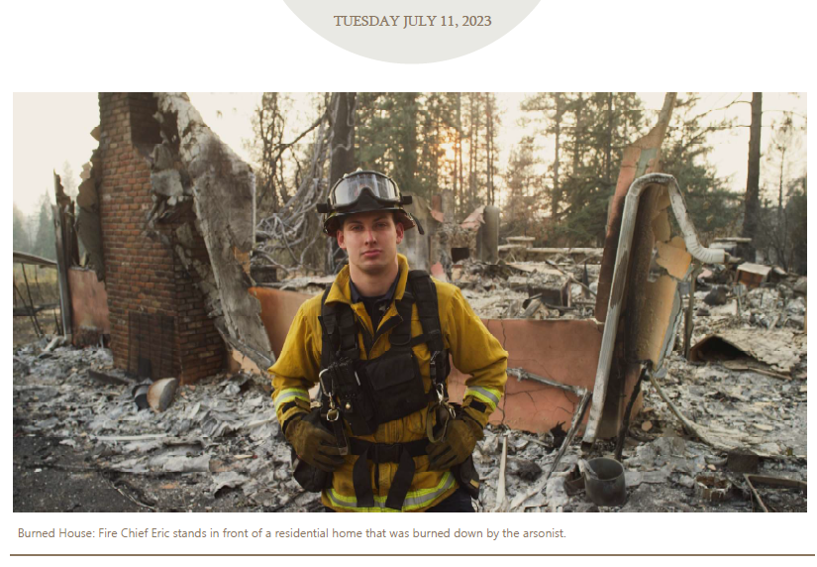
Newspaper Example Notice of Continuation

Slide 61
TRIM Advertising Requirements Notice of Rescheduled Hearing Ad
If a hearing is postponed or rescheduled due to circumstances beyond its control, the school district should publish a Notice of Rescheduled Hearing in a newspaper of general circulation in the county.
The notice will state the time, date, and location of the rescheduled hearing.

Slide 62
TRIM Advertising Requirements Notice of Rescheduled Hearing Ad
The Notice of Rescheduled Hearing ad:
Must not deviate from the specified language
Has no size requirement
Requires no accompanying ads
The school district should post an 8.5 X 11 inch copy of the notice at the place of the original hearing.
The school district must hold the hearing two to five days after the ad appears in a newspaper.
public hearing
AD PUBLISHED
DAY 1
DAY 2
DAY 3
DAY 4
DAY 5

Slide 63
TRIM Advertising Requirements Notice of Rescheduled Hearing Example
NOTICE OF RESCHEDULED HEARING
The tentative/final hearing adopting a millage and budget on (hearing date)
for the (name of school district) is being rescheduled due to (named storm).
A rescheduled (tentative/final) budget hearing will be held on:
(Date, time, and meeting place)
(Include name of town)

Slide 64
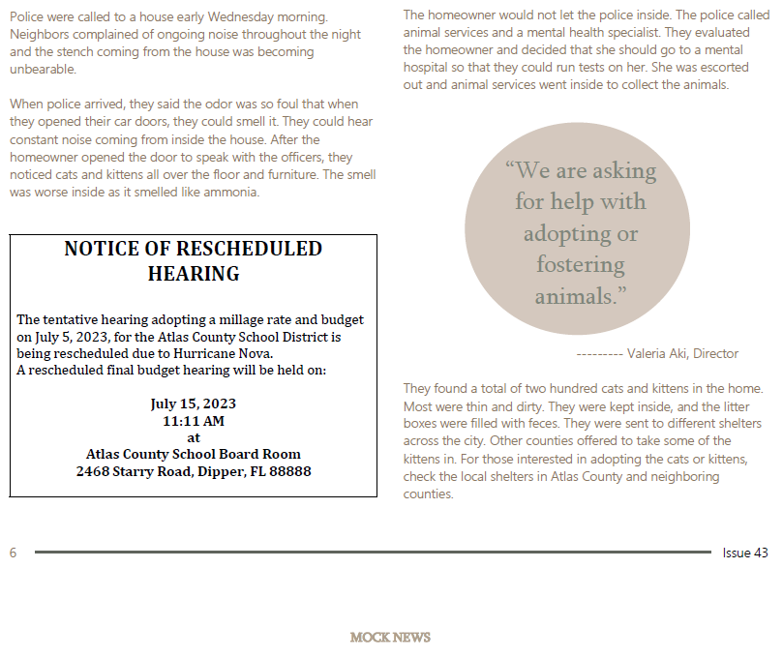
Newspaper Example Notice of Rescheduled Hearing

Slide 65
TRIM Hearing Requirements

Slide 66
TRIM Hearing Requirements
Two to five days after publishing the ads for the tentative budget hearing, each school district holds a public hearing on the tentative budget and millage.
At the hearing, the school district adopts the tentative millage rates and tentative budget.

Slide 67
TRIM Hearing Requirements Scheduling Hearings
The school board may schedule the hearing for a time Monday through Friday after 5:00 p.m. or anytime on Saturday, but never for a Sunday.
The board of county commissioners (BOCC) cannot schedule its hearings on days a school board has hearings scheduled.
No other taxing authority in the county may hold a public hearing on the same date as the school board or BOCC.

Slide 68
TRIM Hearing Requirements At the Hearings
The first issues discussed at the hearing are:
Percentage increase in millage over the rolled-back rate necessary to fund the budget, if any
Specific purposes for which ad valorem tax revenues are increasing

Slide 69
TRIM Hearing Requirements At the Hearings
The governing body will hear comments regarding a proposed increase in millage and explain the reasons for the proposed increase over the rolled-back rate.
The general public may speak and ask questions before the governing body adopts any measures.
The governing body must adopt its tentative or final millage rate before adopting its tentative or final budget.
Adopt millage first; adopt budget second.

Slide 70
TRIM Hearing Requirements At the Final Hearing
The taxing authority must adopt the millage rate first by resolution or ordinance. The resolution or ordinance will state the adopted millage rate and the percent, if any, by which it exceeds the rolled-back rate.
The taxing authority will adopt the millage rate and the budget by separate votes at the final hearing.
The millage rate the school district adopts at the final budget hearing cannot exceed the rate the board tentatively adopted at the first hearing unless the PA sends each taxpayer a revised Notice of Proposed Property Taxes before the final hearing.
Continued

Slide 71
TRIM Hearing Requirements At the Final Hearing
The school district may not levy any millage other than the one it approved by referendum until the school district’s governing board approves the resolution or ordinance to levy and submits it in a timely manner to the PA and the tax collector.
If the fall term for a school district begins before adoption of the final budget, the school district may expend monies in accordance with the adopted tentative budget until a final budget is adopted.

Slide 72
TRIM Hearing Requirements Recessed Hearing
The board can recess the tentative or final hearing.
The board should not adjourn the hearing; the hearing will need to be recessed.
If the hearing is recessed, the taxing authority must publish a notice in a newspaper of general circulation in the county.

Slide 73
Executive Order for State of Emergency
School districts should be cognizant of any executive order issued by the governor declaring a state of emergency because of an imminent tropical storm, hurricane, or other calamity. The executive order provides pertinent information and guidance such as:
Listing counties or areas impacted by the emergency event
Suspending the effect of any statute, rule, or order that would prevent, hinder, or delay any action necessary to cope with the emergency

Slide 74
Executive Order for State of Emergency
The executive director of the Department of Revenue may in turn issue an emergency order with specific guidance with regard to the TRIM process, such as:
A list of the counties impacted
An extension of TRIM timelines
A temporarily waiver of TRIM compliance requirements
Specific guidance related to TRIM hearing and advertising requirements

Slide 75
TRIM Resolutions/Ordinances

Slide 76
TRIM Resolution/Ordinance Millage Resolution/Ordinance
School districts will forward the resolution or ordinance adopting the final millage to the PA, tax collector, and Department of Revenue within three days after the final budget hearing.
When submitting an electronic copy of the final millage resolution or ordinance to the Department please use the following email address: TRIM@floridarevenue.com.
The PA’s receipt of the resolution or ordinance will be official notice of the millage rate the school district approved.

Slide 77
TRIM Resolution/Ordinance Millage Resolution/Ordinance
The tentative and final resolution/ordinance adopting millage rates must include:
The school district’s name
The percentage increase over the rolled-back rate
Each adopted millage rate
The rolled-back rate
Notes:
School Resolution Added from DR-420S

Slide 78
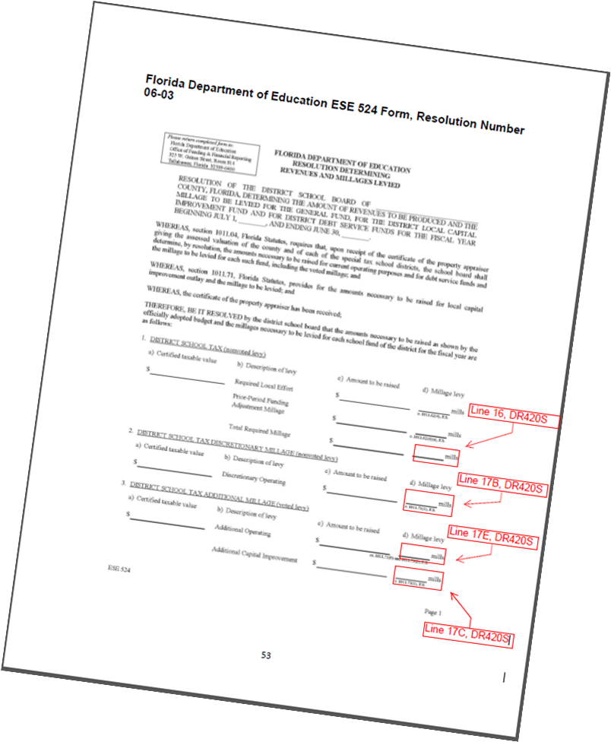
School Resolution Example

Slide 79
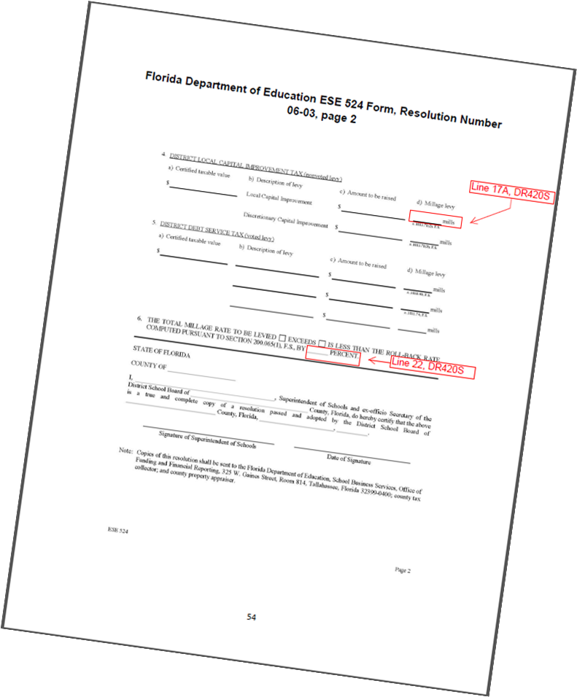
School Resolution Example Continued

Slide 80
TRIM Resolution/Ordinance Budget Resolution/Ordinance
Must be adopted by separate vote after the millage adoption
If the order of millage and budget adoption cannot be determined, the school board will need to provide the meeting minutes.

Slide 81
Certifying Compliance to the Department

Slide 82
Certifying Compliance to the Department
School districts must submit their TRIM compliance package within 30 days of the final budget hearing using these forms:
Certification of Compliance (Form DR-487)
Certification of Final Taxable Value (Form DR-422)

Slide 83
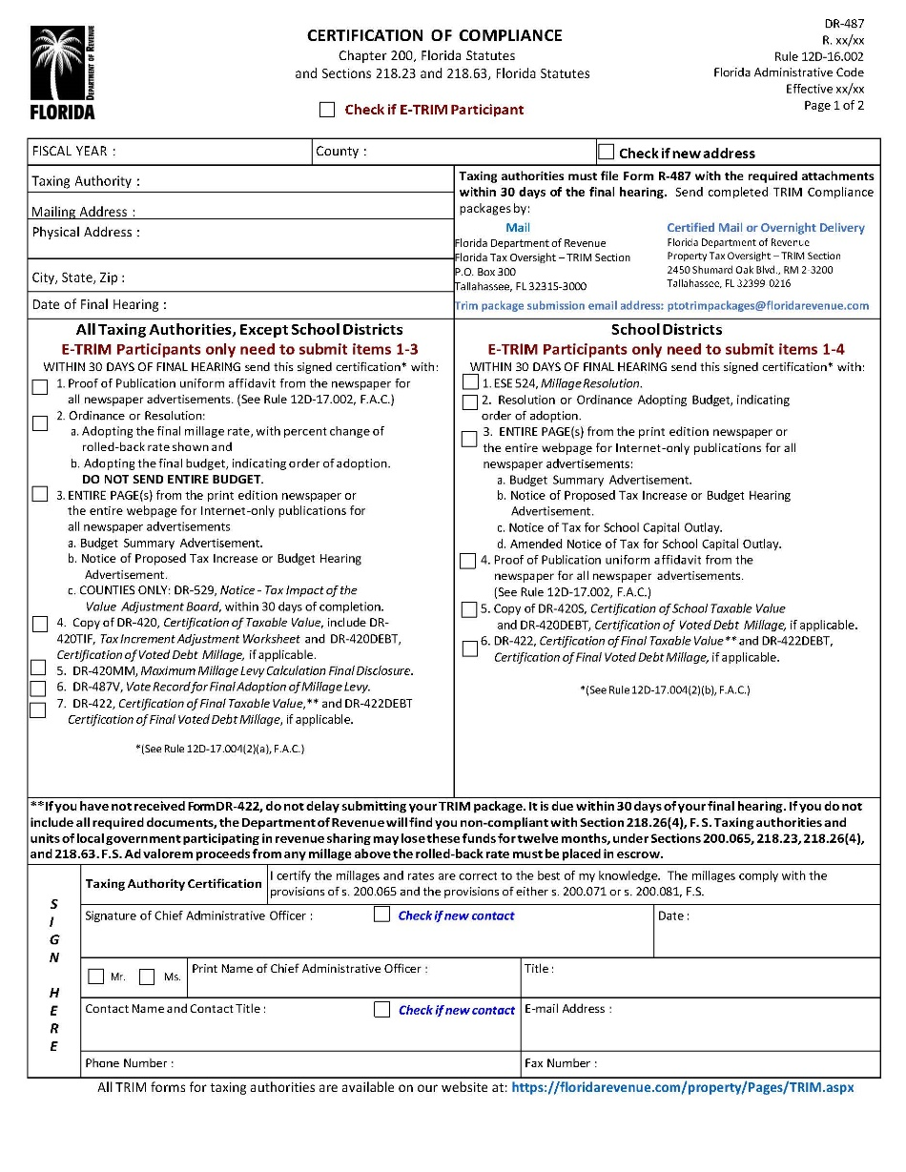
Form DR-487
Notes:
Waiting for DR-487 year to be updated

Slide 84
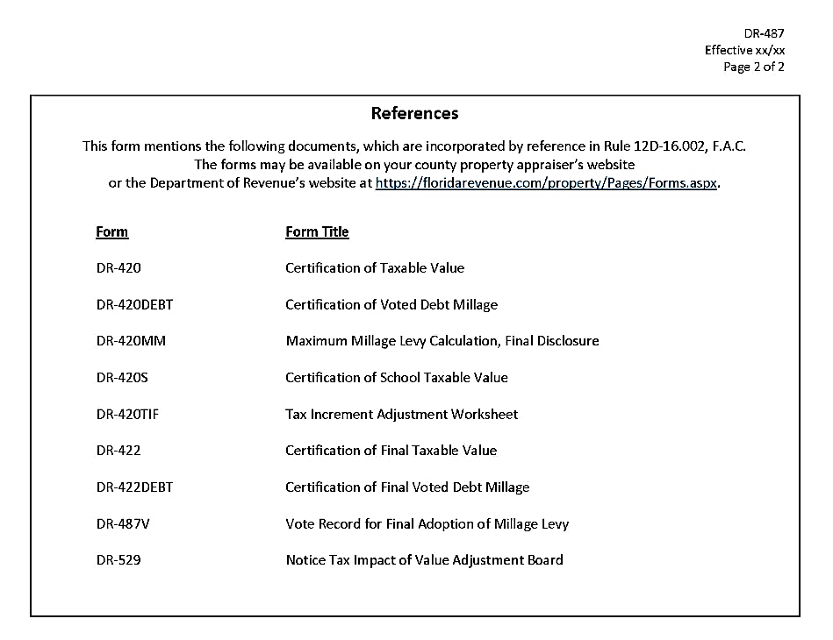
Form DR-487 page 2
Notes:
Double form taken out

Slide 85
Electronic Submission
When submitting the TRIM compliance package to the Department’s TRIM section electronically, you must include in the package:
Form DR-487
Resolution/ordinance adopting the final millage rate
Resolution/ordinance adopting the final budget
Entire page of the newspaper or screenshot from publicly accessible website for all TRIM advertisements
Proof of publications for all TRIM advertisements
If you mailed notices in lieu of newspaper advertisements, you must include a copy of the mailed notices and proof of mailing from the post office.
All TRIM forms
Notes:
Proof of Publication

Slide 86
2023 Top Infractions and Violations
Tax levy incorrect/percent increase incorrect
Percent increase over the roll-back-rate is not shown or is incorrect (ordinance/resolution)
Late package
Incorrect verbiage in advertisement
Budget not balanced

Slide 87
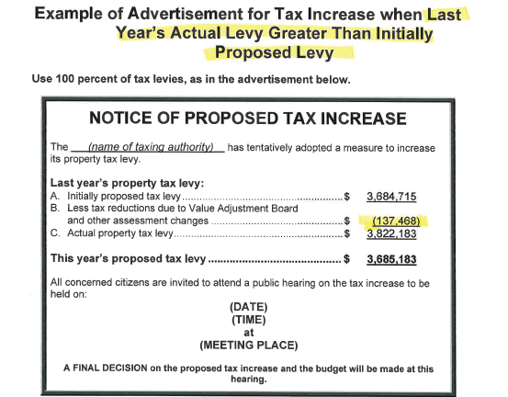
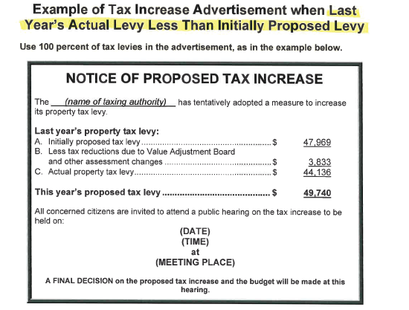
Notice of Proposed Tax Increase Ad
If Line A Is Less than Line C
If Line A is Greater than Line C

Slide 88
Percent Increase Over RBR Not Shown or Incorrect
The resolution or ordinance must include the:
Name of the taxing authority
Rolled-back rate
Percentage increase over the rolled-back rate
Final adopted millage rate

Slide 89
Late Package Examples
Final Hearing Date | Post Marked Date | Date Received | Late Package? | Days Late
08/15/2024 | 09/20/2024 | 09/21/2024 | Yes | 6
09/20/2024 | 10/15/2024 | 10/16/2024 | No | 0
09/24/2024 | 11/10/2024 | 11/11/2024 | Yes | 11
10/01/2024 | 10/30/2024 | 10/31/2024 | No | 0
Notes:
New Slide added

Slide 90
Late Package Example Continued

Slide 91
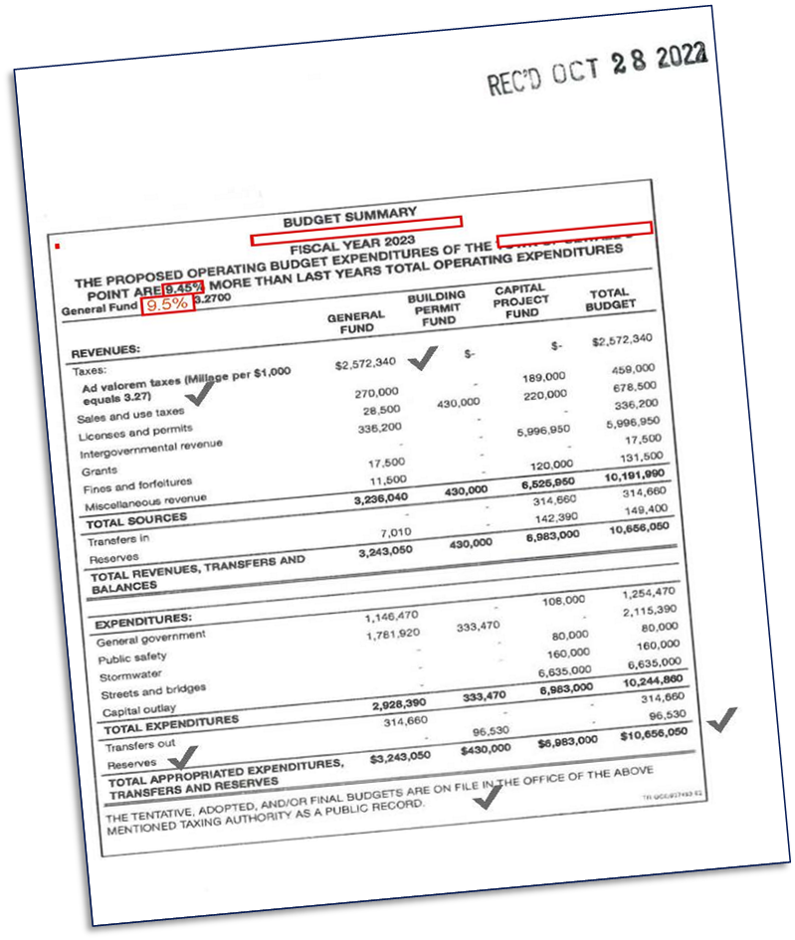
Incorrect Verbiage

Slide 92
Budget is Not Balanced

Slide 93
To Help Prevent Infractions
To help prevent Infractions, submit a copy of your ads, resolutions, and calculations to the TRIM team at our email, TRIM@floridarevenue.com BEFORE publishing to ensure compliance.

Slide 94
TRIM Compliance Contacts
TRIM STAFF | PHONE NUMBER
Wyatt Peters | (850) 617-8921
Kendall Tolbert | (850) 617-8861
Breauna Hines | (850) 617-8923
Roberta Epp | (850) 617-8890
Dianne Porter | (850) 617-8920
Fax Number | (850) 617-6115
TRIM Email Address eTRIM Email Address | TRIM@floridarevenue.com eTRIM@floridarevenue.com

Slide 95
Thank you for your participation today!

