Slide 1

Hearing Information and
Advertisement Selection
2024
Presented by
The TRIM Team
Truth In Millage, Property Tax Oversight

Slide 2

Overview
Truth In Millage (TRIM) Hearing Requirements
Truth In Millage (TRIM) Advertising Requirements
Resolutions/Ordinances
TRIM Compliance Contacts

Slide 3
TRIM Hearing Requirements

Slide 4
TRIM Hearing Information
2
Taxing authorities must hold two public hearings to adopt a millage rate and budget.

Slide 5
TRIM Hearing Information
Scheduling and Advertising Hearing
TRIM hearings should be held:
Monday – Friday
after 5:00 p.m.
Any time on
Saturday
Never on
Sunday

Slide 6
TRIM Hearing Information
Scheduling and Advertising Hearing
The school board has priority for a hearing date.
The board of County Commissioners (BOCC) has second choice.
No other taxing authority in the county can hold a hearing on the same date as the school board or BOCC.

Slide 7

TRIM Hearing Information
Scheduling and Advertising Hearing
The tentative TRIM hearing is advertised on the TRIM notice.
The final hearing must be advertised within 15 days of adopting the tentative millage and budget.
final hearing advertisement
TENTATIVE MILLAGE & BUDGET ADOPTED
1
2
3
4
5
6
7
8
9
10
11
12
13
14
15
DAYS

Slide 8
TRIM Hearing Information
At the Hearing
The first issues discussed will be:
Percentage increase in millage over the rolled-back rate necessary to fund the budget, if any
Specific reasons why ad valorem tax revenues are increasing

Slide 9

TRIM Hearing Information
At the Hearing
The general public may speak and ask questions before the governing body adopts any measures.
The governing body must adopt its tentative or final millage rate before adopting its tentative or final budget.
Adopt millage first; adopt budget second.

Slide 10
TRIM Hearing Information
At the Hearing
Each taxing authority levying a millage rate must publicly announce, before adopting the millage resolution:
The taxing authority’s name
The rolled-back rate
The percentage increase over the rolled-back rate
The millage rate to be levied

Slide 11
TRIM Hearing Information
At the Hearing
The tentative millage rate cannot exceed the proposed millage rate unless the PA mails each taxpayer a revised TRIM notice at the TA’s expense.
The final millage rate cannot exceed the tentatively adopted millage rate.
The TRIM process must be completed within 101 days.

Slide 12
TRIM Hearing Information
At the Hearing
The TA cannot levy any millage until its governing board has approved a resolution or ordinance.

Slide 13
Executive Order for State of Emergency
Executive Order
In the event of a state of emergency declared because of an imminent tropical storm, hurricane, or other calamity, the governor of the State of Florida will issue an executive order. The executive order will provide pertinent information and guidance such as:
A list of the counties or areas impacted by the emergency event
Suspension of the effect of any statute, rule, or order that would prevent, hinder, or delay any action necessary to cope with the emergency

Slide 14
Executive Order for State of Emergency
Department Emergency Order
The executive director of the Department will in turn issue an emergency order to implement the provisions of the governor’s order. The emergency order will provide specific guidance for the TRIM process, such as:
A list of the counties impacted
Extension of TRIM timelines
Temporarily waived TRIM compliance requirements
Specific guidance related to TRIM hearing and advertising requirements

Slide 15
TRIM Advertising Requirements

Slide 16
TRIM Advertising Requirements
TAs must select the appropriate advertisement to announce the final
TRIM hearing.
Advertisements shall be published as provided in chapter 50, Florida Statutes. The TRIM ads may be placed in a newspaper of general circulation in the county or in its geographically limited insert. The insert must circulate in the geographic boundaries that include the taxing authority’s geographic boundaries
(s. 200.065(3)(h), F.S.).

Slide 17

TRIM Advertising Requirements
Newspaper advertisements cannot:
Be placed in the legal or classified section (s. 200.065(3), F.S.)
Deviate from the language specified in s. 200.065, F.S.
Be accompanied, preceded, or followed by other advertising or notices that
conflict with or contradict the required publications (s. 200.065(3)(h), F.S.)
Be combined. The advertisements must be separate and adjacent
(s. 200.065(3)(I), F.S.).

Slide 18
TRIM Advertising Requirements
“Adjacent to,” when used in reference to newspaper advertisements, means next to, touching, or contiguous, either at the sides or at the corners. This term includes advertisements placed adjacent to one another, either on the same page or on adjoining pages with a crease separating them, so that a reader may view the advertisements simultaneously when the newspaper pages are open on a flat surface.

Slide 19
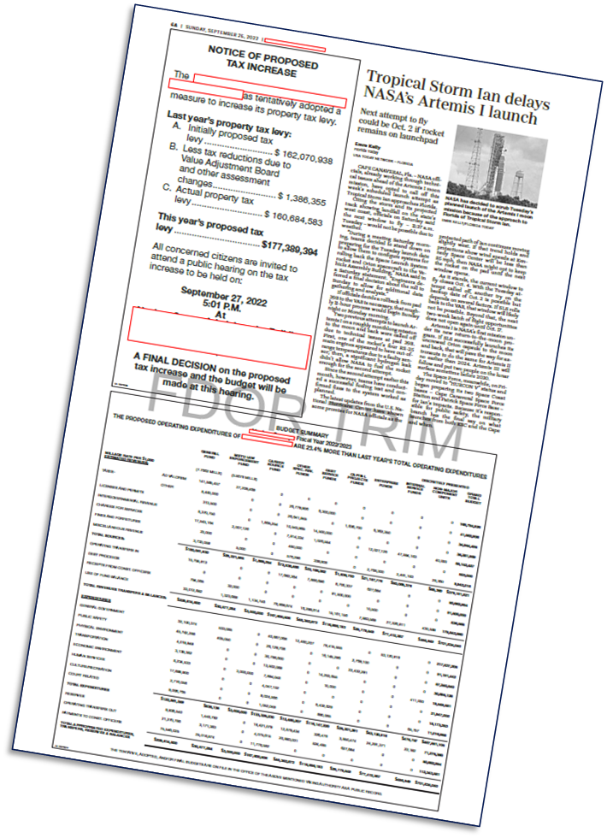
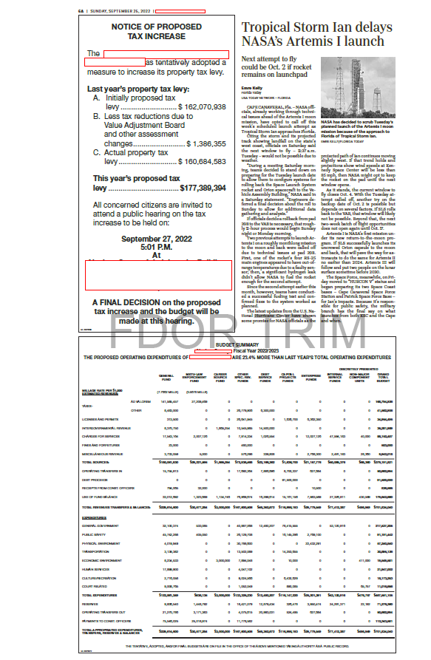
Adjacent Newspaper Example

Slide 20
TRIM Advertising Requirements
Publication on a Publicly Accessible Website
A taxing authority may also publish TRIM advertisements on the publicly accessible website of the county in which it lies if the cost to publish the advertisement is less than the cost of advertising in a newspaper.
A taxing authority in a county with fewer than 160,000 residents must hold a public hearing (noticed in the newspaper) to make a determination that residents have sufficient access to the internet by broadband service.
A multi-county taxing authority that chooses this option must publish the ads on the website of each county that it spans.
Continued
Notes:
Slide change – Bullet Point form

Slide 21
TRIM Advertising Requirements
Publication on a Publicly Accessible Website
TAs who use this option shall provide notice once per year in a newspaper of general circulation or other publication that is mailed or delivered to all residents and property owners throughout the TA’s jurisdiction.
The notice must indicate that the owners and residents may receive legal ads and notices from the TA by first-class mail or email after making a request and registering their names and addresses or email addresses with the TA.
A link to the advertisements shall be prominently placed on or accessible through a direct link from the website homepage of the county and the
website homepage of the TA (see s. 50.0311, F.S., for additional requirements).
Notes:
Slide change – Bullet Point form

Slide 22
TRIM Advertising Requirements
Advertisement Selection
After calculating the percentage change of rolled-back rate, choose the
proper notice:
Publish a Notice of Proposed Tax Increase when percent change is greater than 0%.
Publish a Notice of Budget Hearing when the percent change is equal to or less than 0%.

Slide 23
TRIM Advertising Requirements
Notice of Proposed Tax Increase Ad
Must be no smaller than a quarter-page advertisement
Must have a headline in at least 18-point type
Must have an adjacent Budget Summary ad
Must advertise the final hearing within 15 days of tentative (first) hearing
The final hearing must be held two to five days after advertising.

Slide 24
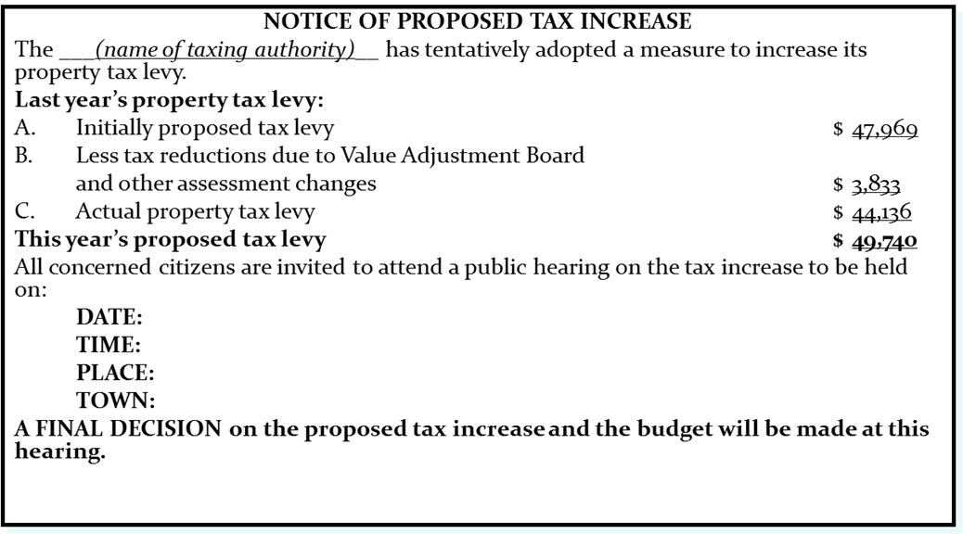
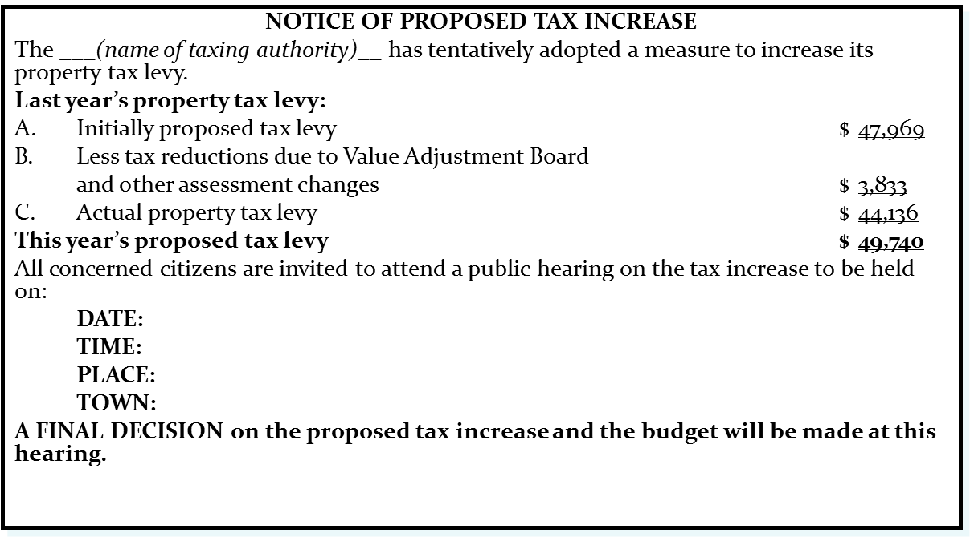
TRIM Advertising Requirements
Notice of Proposed Tax Increase Ad
EXAMPLE
Use 100% of tax levies in advertisement.

Slide 25
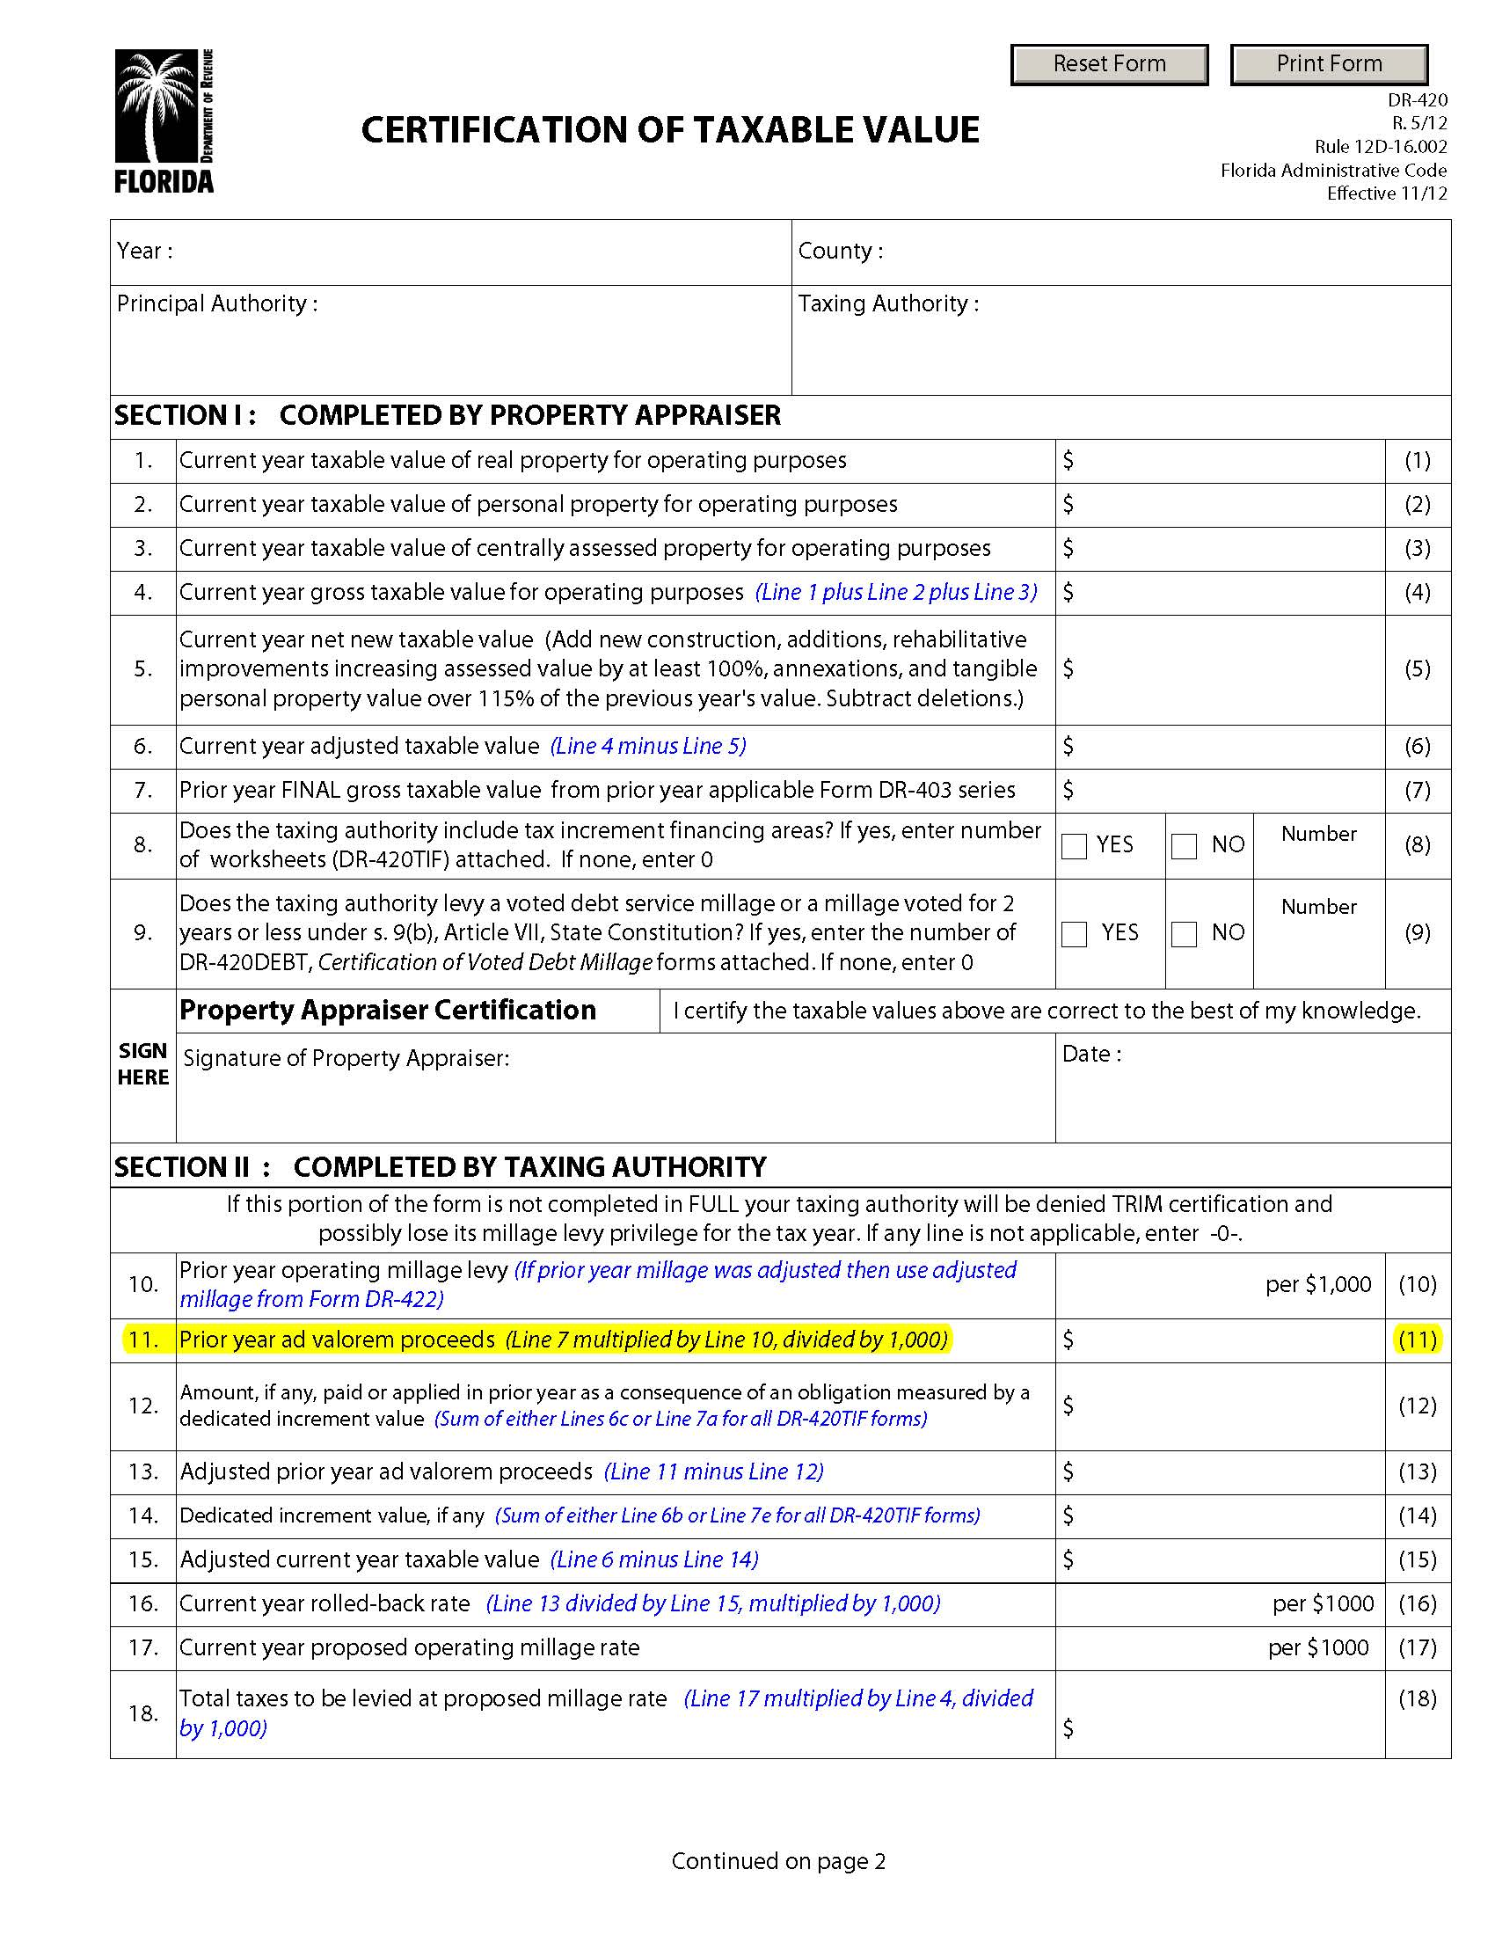
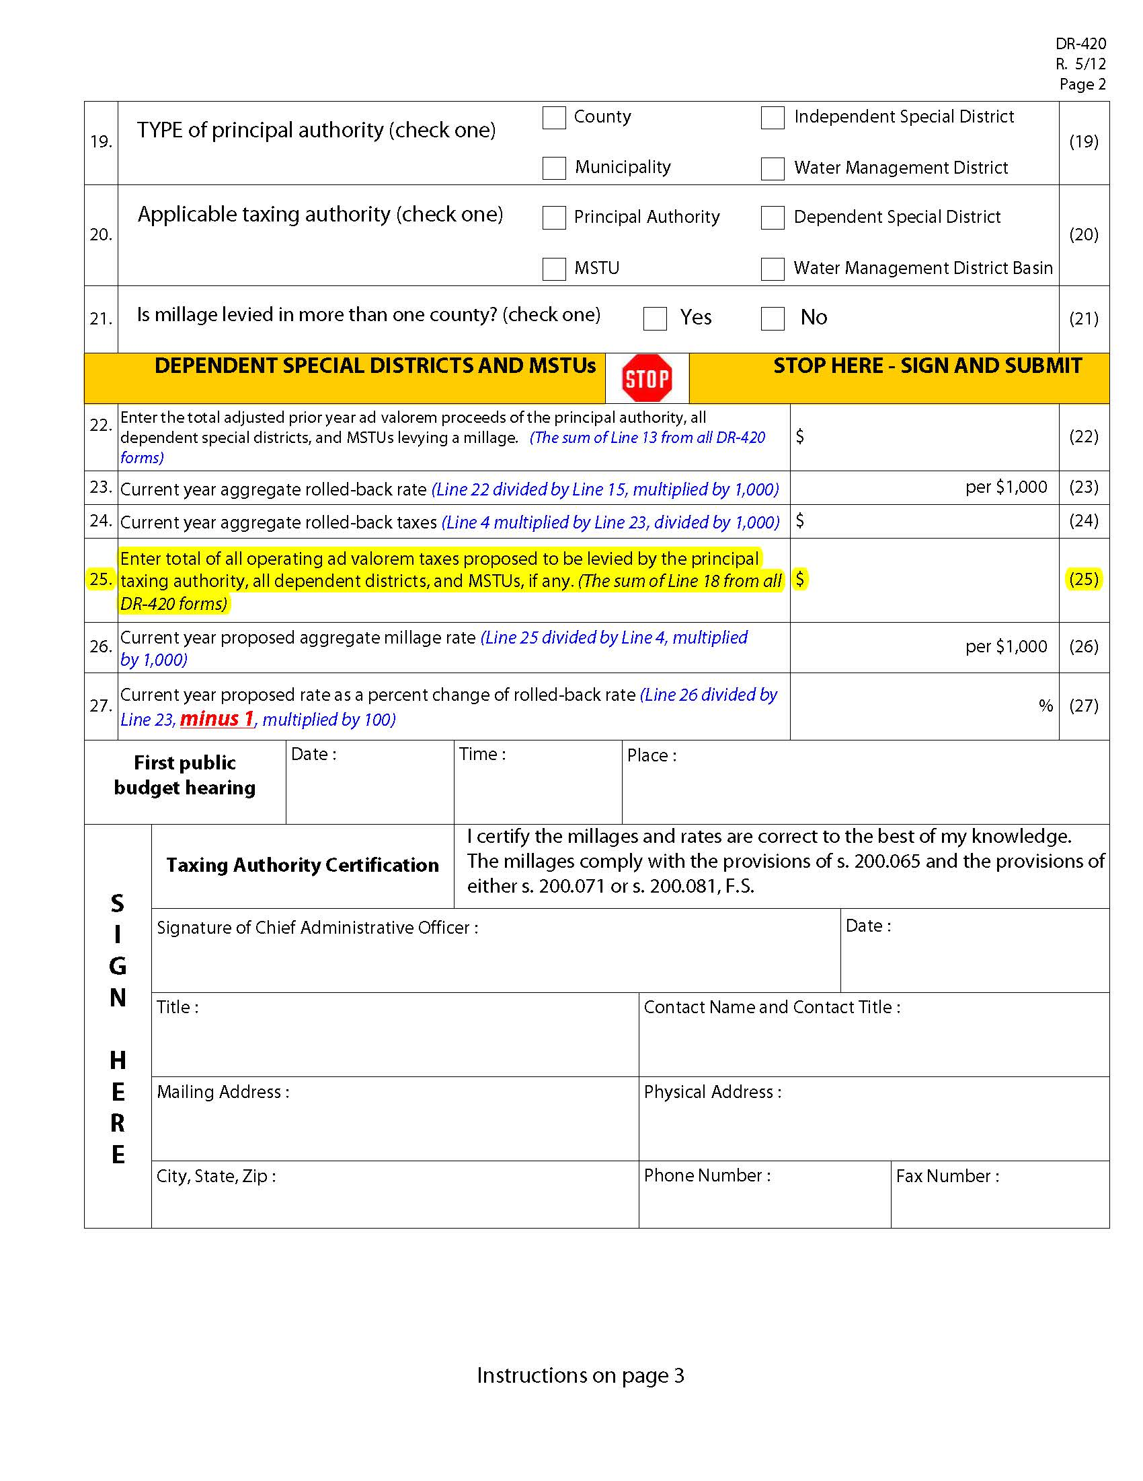
TRIM Advertising Requirements
Notice of Proposed Tax Increase Ad
Line A = Prior year DR-420, line 25
Line B = Subtract line C from line A
Line C = Current year DR-420, line 11
This year’s proposed tax levy = current year’s tentatively adopted millage rate x current year gross taxable value ÷ 1,000 (line 4, current year Form DR-420).
*If the tentatively adopted millage rate is
the same as the proposed millage rate, use
current year Form DR-420, line 25.

Slide 26
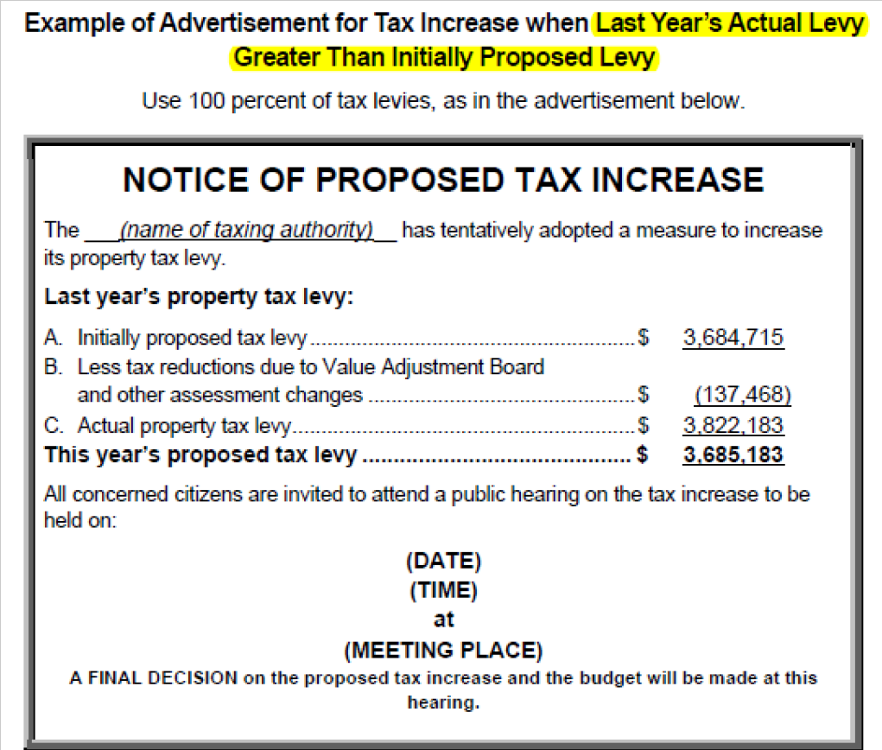
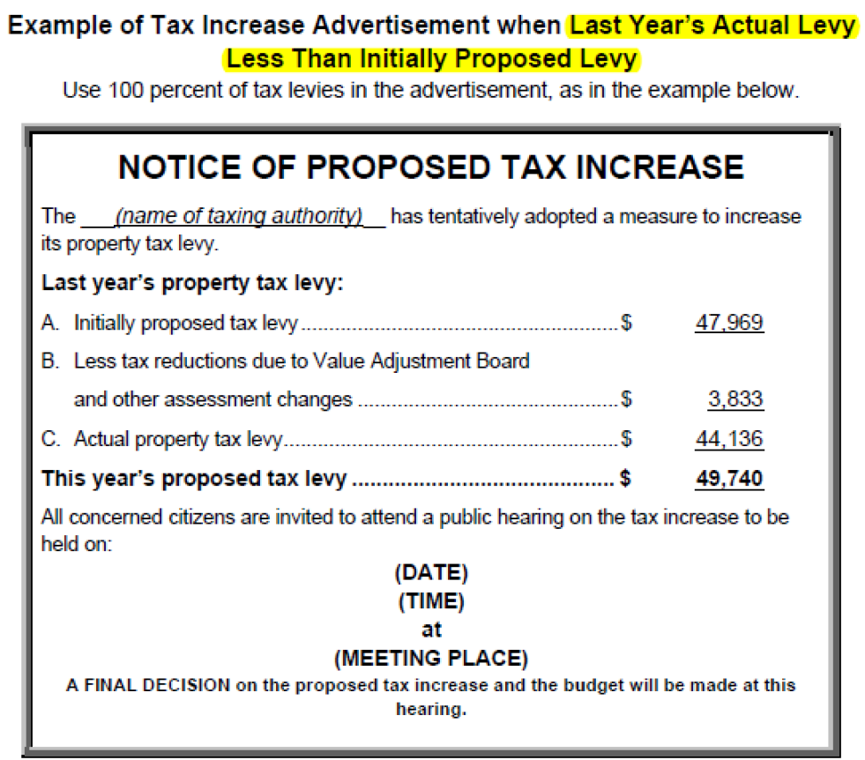
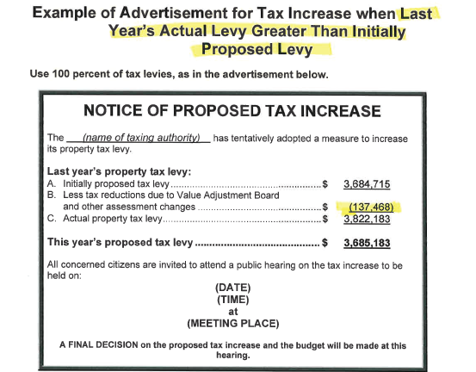
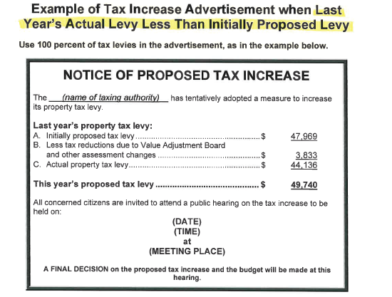
Notice of Proposed Tax Increase Ad
Important to Remember
If Line A Is Less
than Line C
If Line A is Greater
than Line C

Slide 27

Newspaper Example
Notice of Proposed Tax Increase

Slide 28
TRIM Advertising Requirements
Notice of Budget Hearing
Budget hearing advertisement:
Doesn’t have a size requirement
Must have an adjacent Budget Summary ad
Must advertise the final hearing within 15 days of tentative (first) hearing
The final hearing must be held two to five days after advertising.

Slide 29
TRIM Advertising Requirements
Notice of Budget Hearing
EXAMPLE
NOTICE OF BUDGET HEARING
The ____________ has tentatively adopted
a budget for (fiscal year).
A public hearing to make a FINAL DECISION on the budget AND TAXES will be held on:
(Date)
(Time)
at
(Meeting Place)

Slide 30
Newspaper Example
Notice of Budget Hearing

Slide 31
TRIM Advertising Requirements
Budget Summary Ad
The advertisement must show all tentatively adopted millage rates:
General fund
Dependent district
Municipal Service
Taxing Unit (MSTU)
Voted debt service

Slide 32
TRIM Advertising Requirements
Budget Summary Ad
For this advertisement:
Each millage rate must include at least 95% of ad valorem taxes in the budget.
All funds must be shown.
The ad must show a balanced budget.
  All funds should balance.
  The total of all funds should balance.
A line item for reserves must be shown.

Slide 33
TRIM Advertising Requirements
Budget Summary Ad
Other requirements:
The ad must have an adjacent Notice of Proposed Tax Increase ad or Notice of Budget Hearing ad (not both).
This ad has no size requirements.
The ad must comply with all statutory budget requirements.

Slide 34
TRIM Advertising Requirements
Budget Summary Ad
If the proposed operating budget expenditures are more than last year's total operating expenditures, include this statement in bold.
THE PROPOSED OPERATING BUDGET EXPENDITURES OF (name of taxing authority)
ARE (percent, rounded to one decimal place) MORE THAN LAST YEAR'S TOTAL
OPERATING EXPENDITURES. (s. 200.065(3)(l), F.S.)

Slide 35
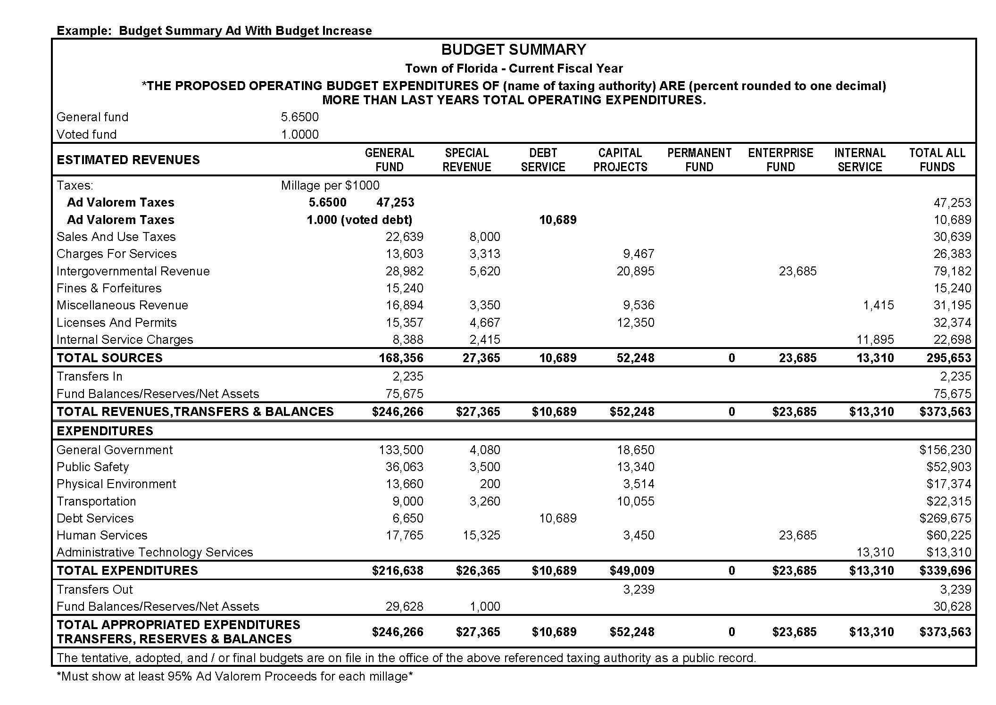
TRIM Advertising Requirements
Budget Summary Ad
Percentage example:
If calculations equal 8.45%,
input 8.5%.
Verify the budget is balanced.
Notes:
Slide Change – Details to percentage and budget balance

Slide 36
TRIM Advertising Requirements
Recessed Hearing Information
If the hearing is recessed, the taxing authority must publish a Notice of Continuation in a newspaper of general circulation in the county.
The notice will state the time, date, and location of the hearing.
Do not adjourn the hearing. The hearing is to be recessed.

Slide 37
TRIM Advertising Requirements
Recessed Hearing Information
EXAMPLE
NOTICE OF CONTINUATION
The tentative/final budget hearing held on (date of hearing)
for the (name of taxing authority) was recessed and will be continued on
(date, time, and location of new hearing).
(Include name of town)

Slide 38
Newspaper Example
Notice of Continuation

Slide 39
TRIM Advertising Requirements
Rescheduled Hearing Information Ad
If a hearing is postponed or rescheduled due to circumstances beyond its control, the taxing authority should publish a Notice of Rescheduled Hearing in a newspaper of general circulation in the county.
The notice must state the time, date, and location of the rescheduled hearing.

Slide 40
TRIM Advertising Requirements
Rescheduled Hearing Information Ad
EXAMPLE
NOTICE OF RESCHEDULED HEARING
The tentative/final hearing adopting a millage and budget on (hearing date)
for the (name of taxing authority) is being rescheduled due to (named storm).
A rescheduled (tentative/final) budget hearing will be held on:
(date, time, and meeting place).

Slide 41
Newspaper Example
Notice of Rescheduled Hearing

Slide 42
TRIM Advertising Requirements
Proof of Publications
Submit one for each published advertisement.
Submit with Certification of Compliance (Form DR-487).

Slide 43
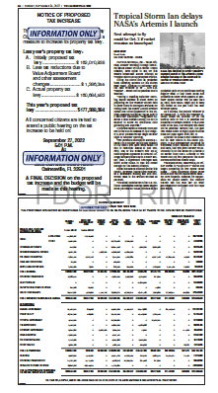
Tear Sheets
A tear sheet is an actual copy of the published newspaper ad.
Tear sheets are used as an alternative to submitting a newspaper.

Slide 44
Resolutions/Ordinances

Slide 45
TRIM
Resolution/Ordinance
The taxing authority cannot levy any millage until its governing board has approved a resolution or ordinance.

Slide 46
TRIM
Millage Resolution/Ordinance
The tentative and final resolution/ordinance adopting millage rates must include:
The TA’s name
The percentage increase over the rolled-back rate
Each adopted millage rate
The rolled-back rate

Slide 47
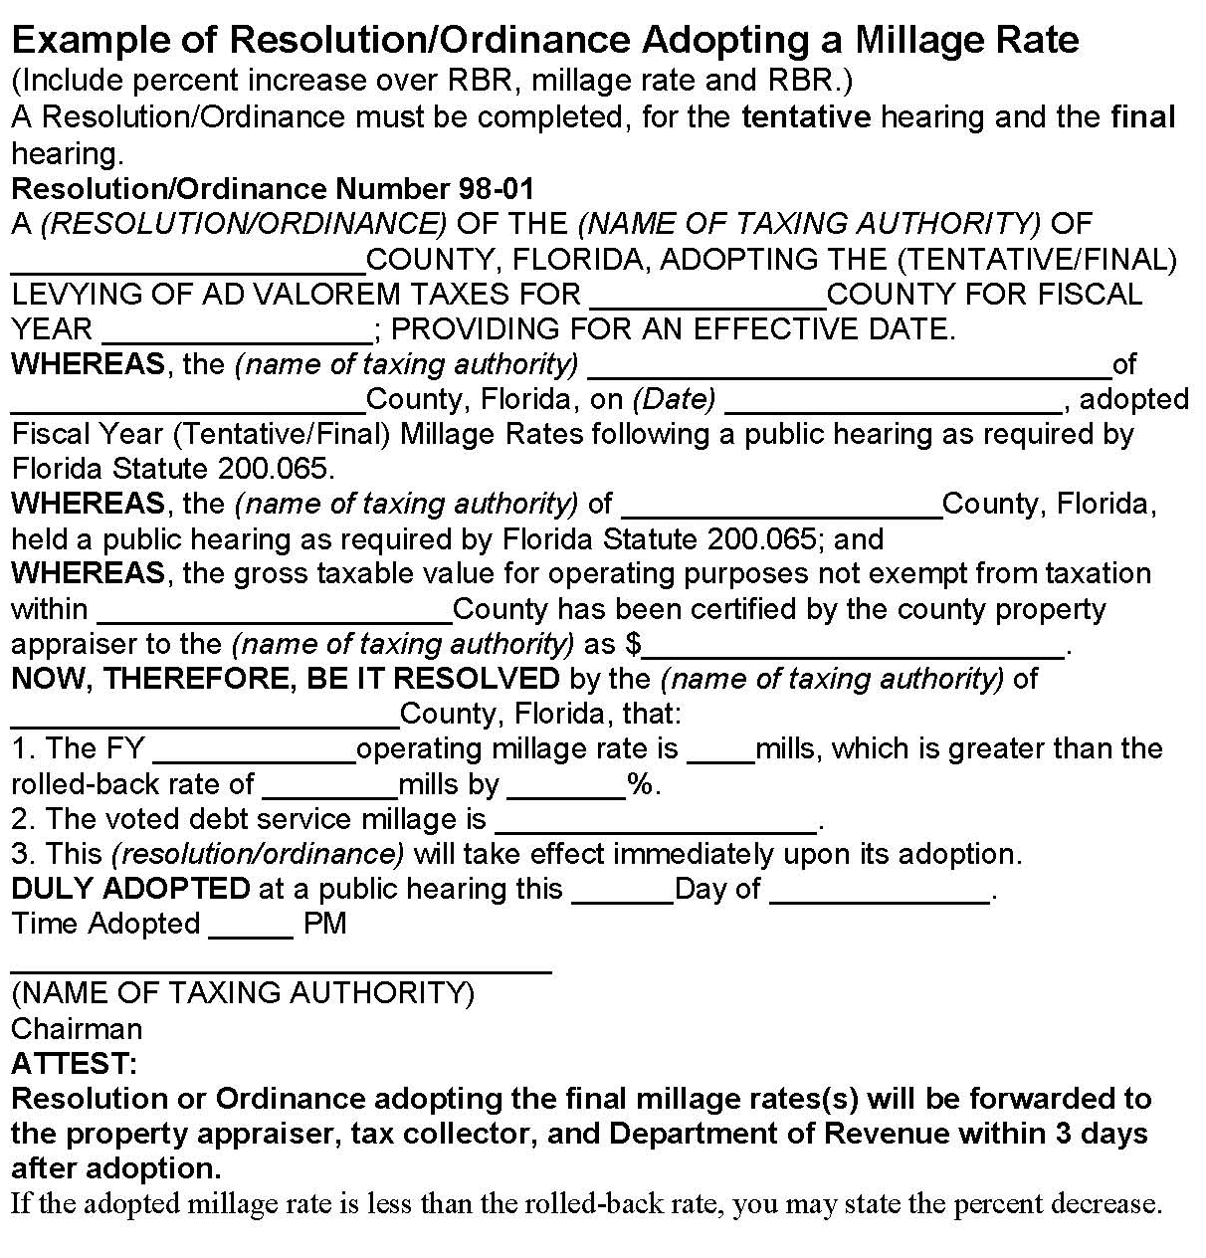
Millage Resolution/Ordinance
Roll-back rate reflected from Form DR-420, Line 16
Millage rate reflected from Form
DR-420MM, Line 15
Percentage increase reflected from Form DR-420, Line 27

Slide 48
TRIM
Budget Resolution/Ordinance
Must be adopted by separate vote after the millage adoption
If order of millage and budget adoption cannot be determined, send minutes of meeting
When the PA receives the resolution or ordinance, it is considered official notice of the millage rate the taxing authority approved.

Slide 49
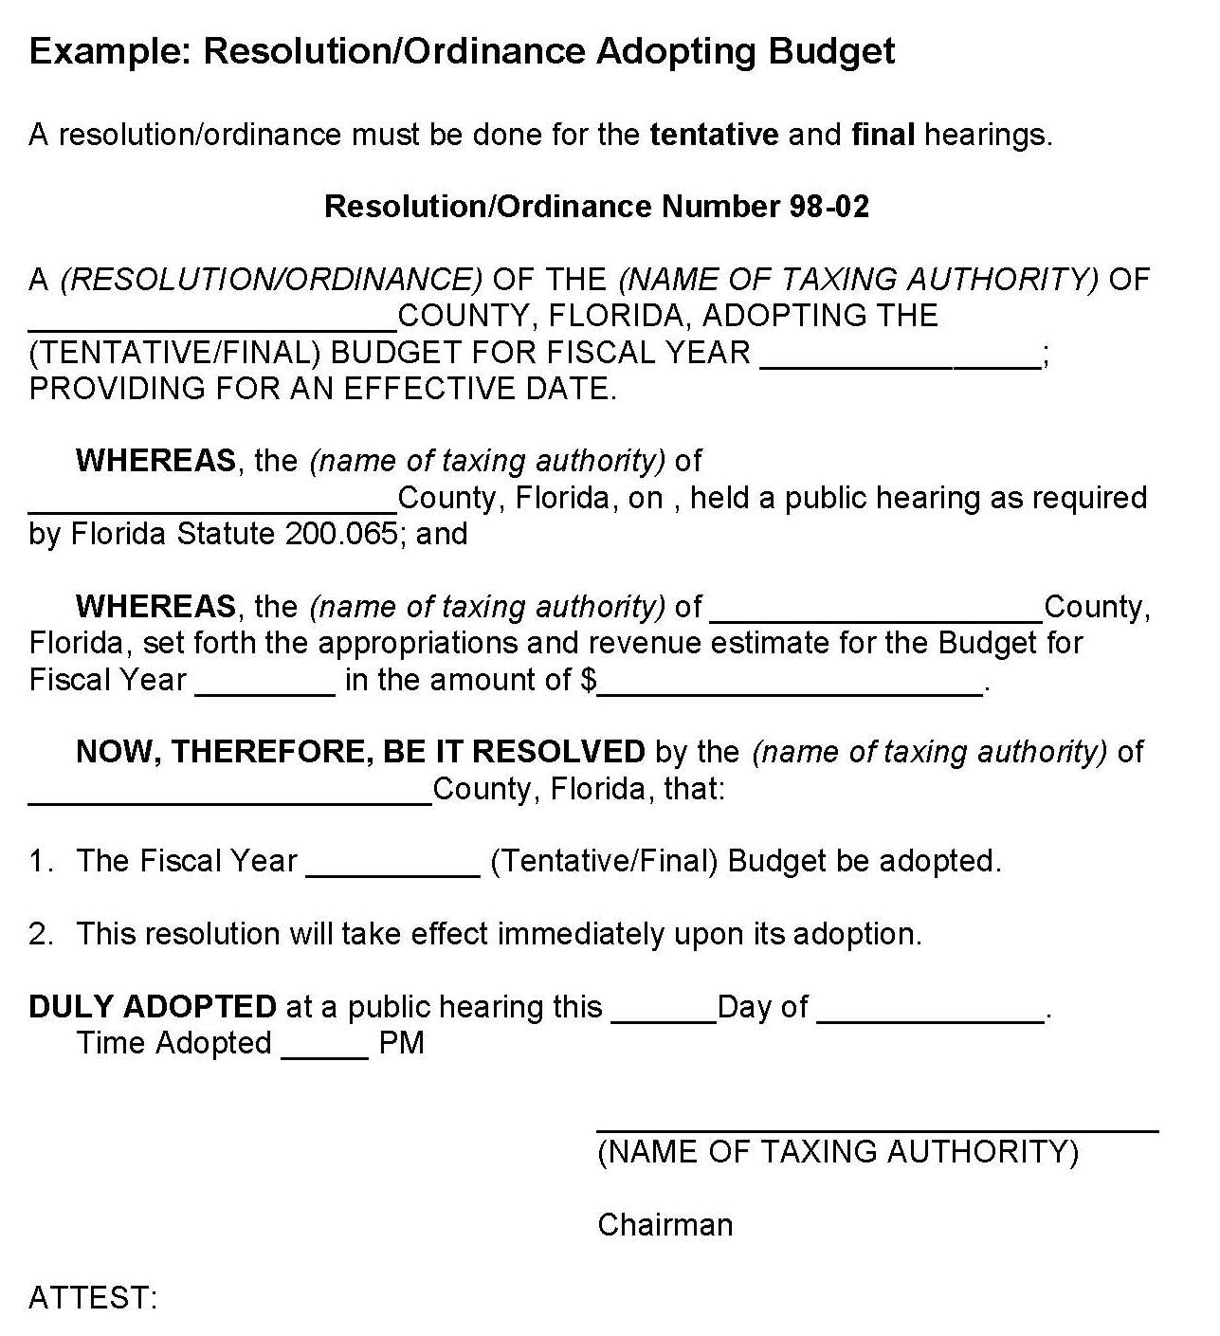
Budget Resolution

Slide 50
TRIM
Resolution/Ordinance
Within three days following the final hearing, forward the resolution/ordinance adopting final millage to the:
Property appraiser
Tax collector
Department of Revenue

Slide 51
To Help Prevent Infractions
To help prevent infractions, submit a copy of your ads, resolutions, and calculations to the TRIM team at TRIM@floridarevenue.com BEFORE publishing to ensure compliance.

Slide 52
TRIM Compliance Contacts
TRIM STAFF | PHONE NUMBER
Wyatt Peters | (850) 617-8921
Dianne Porter | (850) 617-8920
Breauna Hines | (850) 617-8923
Roberta Epp | (850) 617-8890
Geundai Surivongchai | (850) 617-8883
Fax Number | (850) 617-6115
TRIM Email Address eTRIM Email Address | TRIM@floridarevenue.com eTRIM@floridarevenue.com

Slide 53
Thank you for your participation today!

